Slide 1

Historical Review of Microscopic Imaging
BMS 524 - Lecture 1
J. Paul Robinson, Ph.D.
SVM Professor of Cytomics & Prof. Biomedical Engineering
Director, Purdue University Cytometry Laboratories
Notice: The materials in this presentation are copyrighted materials. If you want to use any of these slides, you may do so if you credit each slide with the author’s name. No commercial use is allowed. Posting on Course Hero or any other site is Illegal.
UPDATED January2019

Slide 2
Introduction
Early Microscope History
Fundamental Discoveries
Key Individuals in the 17, 18 and 19th centuries
Modern Microscopy – 20th century

Slide 3
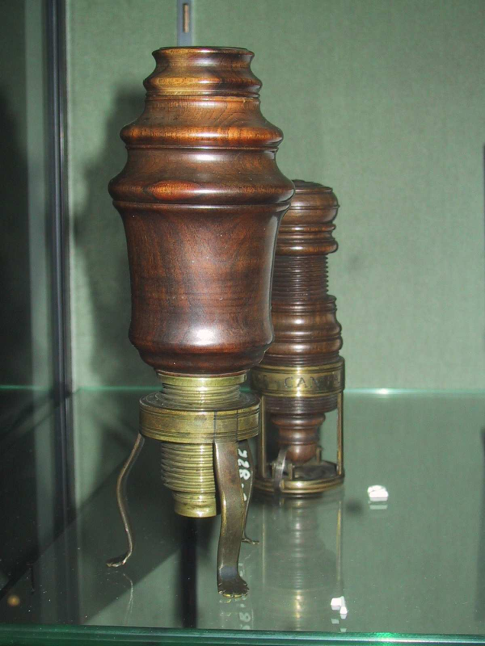
Hans & Zacharias Janssen 1690
1590
1590 - Hans & Zacharias Janssen of Middleburg, Holland manufactured the first compound microscopes
Photo: © J. Paul Robinson

Slide 4
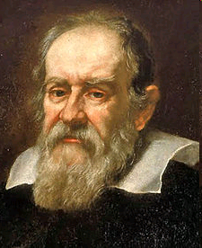
Galileo Galilei (1564-1642)
1610 - he began publicly supporting the heliocentric view, which placed the Sun at the centre of the universe
Galileo has been variously called
  the "father of modern observational astronomy
  the "father of modern physics
  the "father of science
The name "telescope" was coined for Galileo's instrument by a Greek mathematician, Giovanni Demisiani, at a banquet held in 1611 by Prince Federico Cesi to make Galileo a member of his Accademia dei Lincei (literally the "Academy of the Lynx-Eyed", but anglicised as the Lincean Academy)(Per Wikipedia)
1610
Telescope was derived from the Greek tele = 'far' and skopein) = 'to look or see'. In 1610, he used a telescope at close range to magnify the parts of insects.
Denounced to the Roman Inquisition early in 1615
1624 he had perfected a compound microscope
The Linceans played a role again in naming the "microscope" a year later when fellow academy member Giovanni Faber coined the word for Galileo's invention from the Greek words μικρόν (micron) meaning "small," and σκοπεῖν (skopein) meaning "to look at."
Published “Dialogue Concerning the Two Chief World Systems” in 1632, and was tried by the Inquisition, found "vehemently suspect of heresy," forced to recant, and spent the rest of his life under house arrest (to 1642)

Slide 5
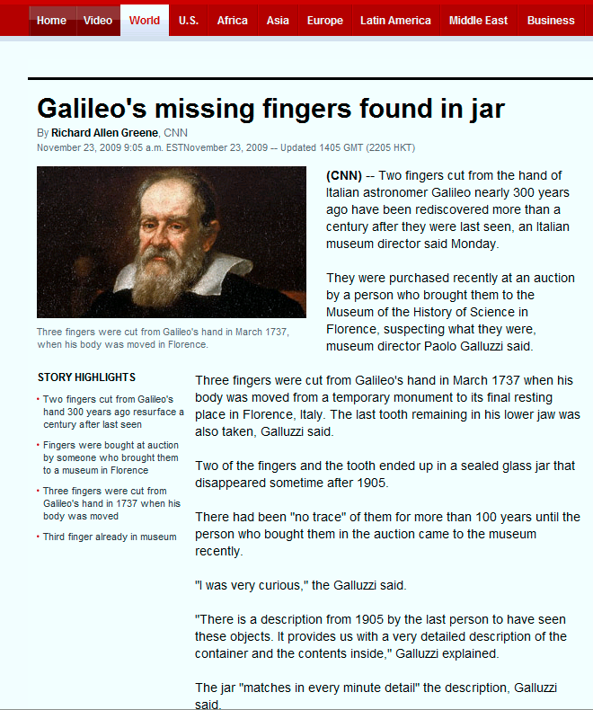

Slide 6

Marcello Malpighi (1628-1694)
1660 - Marcello Malpighi (1628-1694), was one of the first great microscopists, considered the father embryology and early histology
Italian professor of medicine. He spent much of his time at the University of Bologna.
Observed capillaries in 1660
First to observe bordered pits in wood sections.
Gave first account of the development of the seed.
1660
Photo: © J. Paul Robinson

Slide 7
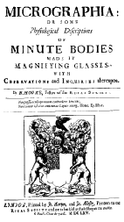
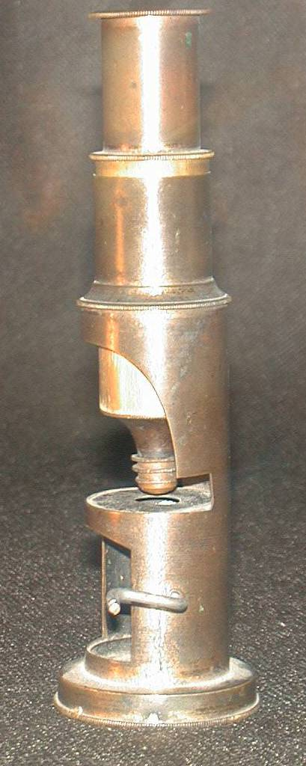
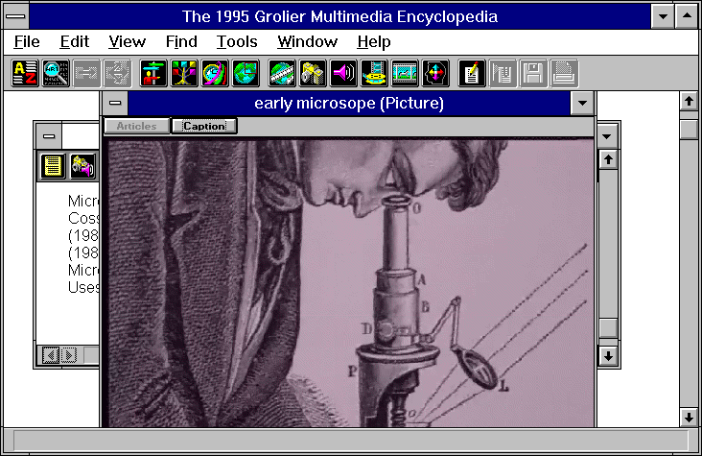
Robert Hooke (1635-1703)-
1665 - Robert Hooke (1635-1703)- book Micrographia, published in 1665, devised the compound microscope most famous microscopical observation was his study of thin slices of cork. Named the term “Cell”
1665
© J.Paul Robinson
The Royal Society of London founded in 1616 during the reign of King James I
Photo: © J. Paul Robinson

Slide 8
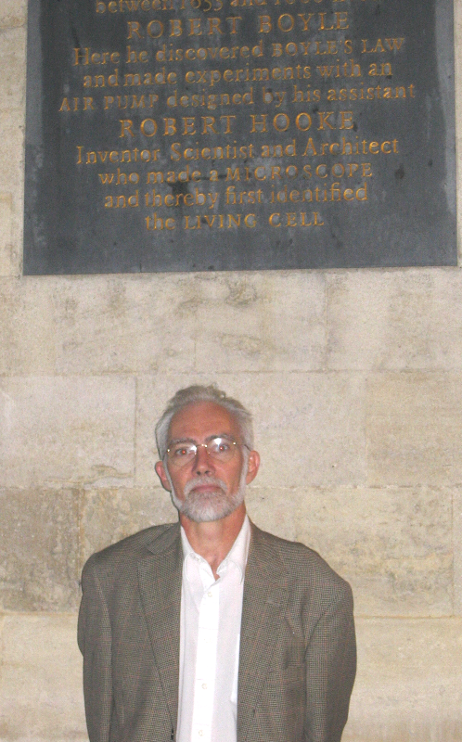
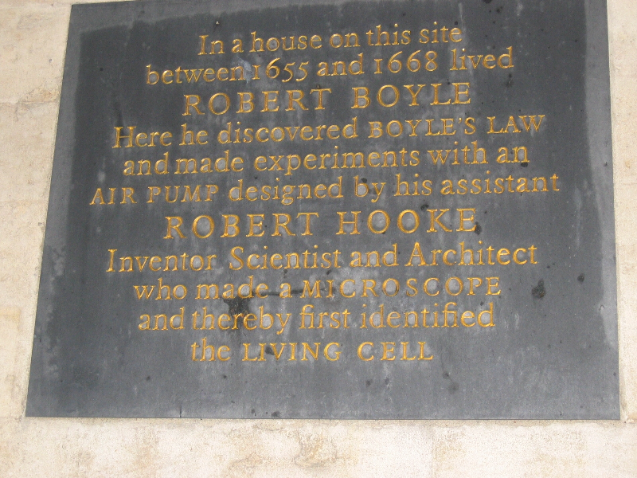
Robert Hooke was Robert Boyle’s laboratory Assistant!
1665
Photos: © J. Paul Robinson
Oxford University
Photo 2003

Slide 9
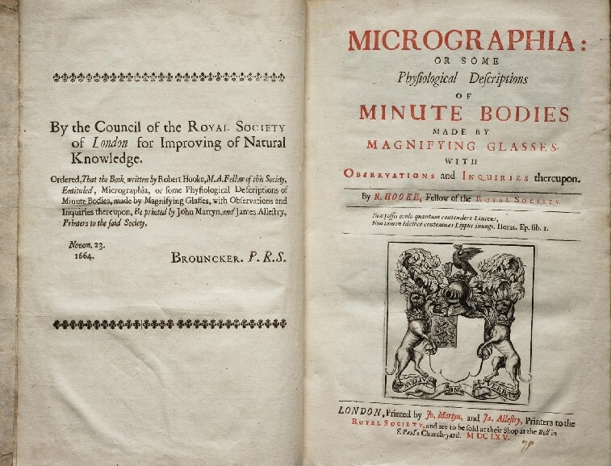

Slide 10
Robert Hooke (1635-1703)
  “. . . I could exceedingly plainly perceive it to be all perforated and porous. . . these pores, or cells, . . . were indeed the first microscopical pores I ever saw, and perhaps, that were ever seen, for I had not met with any Writer or Person, that had made any mention of them before this.” Robert Hooke
1665
Note: this is the famous Robert Hooke quote that is in every textbook, quoted in every manuscript….
But it is actually not a direct quote – it is a classic quote that one person used and everyone else then quotes…

Slide 11
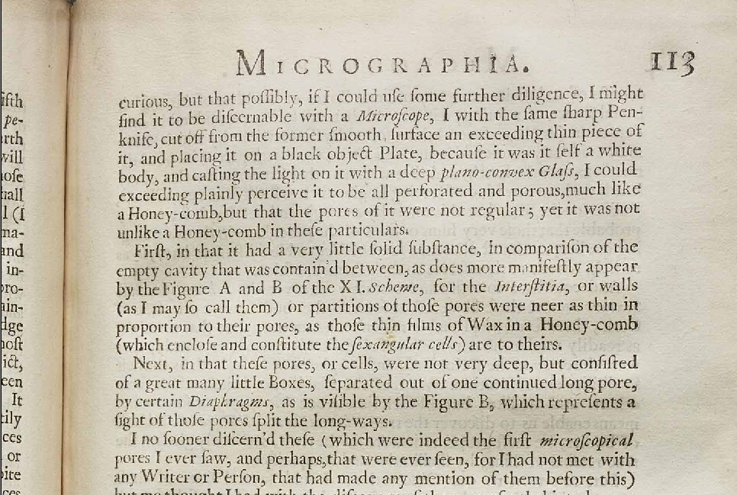

Slide 12
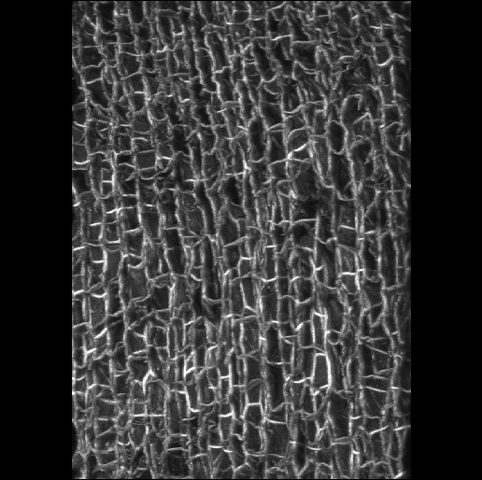
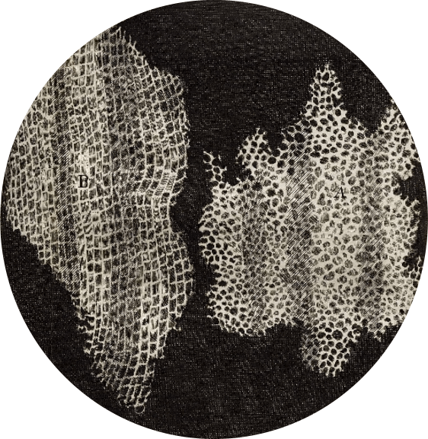
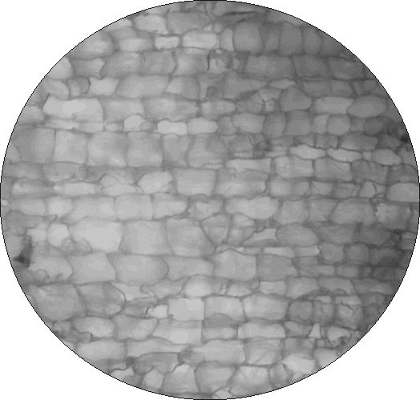
What did Hooke see when he looked at cork?
A confocal
microscope view
of cork
…And even higher
Magnification in 3D
Hooke, 1665
The Purdue version of the
Hooke cork (2002)
Photos: © J. Paul Robinson

Slide 13
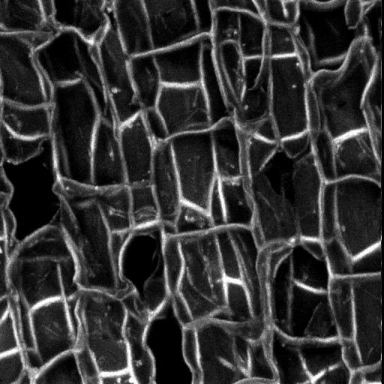

Slide 14

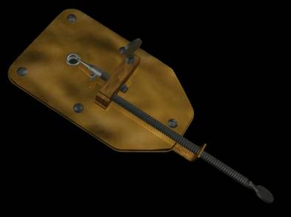
Antioni van Leeuwenhoek (1632-1723)
1673 - Antioni van Leeuwenhoek (1632-1723) Delft, Holland, worked as a draper (a fabric merchant); he is also known to have worked as a surveyor, a wine assayer, and as a minor city official.
Leeuwenhoek is incorrectly called "the inventor of the microscope"
Created a “simple” microscope that could magnify to about 275x, and published drawings of microorganisms in 1683
Could reach magnifications of over 200x with simple ground lenses - however compound microscopes were mostly of poor quality and could only magnify up to 20-30 times. Hooke claimed they were too difficult to use - his eyesight was poor.
Discovered bacteria, free-living and parasitic microscopic
protists, sperm cells, blood cells, microscopic nematodes
In 1673, Leeuwenhoek began writing letters to the Royal
Society of London - published in Philosophical Transactions
of the Royal Society
In 1680 he was elected a full member of the Royal Society,
joining Robert Hooke, Henry Oldenburg, Robert Boyle,
Christopher Wren
1673

Slide 15
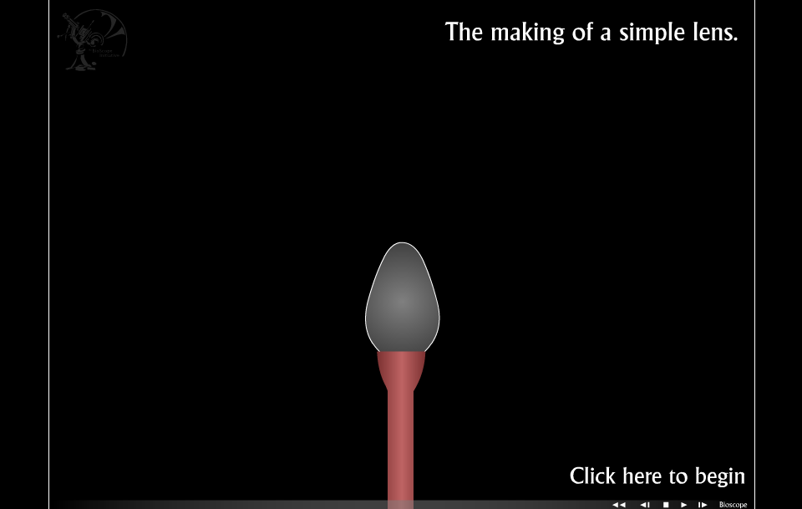
How the first lenses were made

Slide 16

Guiseppe Campani - 1670-1690
Back: Italian compound microscopes - 1670
Italian Compound microscopes
Back: 1670 (probably Campani)
This microscope was formerly at the University of Bologna - it contains a field lens which was the first optical advance about 1660. Only opaque objects can be viewed.
Front: Guiseppe Campani, Rome - 1690 - Campani was the leading Italian telescope and microscope maker in the late `17th century - he probably invented the screw focusing mechanism shown on this scope - the slide holder in the base allows transparent and opaque objects to be viewed
1690
Photos: © J. Paul Robinson

Slide 17
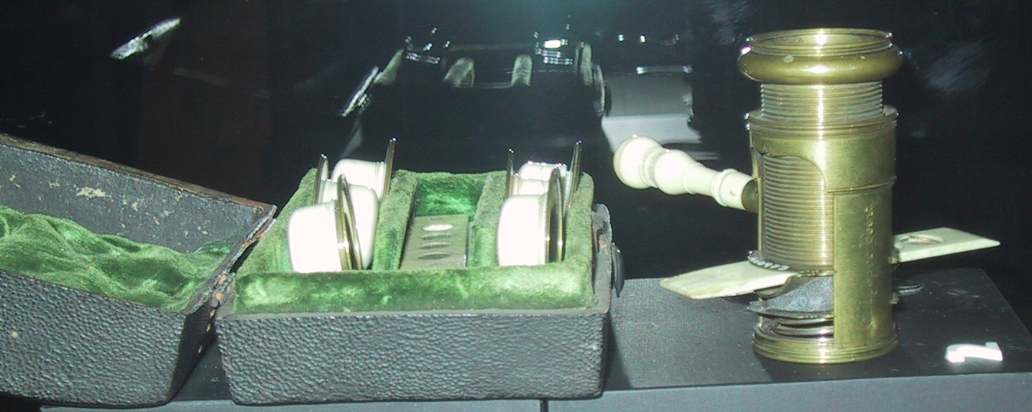
Charles Culpeper
Screwbarrel Microscope - 1720
Made by Charles Culpeper
1720
Photos: © J. Paul Robinson

Slide 18
Chester More Hall
The issues between simple and compound microscope
Simple microscopes could attain around 2 micron resolution, while the best compound microscopes were limited to around 5 microns because of chromatic aberration
In the 1730s a barrister names Chester More Hall observed that flint glass (newly made glass) dispersed colors much more than “crown glass” (older glass). He designed a system that used a concave lens next to a convex lens which could realign all the colors. This was the first achromatic lens. (designed for telescopes)
1730

Slide 19
George Bass
Hall sent a request to one glass maker for some flint glass and a request to another glass maker for some crown glass.
It is believed that both glass makers actually sent both orders on to George Bass
1740

Slide 20
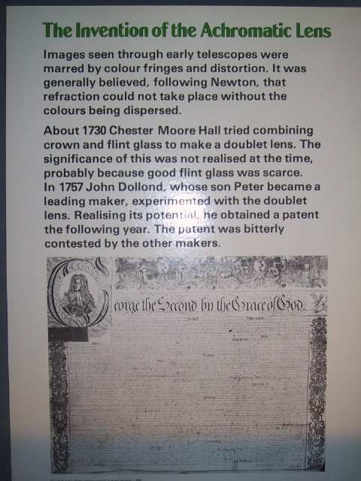
The famous patent of 1758
George Bass was the lens-maker that actually made the lenses, but he did not divulge the secret until over 20 years later to John Dollond who copied the idea in 1757 and patented the achromatic lens in 1758.
1758
© J.Paul Robinson

Slide 21
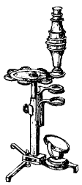
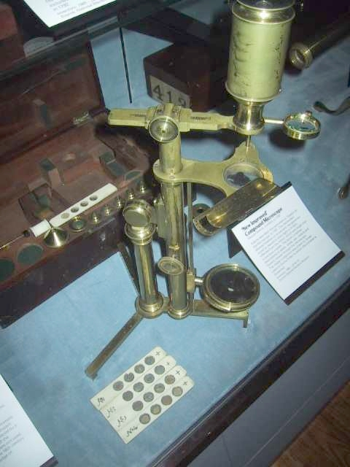
Secondary Microscopes
George Adams Sr. made many microscopes from about 1740-1790 but he was predominantly just a good manufacturer not inventor (in fact it is thought he was more than a copier!)
1763
“New Improved Compound Microscope, George Adams, 1790
Adams described this instrument in his “Essays on the Microscope” in 1787. The mechanism allowed freedom of movement. The specimen could be viewed in direct light or in light reflected from a large mirror.
© J.Paul Robinson

Slide 22
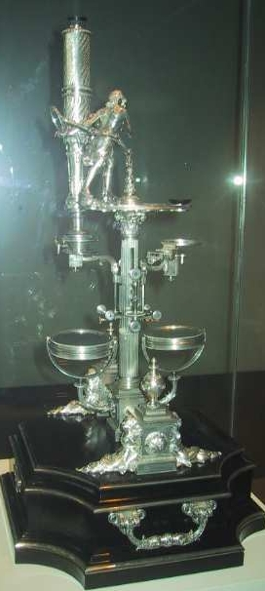
George Adams
Toymaker to Kings
This microscope made by George Adams, Mathematical Instrument maker to King George III around 1763, It was probably intended for the Prince of Wales, the future King George IV. The instrument is based on the design of the “Universal Double Microscope" (London Museum of Science)
1763
Photos: © J. Paul Robinson

Slide 23
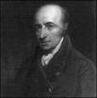
William Hyde Wollaston
William Hyde Wollaston (1766-1828) - Although formally trained as a physician, Wollaston studied and made advances in many scientific fields, including chemistry, physics, botany, crystallography, optics, astronomy and mineralogy. He is particularly noted for originating several inventions in optics, including the Wollaston prism that is fundamentally important to interferometry and differential interference (DIC) contrast microscopy.
He discovered the elements palladium (symbol Pd) in 1803 and rhodium (symbol Rh) in 1804.
1812

Slide 24
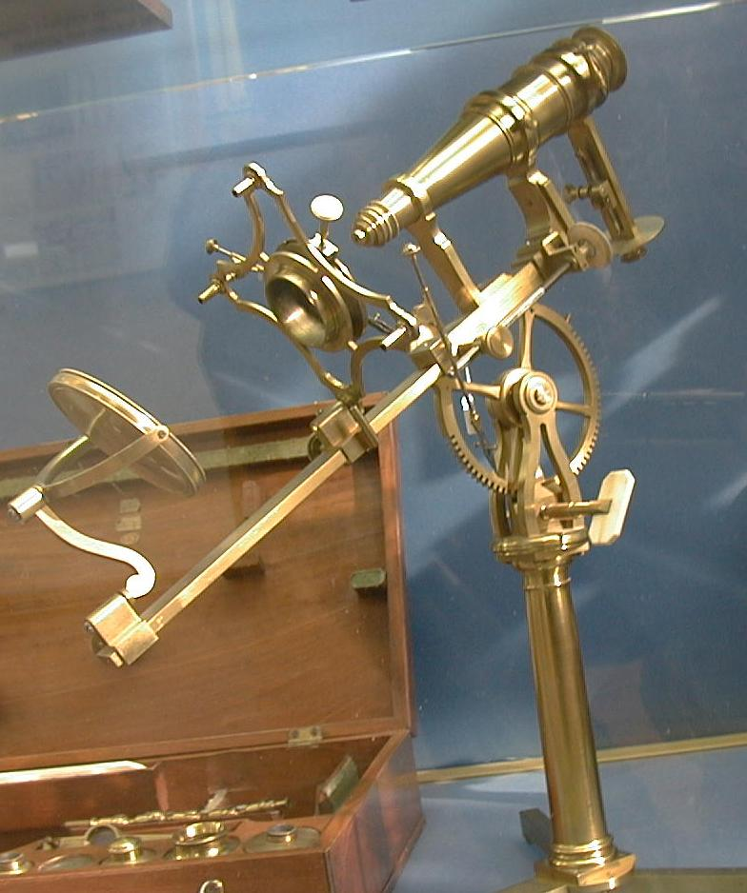
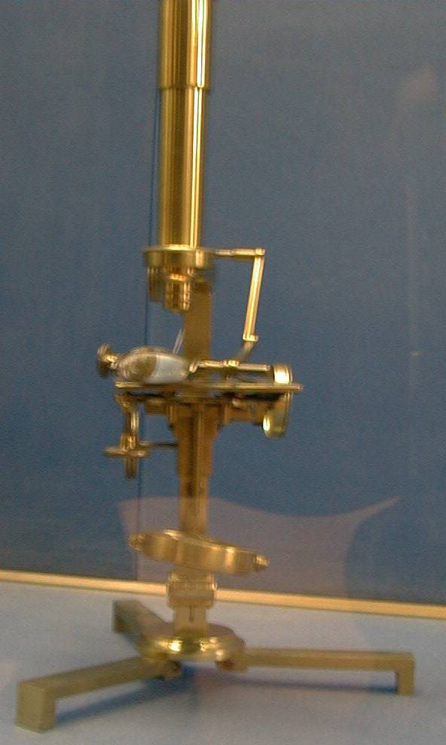
Giovanni Battista Amici
In 1827 Giovanni Battista Amici, built high quality microscopes and introduced the first matched achromatic microscope in 1827. He had previously (1813) designed “reflecting microscopes” using curved mirrors rather than lenses. He recognized the importance of coverslip thickness and developed the concept of “water immersion”
1827
© J.Paul Robinson
© J.Paul Robinson

Slide 25
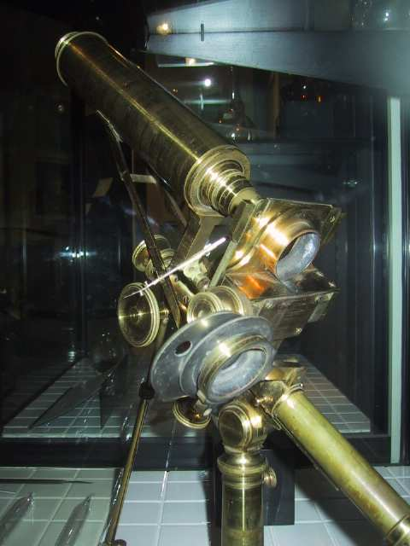
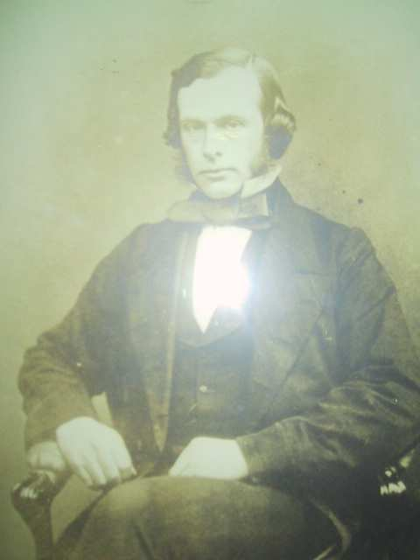
Joseph Lister
In 1830, by Joseph Jackson Lister (father of Lord Joseph Lister) solved the problem of Spherical Aberration - caused by light passing through different parts of the same lens. He solved it mathematically and published this in the Philosophical Transactions in 1830
1830
Joseph Lister
© J.Paul Robinson
Photos: © J. Paul Robinson

Slide 26
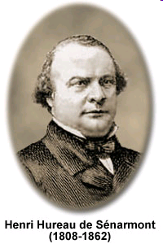
Henri Hureau de Sénarmont (1808-1862)
Henri Hureau de Sénarmont (1808-1862)
Sénarmont was a professor of mineralogy and director of studies at the École des Mines in Paris, especially distinguished for his research on polarization and his studies on the artificial formation of minerals. He also contributed to the Geological Survey of France by preparing geological maps and essays.
Perhaps the most significant contribution made by de Sénarmont to optics was the polarized light retardation compensator bearing his name, which is still widely utilized today
1830
Image source: http://micro.magnet.fsu.edu/optics/timeline/people/senarmont.html

Slide 27
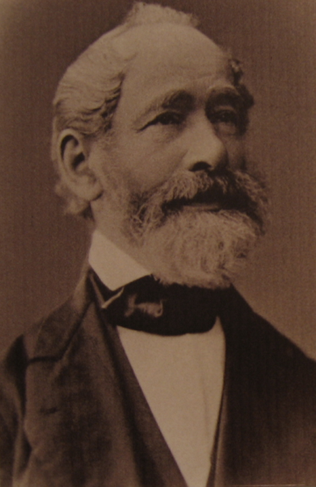
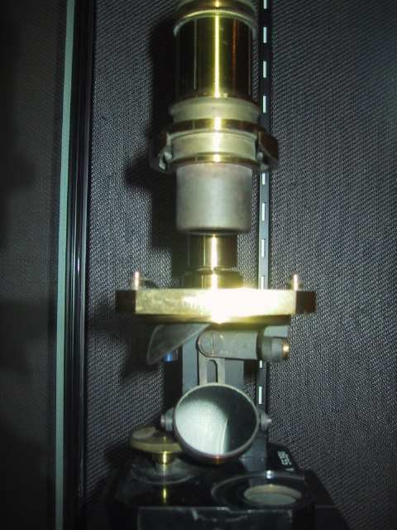
Carl Zeiss 1816-1888
Carl Zeiss opens his workshop in Jana, Germany to make eyeglasses and microscopes for the University in 1846
Abbe and Zeiss developed oil immersion systems by making oils that matched the refractive index of glass. Thus they were able to make the a Numeric Aperture (N.A.) to the maximum of 1.4 allowing light microscopes to resolve two points distanced only 0.2 microns apart (the theoretical maximum resolution of visible light microscopes). Leitz was also making microscope at this time.
1846
Zeiss student microscope 1880

Slide 28
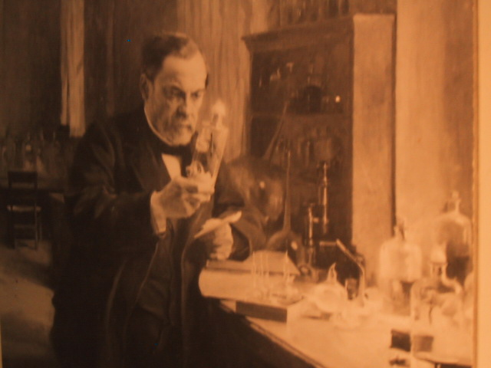
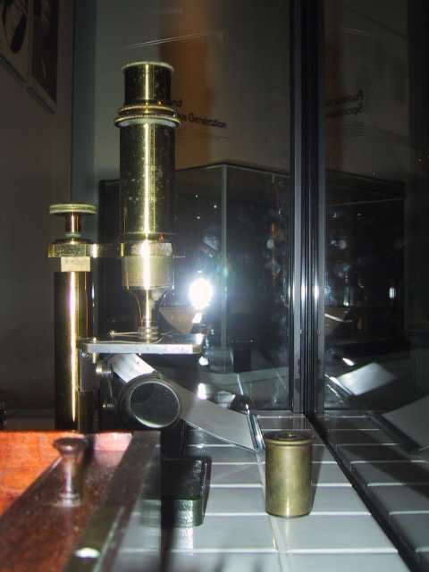
Pasteur - 1860
Photos: taken in London Science Museum by J. Paul Robinson
1860
Photo: © J. Paul Robinson
Louis Pasteur – his microscope was made in Paris by Nachet in about 1860 and was made of brass

Slide 29

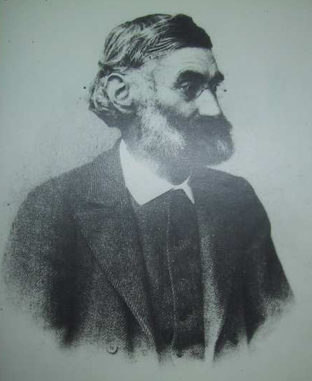
Abbe & Zeiss
Ernst Abbe joins Zeiss (Jena), develops Abbe sine condition optics, improving optics significantly in 1873
Ernst Abbe together with Carl Zeiss published a paper in 1877 defining the physical laws that determined resolving distance of an objective. Known as Abbe’s Law
“minimum resolving distance (d) is related to the wavelength of light (lambda) divided by the Numeric Aperture, which is proportional to the angle of the light cone (theta) formed by a point on the object, to the objective”.
“The impetus for the emergence into the industrial age was given by Ernst Abbe (appointed Associate Professor in 1870), who, while still in his early 30s, developed his theory of microscope image formation, which took into consideration the familiar phenomenon of diffraction, and thus made the leap in microscope construction from trial and error to methodical design. He was given this commission by a university mechanic, Carl Zeiss, who had been steadily perfecting the construction of optical equipment in his private workshops. Otto Schott, who received his doctorate at Jena in 1875, was the third to enter into this alliance by founding, at Abbe’s urging, a "Laboratory for Glass Technology" in 1884, to produce the highly pure special lenses for Zeiss’s microscopes and optical equipment. Humboldt’s pupil Matthias Jakob Schleiden, Professor of Botany and famous for his cell theory, encouraged -- and later benefited from -- this process, which was to prove exemplary in German economic history.”
http://www.uni-jena.de/History-lang-en.html
1877
Abbe

Slide 30
Abbe & Zeiss
Abbe and Zeiss developed oil immersion systems by making oils that matched the refractive index of glass. Thus they were able to make the a Numeric Aperture (N.A.) to the maximum of 1.4 allowing light microscopes to resolve two points distanced only 0.2 microns apart (the theoretical maximum resolution of visible light microscopes).
Leitz was also making microscope at this time.
Paul Rudolph of Zeiss Jena, develops Tessar high resolution & contrast lens; 4 elements in 3 groups 1902
1880
Zeiss student microscope 1880

Slide 31
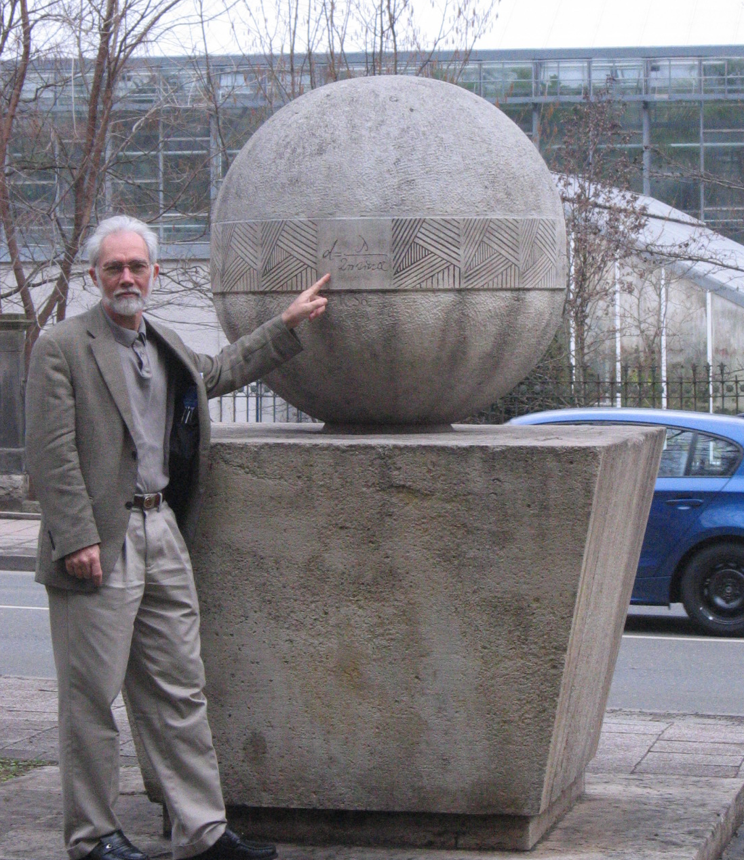
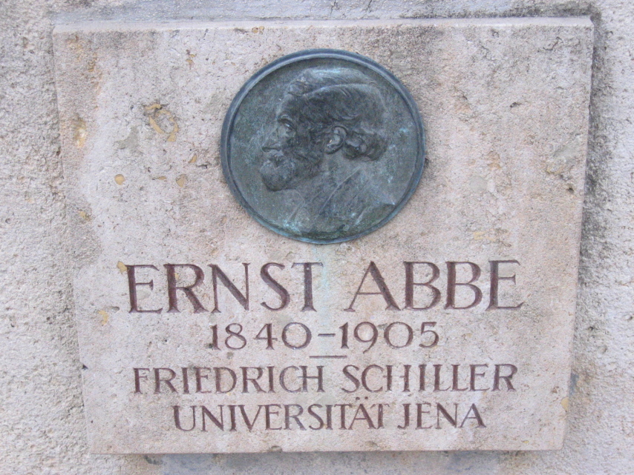
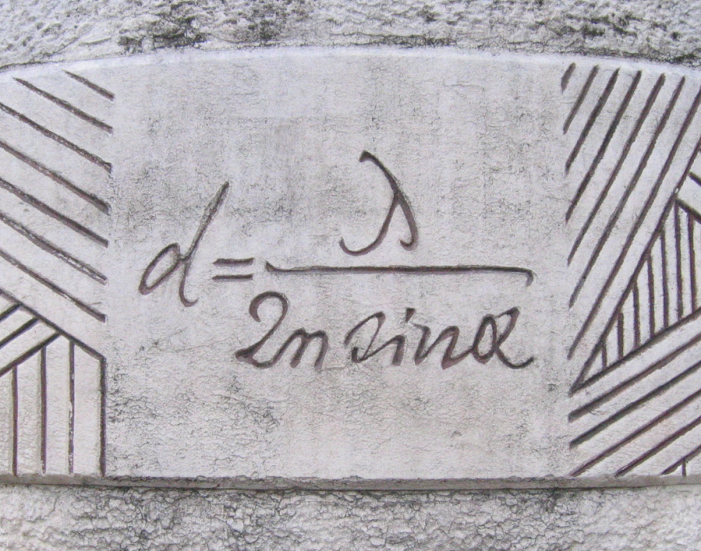
1880
Photos: © J. Paul Robinson
Ernst Abbe memorial in Jena, Germany

Slide 32
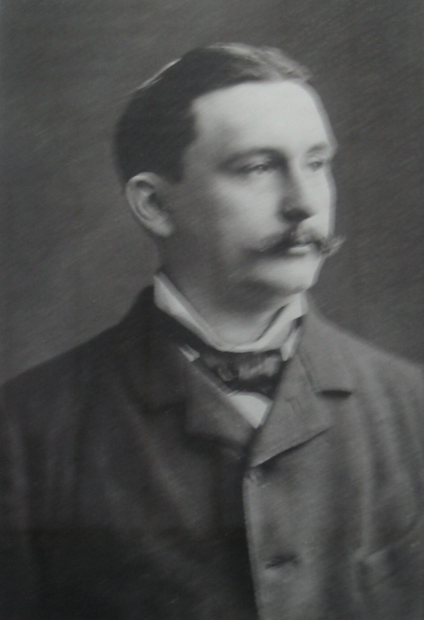
Otto Schott
Otto Schott, who received his doctorate at Jena in 1875, was the third to enter into this alliance by founding, at Abbe’s urging, a "Laboratory for Glass Technology" in 1884, to produce the highly pure special lenses for Zeiss’s microscopes and optical equipment.
Otto Schott joins Abbe and Zeiss, produces glass equal to Abbe’s work, Apochromatic lens, 1886
Dr Otto Schott formulated glass lenses that color-corrected objectives and produced the first “apochromatic” objectives in 1886.
1886

Slide 33
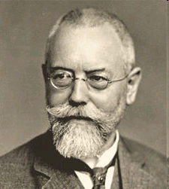
August Karl Johann Valentin Köhler (1866-1948)
Early 20th Century Professor Köhler developed the method of illumination still called “Köhler Illumination”
In 1900, he was invited to join the Zeiss Optical Works company in Jena, Germany, by Siegfried Czapski based on his earlier work on improving microscope illumination. He stayed with Zeiss as a physicist for 45 years and became instrumental to the development of modern light microscope design.
Köhler recognized that using shorter wavelength light (UV) could improve resolution
The driving force for Köhler’s even illumunation invention was the use of gas lamps and similar uneven light sources that created serious problems in trying to gain even and constant illumination
1900
Image source: http://en.wikipedia.org/wiki/File:August_Koehler.jpg

Slide 34
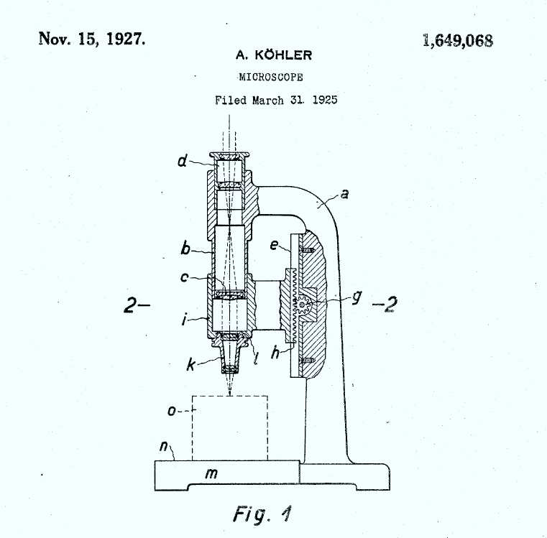
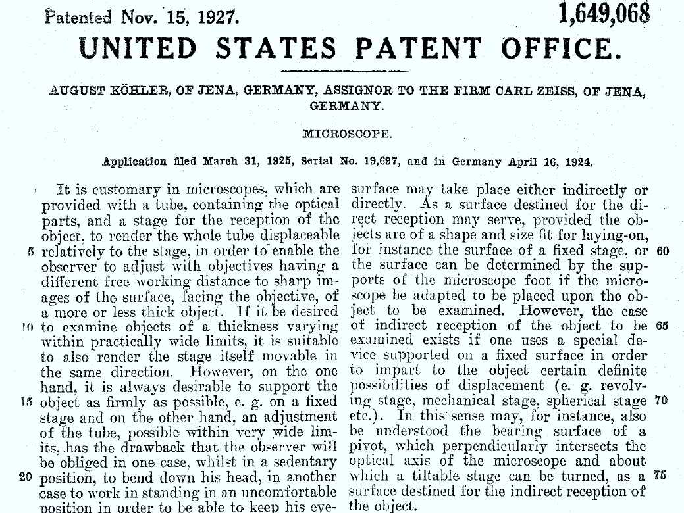
August Köhler
Köhler illumination creates an evenly illuminated field of view while illuminating the specimen with a very wide cone of light
Two conjugate image planes are formed
  one contains an image of the specimen and the other the filament from the light
He filed an application for a fixed-ocular microscope of his design in Germany on April 16, 1924 and with the United States Patent Office on March 31, 1925 (patent number 1649068)
1900

Slide 35
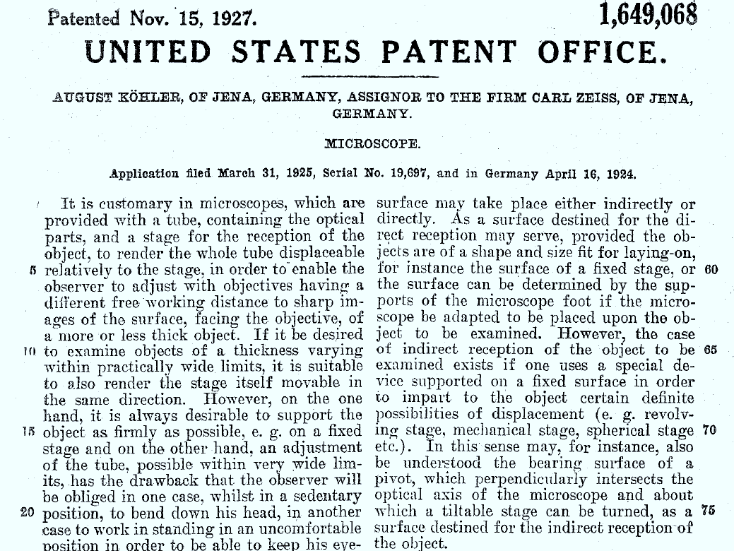
1900

Slide 36

1900

Slide 37
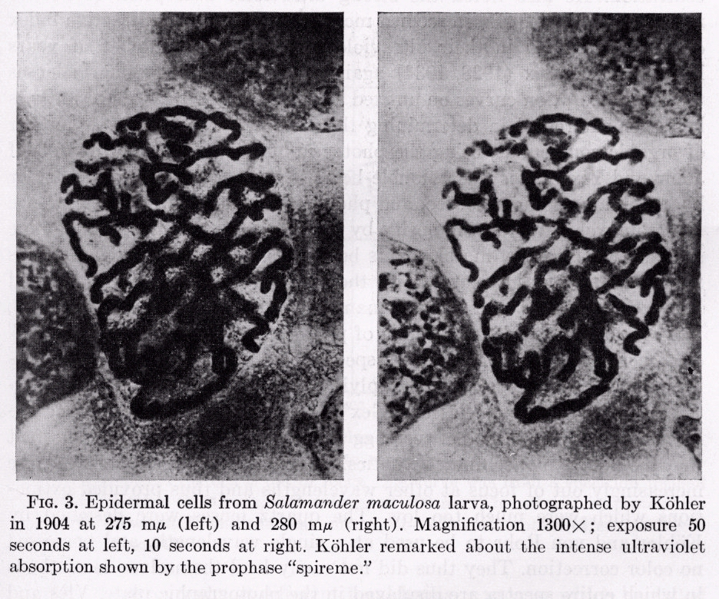

First Ultraviolet Imaging
A. Kohler 1904
275 nm
280 nm
1900
Salamander maculosa larva epidermal cells - 1300 X
Slide provided by Compucyte Corp
A. Kohler, Mikrophotographische Untersuchungen mit ultraviolettem Licht, Z. Wiss. Mikroskopie 21, 1904

Slide 38
Köhler
Köhler illumination creates an evenly illuminated field of view while illuminating the specimen with a very wide cone of light
Two conjugate image planes are formed
  one contains an image of the specimen and the other the filament from the light

Slide 39
Köhler Illumination
condenser
eyepiece
Field iris
Specimen
Field stop
retina
Conjugate planes for image-forming rays
Field iris
Specimen
Field stop
1900
Conjugate planes for illuminating rays

Slide 40
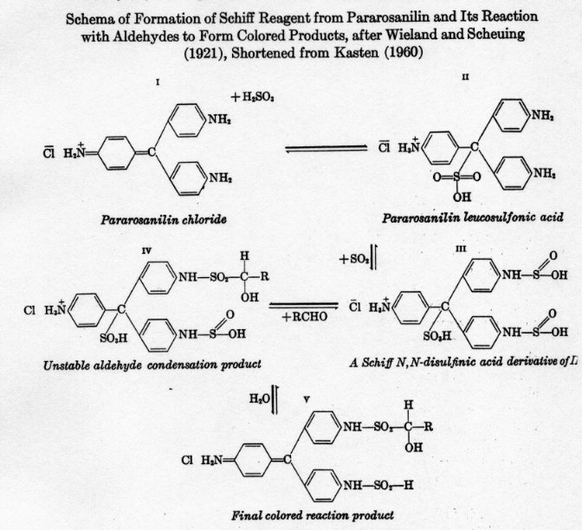

Feulgen Reaction 1924
Demonstrated that DNA was present in both animal and plant cell nuclei - developed a stoichiometric procedure for staining DNA involving a derivatizing dye, (fuchsin) to a Schiff base
Schema of formation of Schiff Reagent from Pararosanilin and its reaction with aldehydes to form colored products
After Wieland and Scheuing (1921)
Shortened from Kasten (1960)
1924
R. Feulgen & H. Rossenback, Microskopisch-chemischer Nachweis einer Nucleinsaure von
Typus der Thymonucleinsaure und auf die darauf berunhende elektive Farbung von
Zellkernen in mikroskopischen Präparaten, Hoppe Seyler Z. Physiol. Chem. 135, 1924

Slide 41
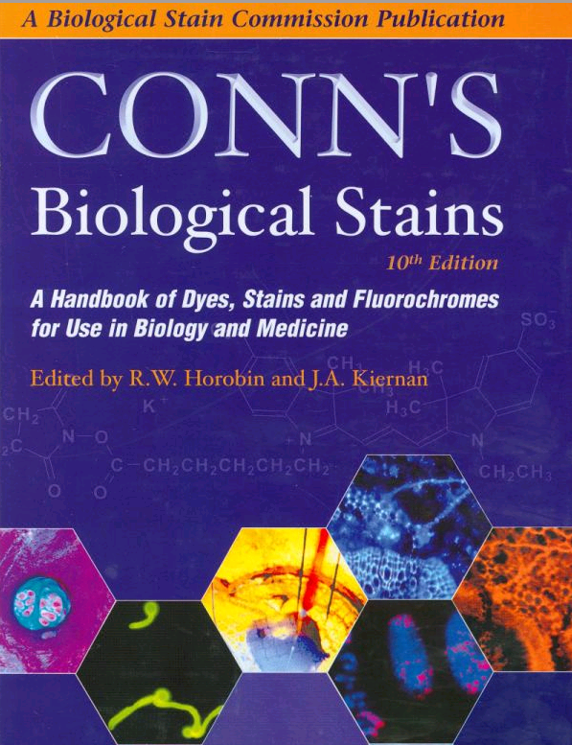
Conn’s Biological Stains - First Published in 1925
1925

Slide 42
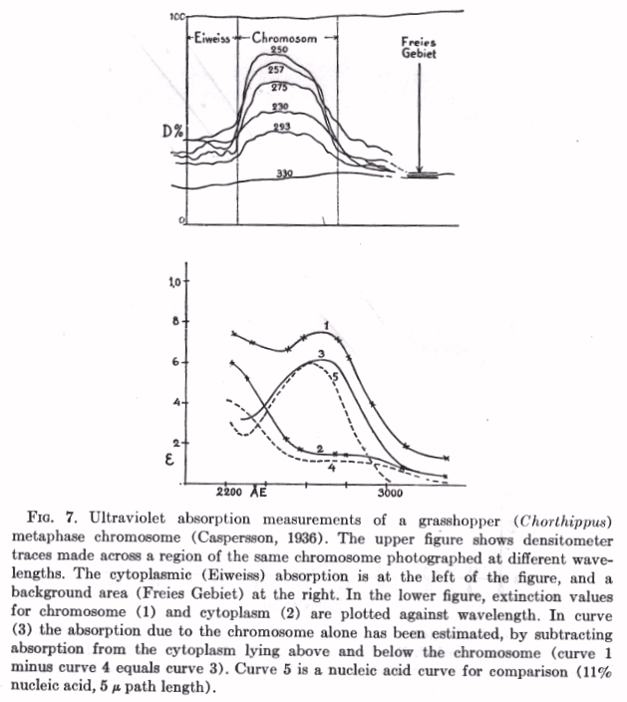
UV Measurements of DNA and Cytoplasm
T. Caspersson 1936
Ultraviolet absorption measurements of
a grasshopper metaphase chromosome
Densitometer traces across
a region of the chromosome
Extinction values for chromosome and cytoplasm plotted against wavelength
1936
Cytoplasmic absorption
Chromosomal absorption
Background signal
Uber den chemischen Aufbau der Strukturen des Zellkernes, Skand. Arch. Physiol. 73, 1936

Slide 43
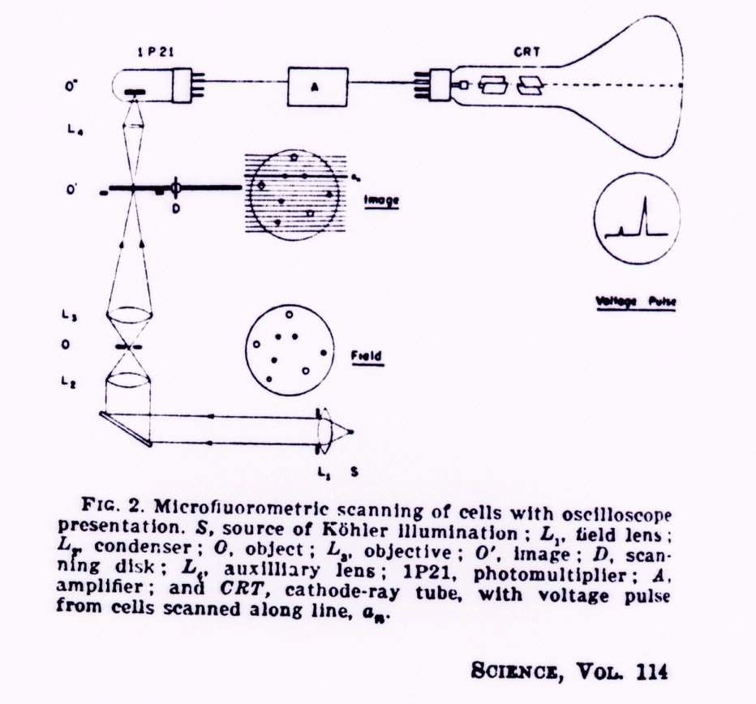
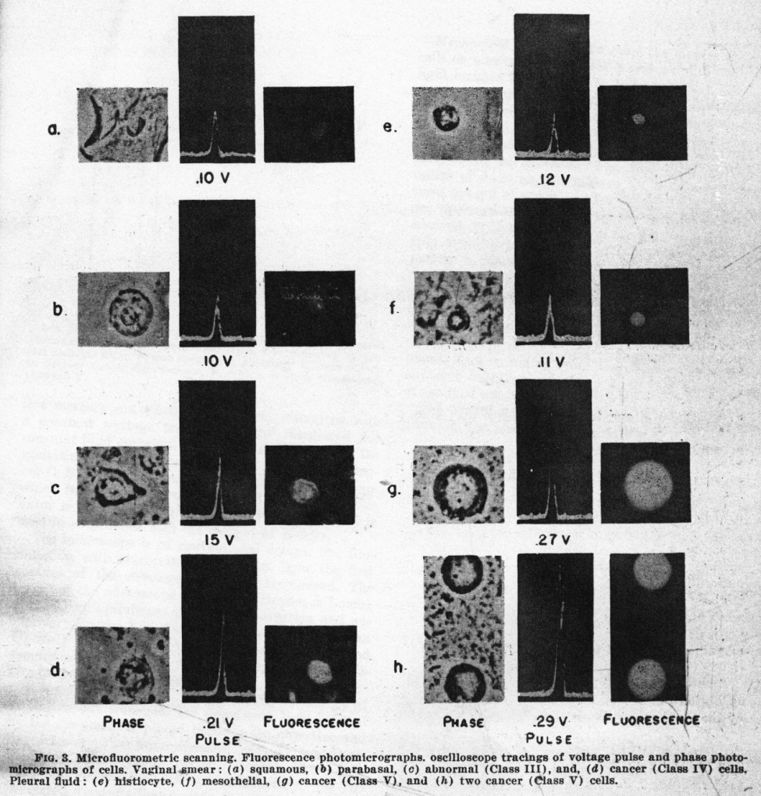
Early Microfluorometric Scanner
Robert Mellors 1951
1951
RC Mellors & R. Silver, A microfluorometric scanner for the differential detection of cells: application to exfoliative cytology, Science 104, 1951
Slide kindly supplied by Compucyte

Slide 44
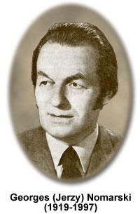
Georges Nomarski (1919-1997)
Georges Nomarski (1919-1997) - A Polish born physicist and optics theoretician, Georges Nomarski adopted France as his home after World War II. Nomarski is credited with numerous inventions and patents, including a major contribution to the well-known differential interference contrast (DIC) microscopy technique. Also referred to as Nomarski interference contrast (NIC), the method is widely used to study live biological specimens and unstained tissues.
Additional Information and Image at right from:
http://micro.magnet.fsu.edu/optics/timeline/people/nomarski.html
1953

Slide 45
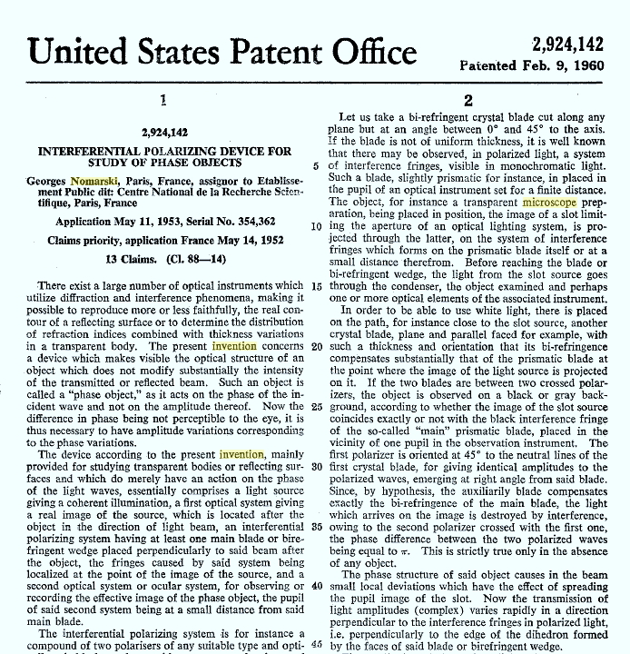
1953

Slide 46
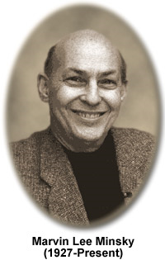
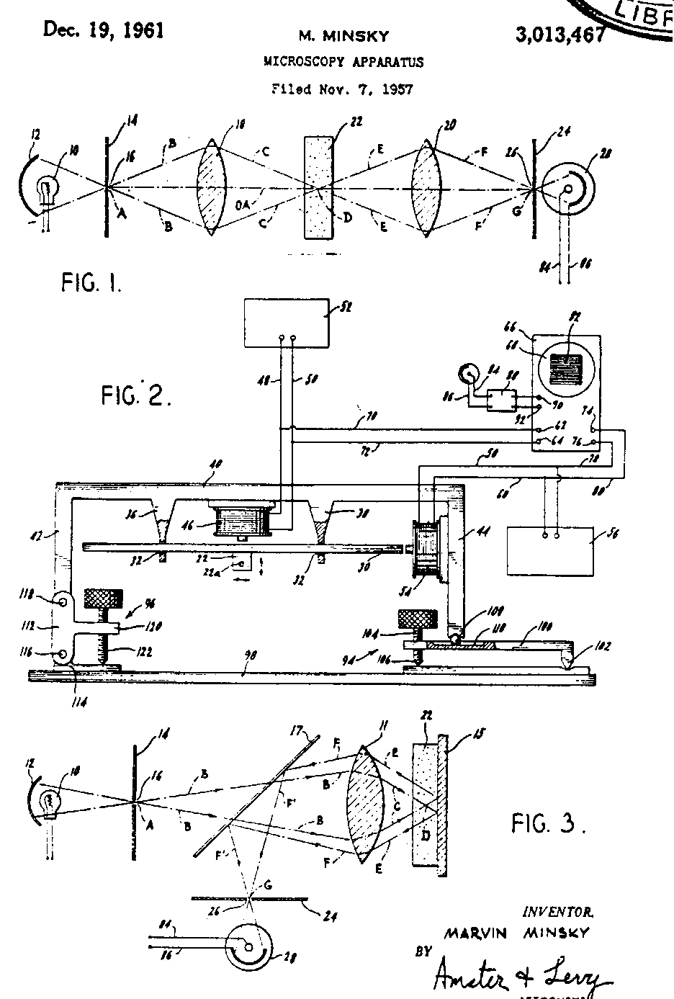


First disclosed the confocal microscope principle - 1953
1953
Minsky’s prototype
Data from Patents database

Slide 47

Cytometry Analytic Techniques
M.R. Mendelsohn 1958
The Two-Wavelength Method of Microspectrophotometry
J. Biophys. Biochem Cytol. 4, 1958
1958
Slide kindly supplied by Compucyte

Slide 48



Character Recognition and the beginning of cancer recognition
Dr. Kamentsky
LA Kamentsky & CN Liu, Computer-automated design of multifont print recognition
logic, IBM J. Research & Development 7, 1963
1963
Slide kindly supplied by Compucyte

Slide 49

Relating Cytometry to Pathology
O. Caspersson 1964
Cells from a normal cervix
Frequency distribution of DNA content
Cells from a cervical carcinoma
Premalignant cells from the epithelium
Quantitative cytochemical studies on normal, malignant, premalignant and atypical cell populations from the human uterine cervix, Acta Cytologica 8, 1964
1963
Slide kindly supplied by Compucyte

Slide 50



Visible & UV Scanning - 1963
Brightfield Image
UV Images
1963
Dr. Melamed
Dr. Koss
Dr. Kamentsky
Slide kindly supplied by Compucyte

Slide 51






UV Scanning - Measurements
Dr. Kamentsky
Normal Cells
Cancer Cells
1963
Ultraviolet Absorption in Epidermoid Cancer Cells LA Kamentsky, H. Derman,
and MR Melamed, Science 142, 1963
Slide kindly supplied by Compucyte

Slide 52


Johan Sebastiaan (Bas) Ploem
1965
Epi-illumination
Leitz PLOEMOPAK illuminator
An epi-illumination cube used in fluorescence microscopy. Ploem's vertical illuminator bears his name and is commonly used today.
Image from wikimedia.org
Liver tissue. Nuclei stained with Feulgen-pararosaniline for DNA. Epi-illumination with narrow band green light (546nm) and a dichroic beam splitter for reflecting green light. Probably the first example of microscope excitation with green light (Ploem, 1965). Note large image contrast
Image from micro.magnet.fsu.edu
For his contributions to the practice of microscopy, Ploem has received various honors. He was elected as a fellow of the Papanicolaou Cancer Research Institute in 1977 and was a recipient of the C. E. Alken Foundation award in 1982. He is also a member of the Society of Analytical Cytology, the Dutch Society of Cytology, the International Academy of Cytology and the Royal Microscopical Society, for which he served as president in 1986. In 1993, he became an Honorary Fellow of the International Society for Analytical Cytology

Slide 53

Robert Day Allen (1927-1986)
Robert Day Allen (1927-1986) - Robert Day Allen was a renowned microscopist, a prominent researcher of cell motility processes, and a co-developer of video-enhanced contrast microscopy ((VEC)), which is a modification of the traditional form of differential interference contrast (DIC) microscopy. Along with Georges Nomarski and G. B. David, Allen assisted the Carl Zeiss Optical Company in developing a Nomarski differential interference microscope for transmitted light applications. In a hallmark paper published in Zeitschrift für wissenschaftliche Mikroskopie und mikroskopische Technik, Allen and his colleagues defined the basic principles of the DIC technique and the interpretation of images.
Rebhun LI. Robert Day Allen (1927-1986): an appreciation. Cell Motil Cytoskeleton. 1986;6(3):249-55
1966
More information at: (Image reproduced from below URL)
http://micro.magnet.fsu.edu/optics/timeline/people/dayallen.html

Slide 54

1966

Slide 55
Young & Roberts, 1952
Flying spot” microscope based on a scanned spot on the surface of an oscilloscope tube as the illuminant in an image plane of a microscope and a photocell positioned to capture all the light that entered the eyepiece as the detector
Reference: Young, J.Z., Roberts, F., 1951. A flying spot microscope. Nature 167, 231.

Slide 56

Confocal Microscope -1986-1988
MRC Laboratory of Molecular Biology in Cambridge in 1986
Image from Biology of the Cell 95 (2003) 335–342
1986

Slide 57
Laser Scanning Cytometry – 1990
Kamentsky
Dr. Kamentsky
Laser Scanning Cytometer
1990
Slide kindly supplied by Compucyte

Slide 58









Laser Scanning Cytometry
Untreated
Treated
P27 in Prostate Tissue
Quantification of total γH2AX
expression & foci count
Drug-induced apoptosis results in changes to cell morphology
Slide kindly supplied by Compucyte
Notes:
The iCyte Automated Imaging Cytometer is designed for automated analysis. With no microscope oculars or viewing optics, it relies on laser scan imaging to visualize cells during analysis. Further, iCyte has an auto-focus capability that makes walk-away operation a possibility. An optional robotic autoloader is available.

Slide 59






Other Miscroscopies
Stochastic Optical Reconstruction Microscopy (STORM) Imaging
“..activated state of a photoswitchable molecule must lead to the consecutive emission of sufficient photons to enable precise localization before it enters a dark state or becomes deactivated by photobleaching.”
Pulse
Fluorescence
Image
Successive pulses of light activate photosensitive probes and the network is built up as an image
https://www.microscopyu.com/tutorials/stochastic-optical-reconstruction-microscopy-storm-imaging

Slide 61
Conclusion
Microscopes have developed over the past 400 years
Achromatic aberration, Spherical aberration
Köhler illumination
Refraction, absorption, dispersion, diffraction
Magnification
Upright and inverted microscopes
Optical Designs - 160 mm and infinity optics

Slide 62
Summary Lecture 1
Historical context of discovery of microscopes
The major players in microscopy
Variety of imaging tools developed to focus on specific problems
New inventions for high resolution imaging
Linking automated microscopy to image processing
http://tinyurl.com/2dr5p

