Slide 1
BMS 631 - Lecture 5
J.Paul Robinson The SVM Professor of Cytomics College of Veterinary Medicine,
&
Professor of Biomedical Engineering
College of Engineering
Purdue University
Optical Systems
optical geometry; light sources, laser illumination,
& other useful means; optics and shaping the incoming beam;
forward angle light scatter - what it is, why it is useful.
Side angle (90 degree) light scatter, what does it measure?
References:
Shapiro 3rd ed. 93-115
4th edition 101-159

Slide 2
Review
Scatter - Rayleigh Scatter - directly proportional to property of the scattering molecule called molecular polarizability (ie dipole formation), inversely proportional to the fourth power of the wavelength of the incident light (blue light has highest scatter - thus blue sky!)
Scatter - Raman Scatter - (p 93 3rd ed) molecules undergo vibrational transitions at the same time as scatter occurs- if is transition to higher level is known as Stoke's Raman emission. Normally 1/1000th intensity of Rayleigh Scatter, but is significantly increased when using lasers for excitation.. Raman emission of water at 488 nm excitation is around 570-590 nm.
Polarizations - E vectors - larger changes in E vectors not incident light plane; Mie scattering - increased scatter in the forward angle for larger particles (1/4 wavelength to tens of wavelength). (p89, 3rd ed)

Slide 3
Review
Incident light, reflected light, transmitted light, refractive index - note the angle of incidence = angle of reflection regardless of the material of surface. τt transmission angle depends upon the composition of material according to Snell's law of refraction n¹ sin Τ_{i} =n² sin Τ_{t}
n₁, n₂ are the refractive indices respectively through which the incident beam passes (air = 1 essentially)
Brewster's Angle, chromatic aberration, filters, interference, band pass, dichroic, absorption, laser blocker.
Fluorescence lifetime, polarization, fluidity, anisotrophy, resonance energy transfer, quenching, bleaching (p82 3rd ed)

Slide 4
Light Propagation & Vergence
Considering a point source emission of light, rays emanate over 4pi steradians
If the ray of light travels through a length L of a medium of RI n, the optical path length S=Ln (thus S represents the distance light would have traveled in a vacuum in the same time it took to travel the distance L in the medium (RI n).
Rays diverge (because the come from a point source)
Vergence is measured in diopters
Shapiro p 93

Slide 5
Image Formation
Object plane - (originating image)
Image plane - inverted real image
A real image is formed whenever rays emanating from a single point in the object plane again converge to a single point
Shapiro p 94

Slide 6
Properties of thin Lenses
f
f
p
q
1
1
1
+
=
p
q
f
λ
q
Resolution (R) = 0.61 x
Magnification =
(lateral)
NA
p
(Rayleigh criterion)

Slide 7
Numerical Aperture
The wider the angle the lens is capable of receiving light at, the greater its resolving power
The higher the NA, the shorter the working distance
Shapiro p 96

Slide 8
Numerical Aperture
Resolving power is directly related to numerical aperture.
The higher the NA the greater the resolution
Resolving power:
The ability of an objective to resolve two distinct lines very close together
NA = n sin μ
(n=the lowest refractive index between the object and first objective element) (hopefully 1)
μ is 1/2 the angular aperture of the objective

Slide 9
Reminder: Impact of Numerical Aperture
For a narrow light beam (i.e. closed illumination aperture diaphragm) the finest resolution is (at the brightest point of the visible spectrum i.e. 530 nm)…(closed condensor).
λ
.00053
=
= 0.53 μm
1.00
NA
With a cone of light filling the entire aperture the theoretical resolution is…(fully open condensor)..
λ
.00053
=
= 0.265 μm
2 x NA
2 x 1.00

Slide 10
Object Resolution
Example:
40 x 1.3 N.A. objective at 530 nm light
λ
.00053
=
= 0.20 μm
2 x NA
2 x 1.3
40 x 0.65 N.A. objective at 530 nm light
λ
.00053
=
= 0.405 μm
2 x NA
2 x .65

Slide 11
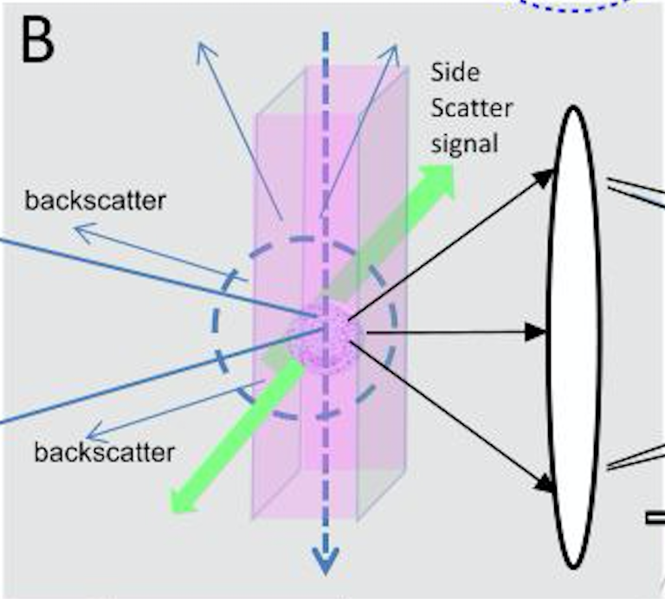
What is the impact of NA on a flow chamber?
Collection of light from the particle is rather inefficient. Therefore, we need to have the most efficient possible optics – and as high an NA as possible.

Slide 12
Reminder: Depth of Field and Resolution
Depth of field is designated as the longitudinal distance for the formation of a sharp image is obtained at a fixed point in the image plane
Limits of resolution are diffraction limited - the diffraction image is a point is a bright central spot surrounded by what is called the Airy disk (alternating light and dark rings)
at wavelength λ, the radius of the Airy disk is 0.61 λ Thus to resolve two points they need to be at least this distance apart (radius of the Airy disk) thus the resolution is defined as 0.61 λ /NA
Shapiro p 97

Slide 13
Technical Aspects of Flow Cytometry
Illumination Sources
Lamps (not used any more in flow)
Xenon
Mercury
Lasers
Argon Ion (Ar)
Krypton (Kr)
Helium Neon (He-Ne)
Helium Cadmium (He-Cd) (rare)
YAG
Solid state lasers
Diodes

Slide 14
Elite Cytometer (top down view)
with 4 Lasers (circa 1990-2005)
353 nm
488 nm
325 nm
633 nm
Complicated
and difficult to align
UV\Beam Splitter
He-Cd Laser 325/441
395 longPass
Argon Laser 353/488 nm
(High speed sorting)
633 Beam Splitter
He-Ne Laser 633 nm
Mirror
Argon Laser 488 nm
Optical bench
Height Translators

Slide 15
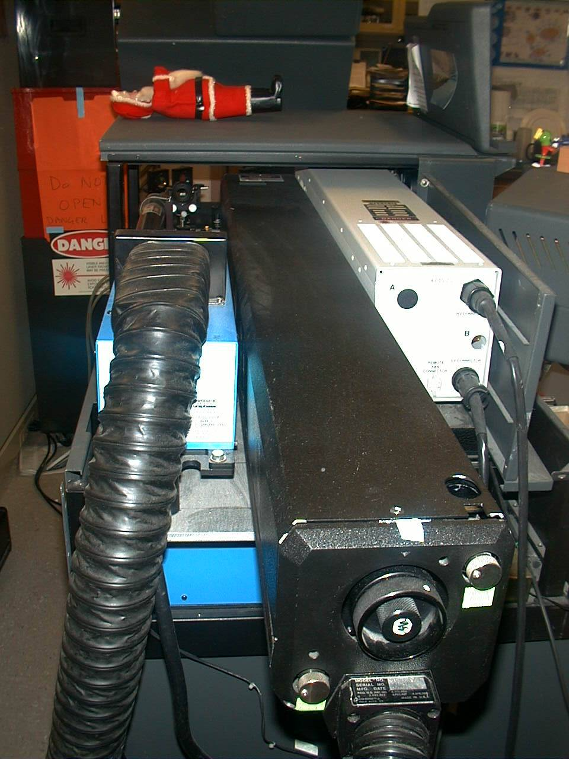
Elite Cytometer with 4 Lasers
He-Cd laser
He-Ne laser
Santa clause
Air-cooled argon laser
Water cooled argon laser

Slide 16
Optical Design Elite-Altra
PMT 5
Diagram originally made in 1990
PMT 4
Sample
PMT 3
Dichroic
Flow cell
Filters
PMT 2
Scatter
PMT 1
Laser
Sensor
Bandpass
Filters

Slide 17
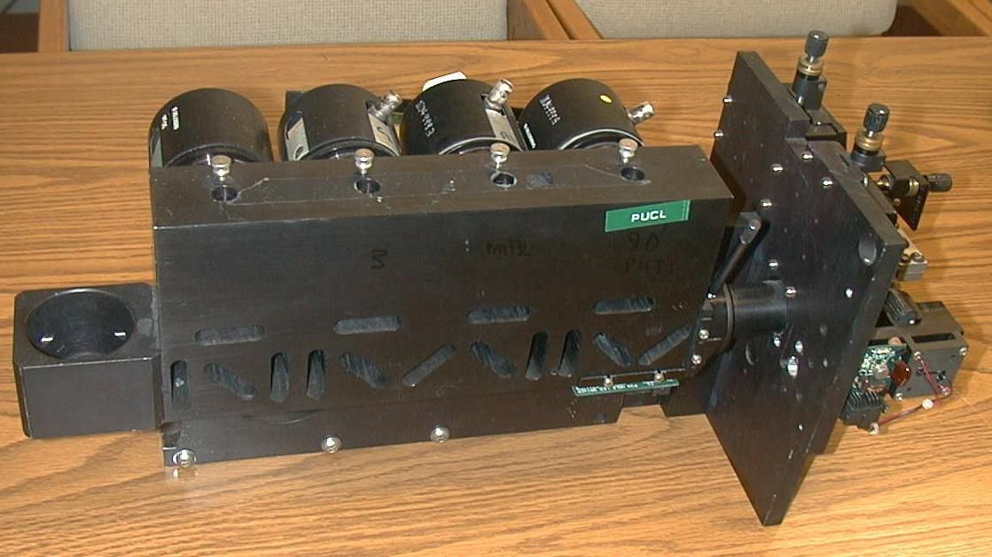
Coulter Optical System - Elite
PMT4
PMT3
PMT2
PMT1
555 - 595
575 BP
525 BP
488 BP
PMT5
L
L
L
675 BP
632 BP
D
5
D
5
488 BK
D
0
2
6
5
0
9
4
655 - 695
APC
PMT6
The Elite optical system uses 5 side window PMTs and a number of filter slots into which any filter can be inserted
TM
PMT7
Purdue Cytometry Labs
PUCL3034

Slide 18
Coulter Optical System - Elite
PMTs
Emply PMT
slot
Filter slots
Light Scatter Detector

Slide 19
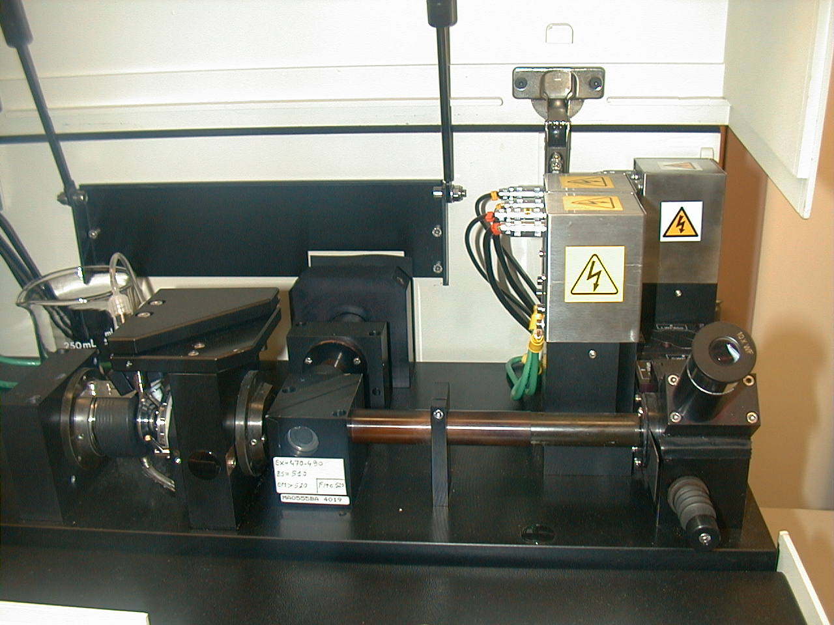
Detection Systems- Bio-Rad Bryte HS
PMTs
Light source
Fluorescence emission filters
Fluorescence signal viewing telescope
Excitation dichroic filter
Fluorescence Detectors and Optical Train
Dsc00050.jpg

Slide 20
Forward Angle
Scatter PMT
Lamp Housing
“Red”PMT
Large Angle
Scatter PMT
Emission
Filter
Block
Sample Inlet
“Orange” PMT
Emission
FilterBlock
“Green” PMT
Slit
Slit
Microscope
Objective
Microscope
Objective
Excitation
Filter
Block
Retractable
Mirror
Retractable
Mirror
The Bryte Optical Layout
Ocular
Ocular

Slide 21
Bryte HS Optical System
Cells
Cover Glass
Fluorescence
Objective
Scatter Objective
Light
Water
Flow
Dark
Xenon Light
Field
Light
Water
Flow
Focus
Dark Spot
Immersion Oil

Slide 22
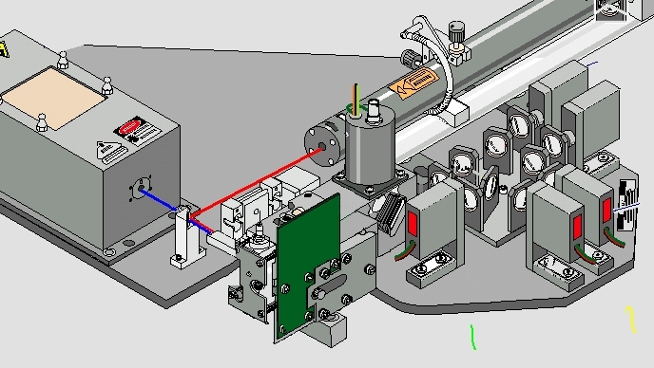
FC500
Laser
Laser
Flow Chamber
FALS detector

Slide 23
FC500
Light from cell
Dichroic or band pass
PMT

Slide 24
Amnis

Slide 25
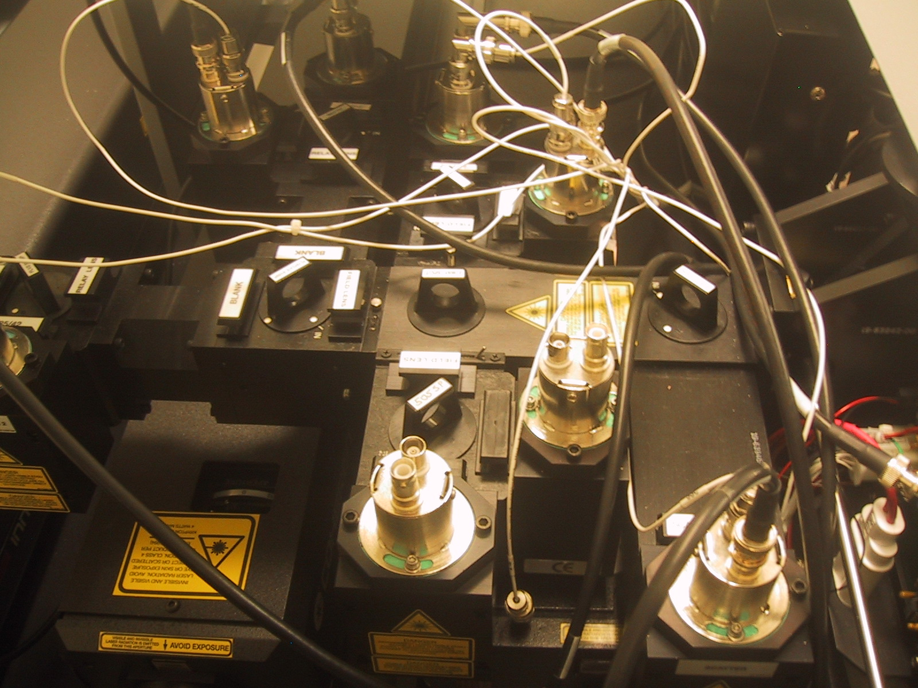
FACStar Plus (1990s)

Slide 26
FACS Vantage

Slide 27
BD FACSAria

Slide 28
FACSAria (2000s)

Slide 29
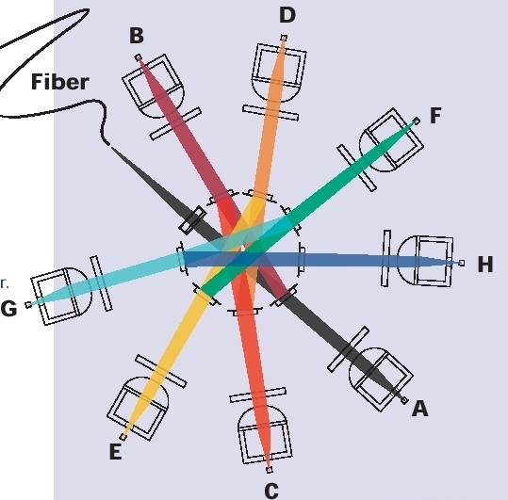
FACSAria

Slide 30
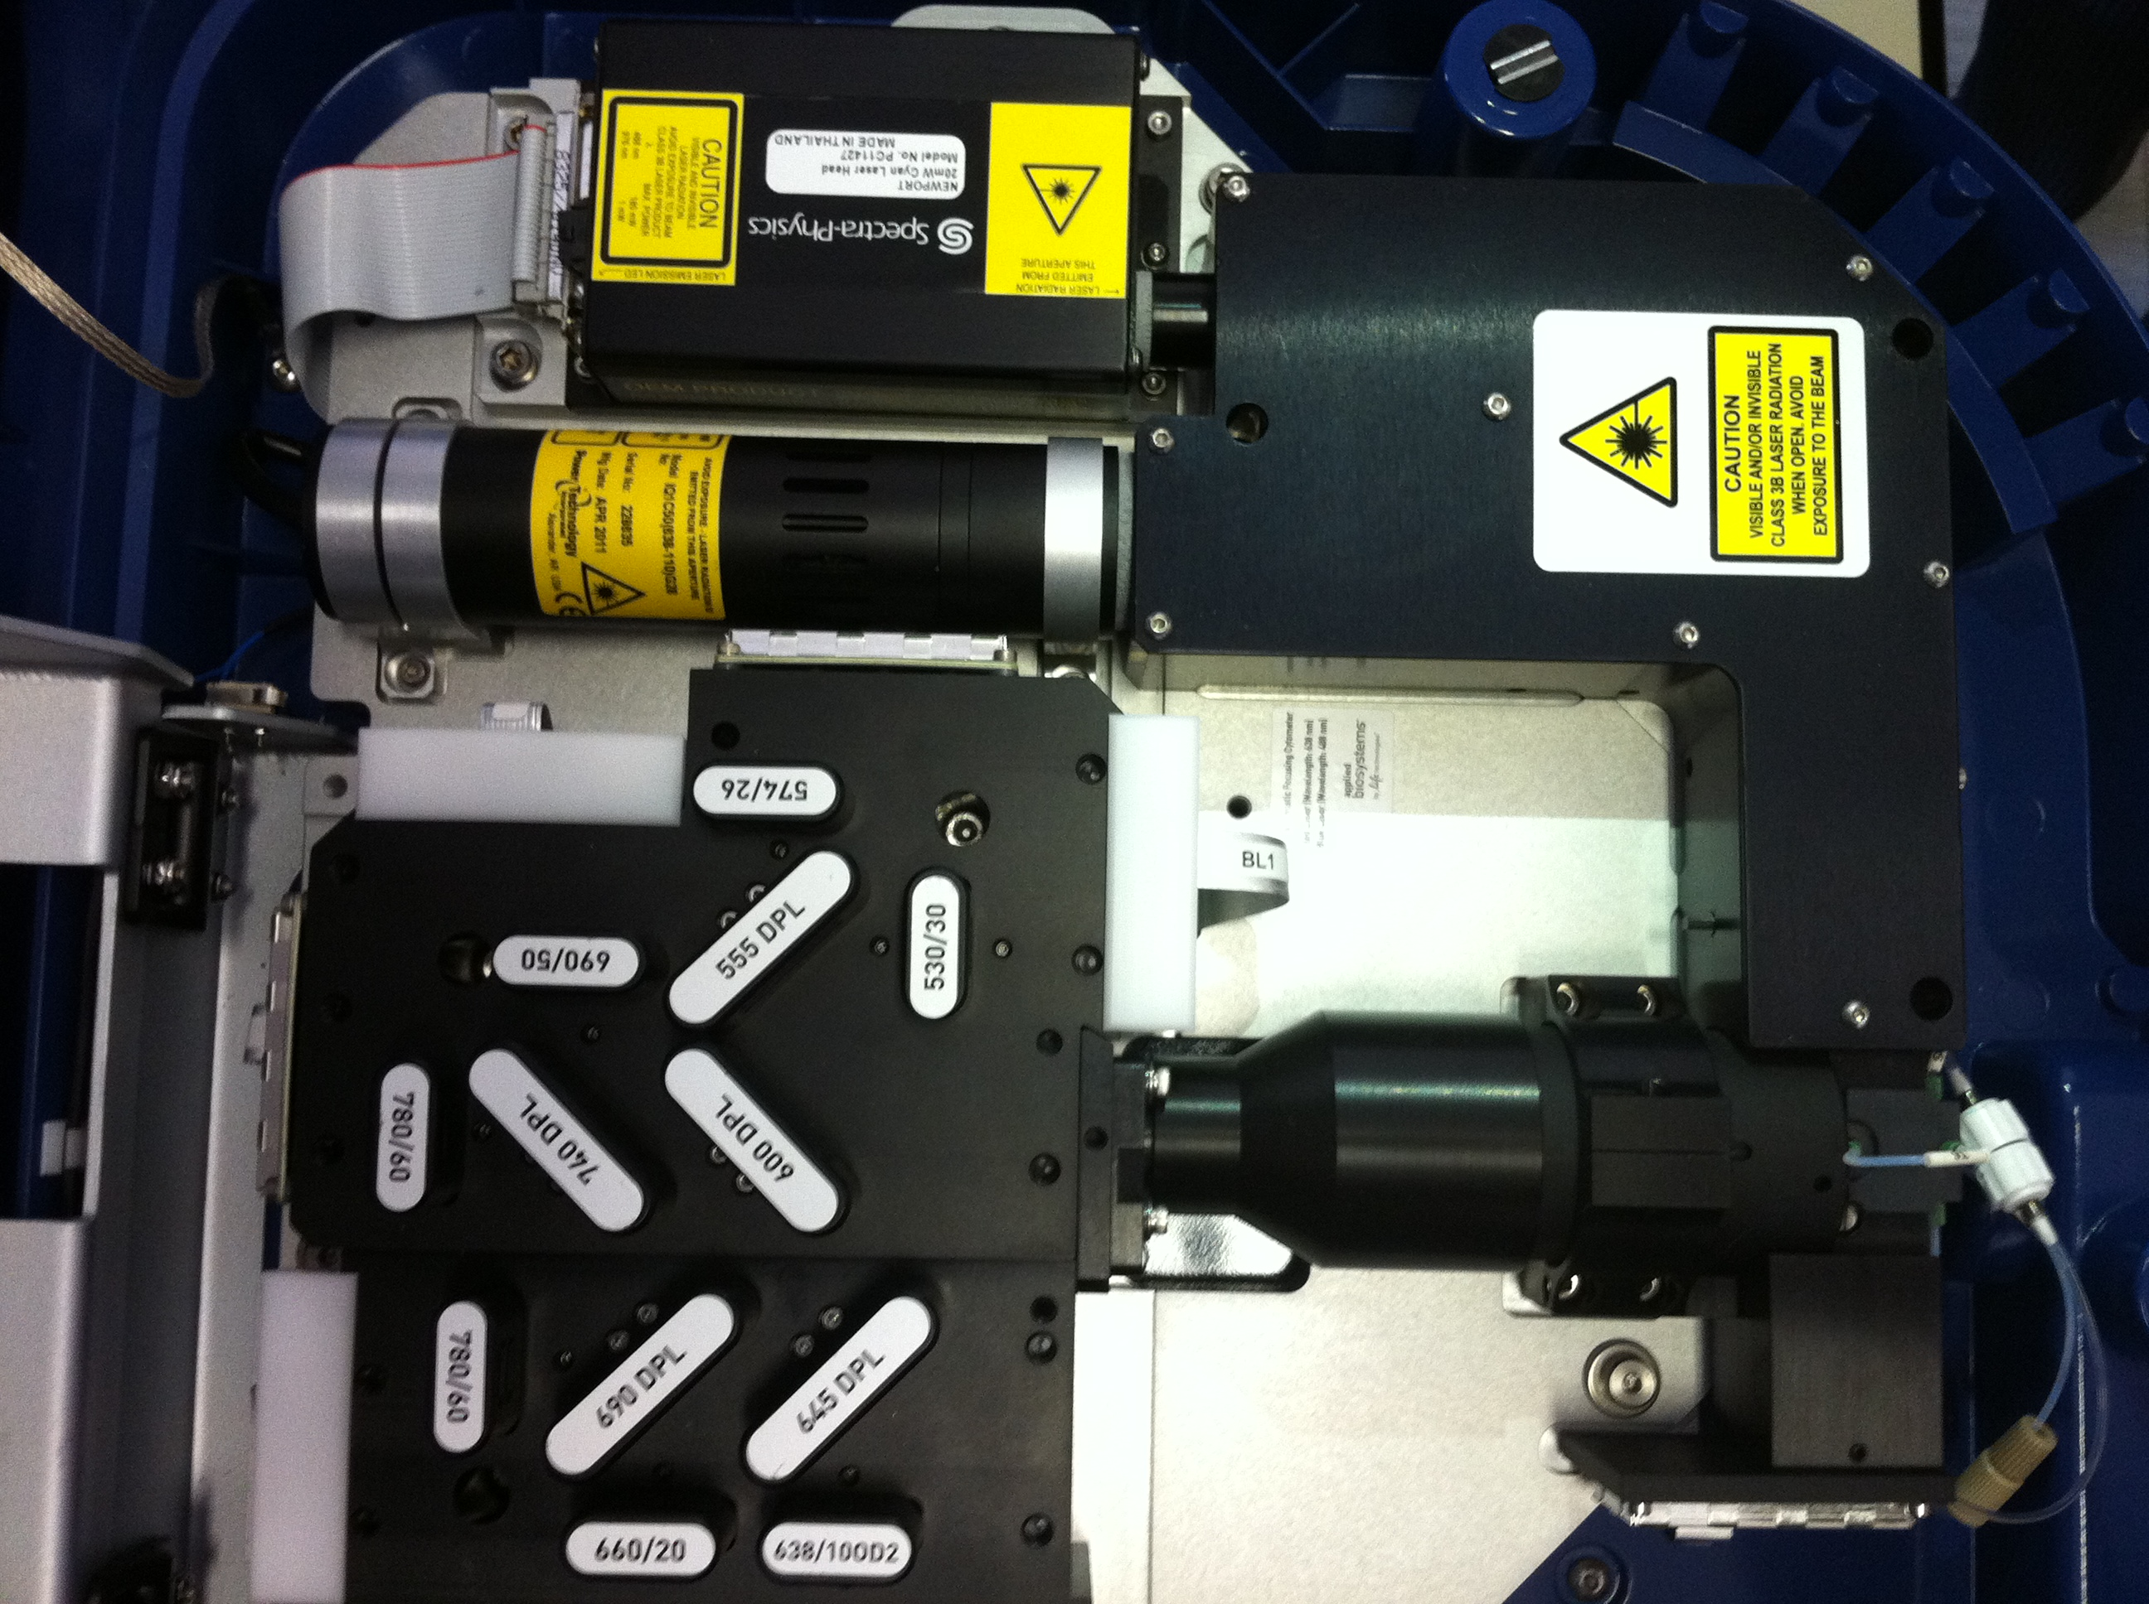
ThermoFisher Attune

Slide 31
ThermoFisher Attune
Lasers
Flow chamber
Optical
filters

Slide 32
Abbott Cell Dyn

Slide 33
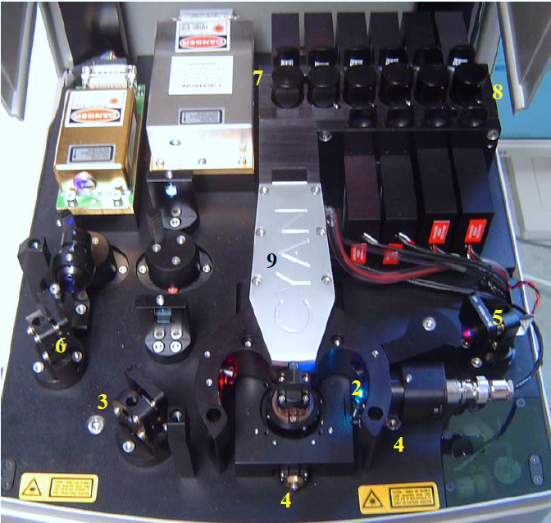
Beckman Coulter CYAN

Slide 34
Beckman Coulter CYAN

Slide 35
Beckman Coulter CYAN

Slide 36
Beckman Coulter CYAN

Slide 37
Beckman Coulter CYAN

Slide 38
Cyan

Slide 39
Beckman Coulter MoFlo or DXP

Slide 40
Beckman Coulter MoFlo or DXP

Slide 41
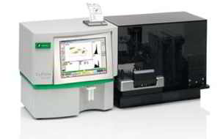
Sysmex-Partec - CyFLOW

Slide 42
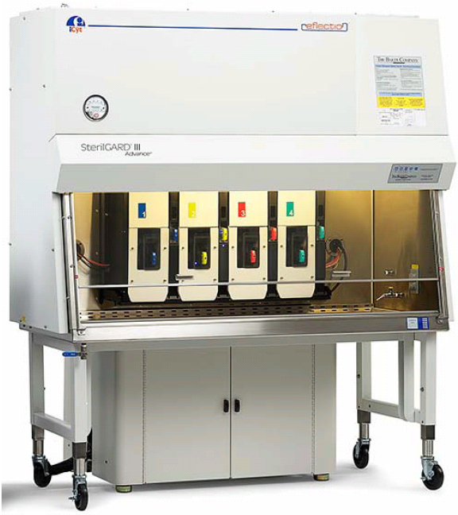
Sony Icyt -Reflection

Slide 43
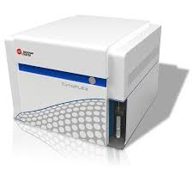
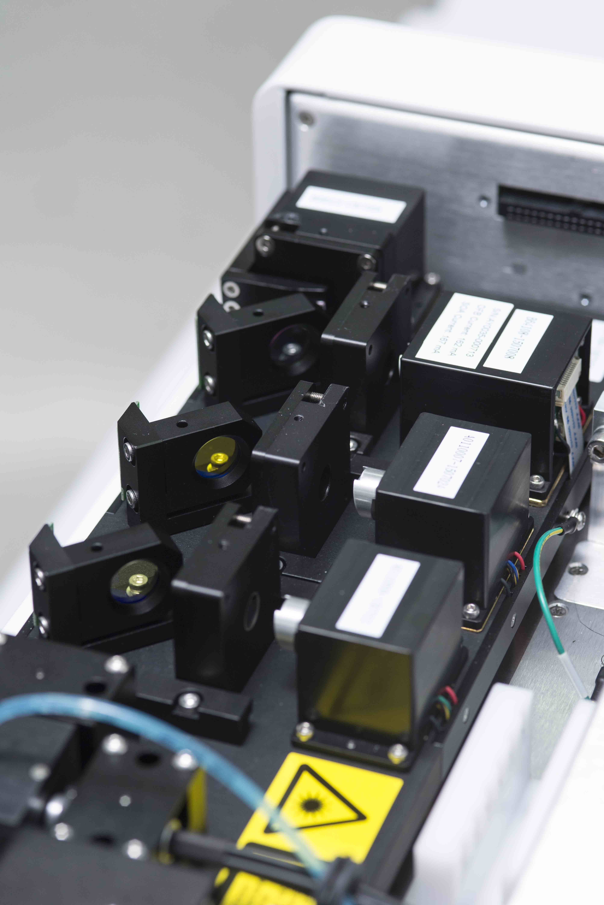
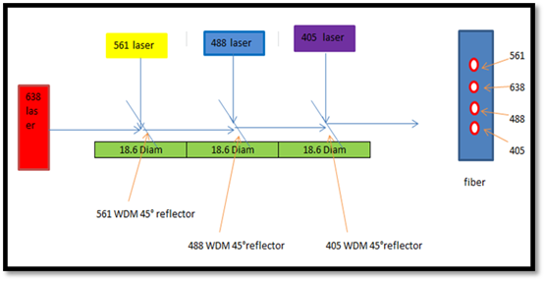
Beckman CytoFlex
3,4,5,6,+
Solid state lasers in a tiny space

Slide 44
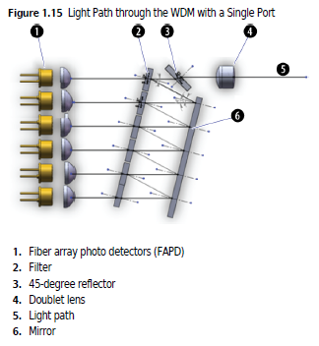
CytoFlex

Slide 45
CYtoFlex (Beckman Coulter)
Fiber optic delivery

Slide 46
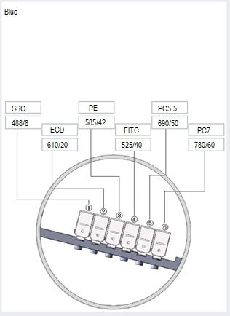
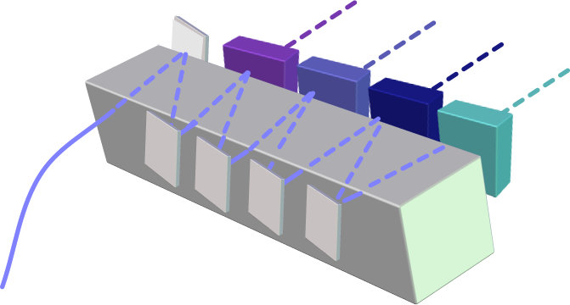
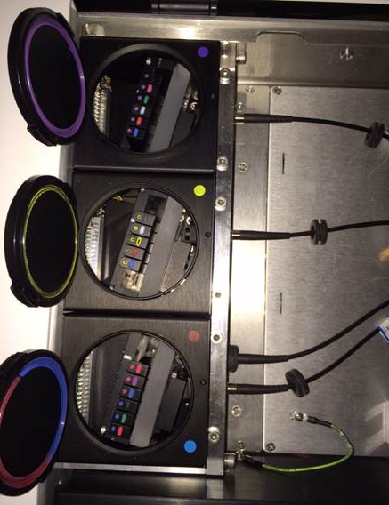
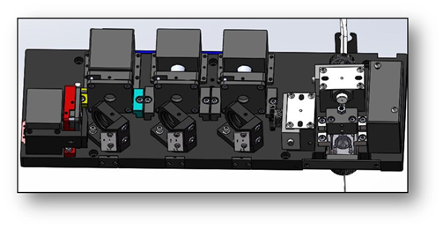
CytoFlex (Beckman Coulter)
Wavelength Division Multiplexing

Slide 47
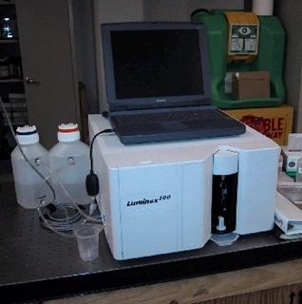
Luminex Cytometer
Slide from Howard Shapiro

Slide 48
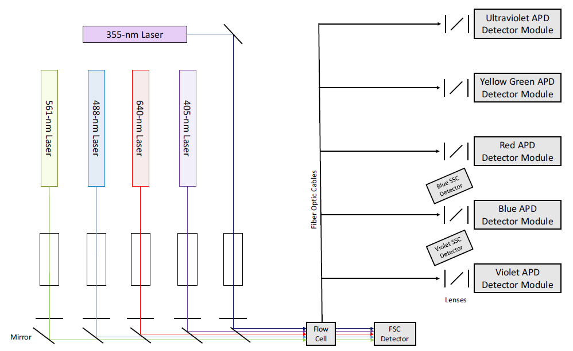
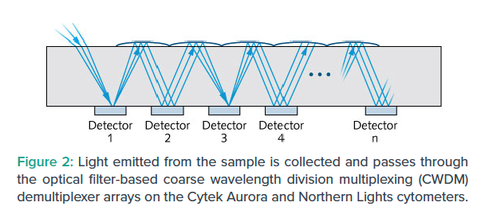
Cytek- Aurora
(DE)
Source: Cytek Aurora User’s Guide, N9-20006 Rev. B, June 2019
48

Slide 49
ACEA Quanteon Instrument

Slide 50
Quanteon uses SiPMs

Slide 51
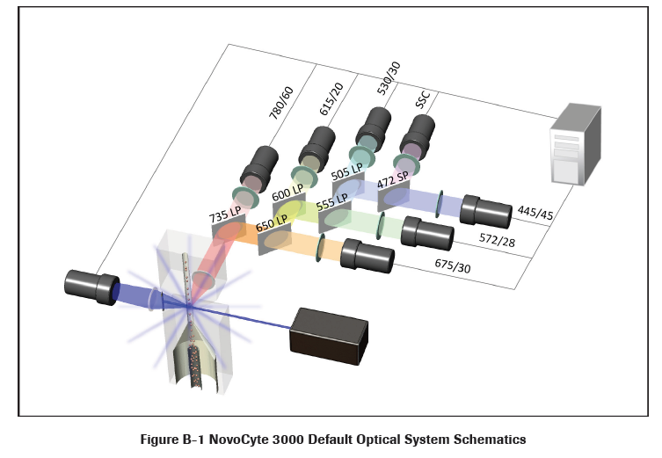
Agilent-ACEA - NovoCyte

Slide 52
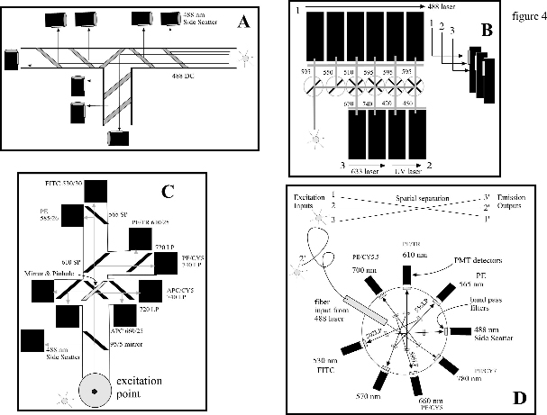
Comparison of Optical Systems

Slide 53
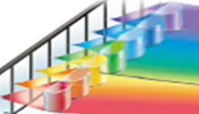
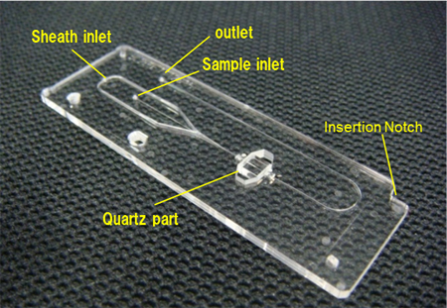
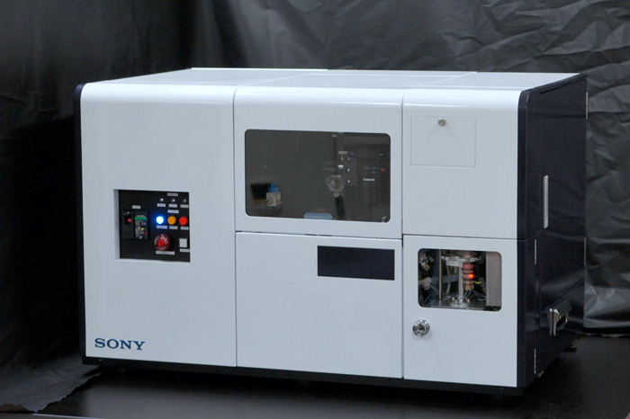
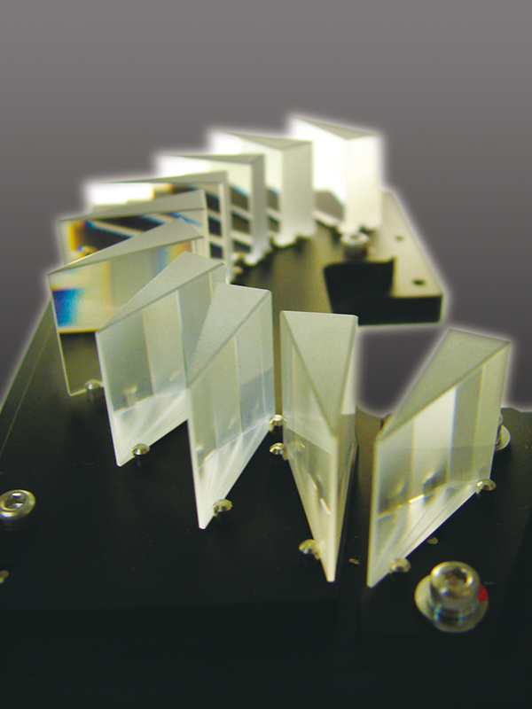
Sony 6800 Spectral

Slide 54
Purdue Spectral system - FC500
Fiber to
spectrometer

Slide 55
Purdue Spectral systemFC500
Scatter signals Controller
32 Ch PMT
64 Ch electronics

Slide 56
Summary Slide
Light propagation and image planes
Polychromatic instruments use optical filters to separate the spectrum
Each cytometer has a different optical path
Different instruments specialize in certain detection methods
Some instruments use PMTs, other APDs and even some use SiPMs
All instruments are capable of using more than one laser, but some can use up to 7
Spectral instruments have very different optical pathways to polychromatic instruments

