Slide 1
Advanced Flow Cytometry
J. Paul Robinson & John Nolan

Slide 2
Multiplexed Analysis of Soluble Analytes
Short Course
John P. Nolan
Scintillon Institute
San Diego, CA
jnolan@Scintillon.org

Slide 3
Learning Objectives
Microparticle-based molecular analysis
Multiplexed encoding of microparticles
Applications
Immunoassay
Nucleic acid analysis
Molecular interactions

Slide 4
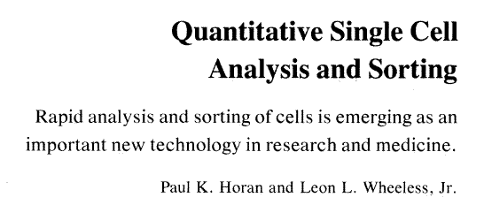
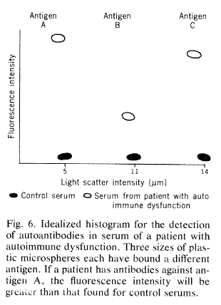
Beads in Flow Cytometry
Alignment
Calibration
Quantification
Compensation
Solid supports for molecular analysis

Slide 5
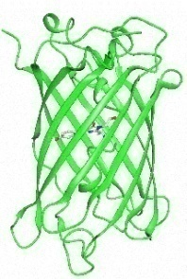
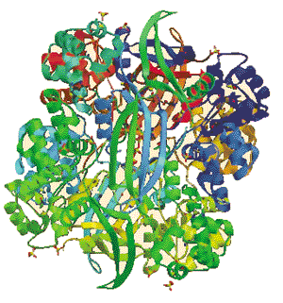
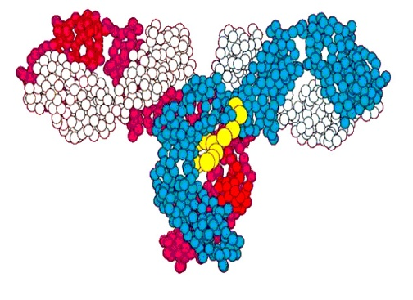
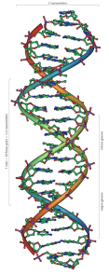
Microsphere-based Molecular Assembly
microsphere
Immobilization Fluorescent labels
DNA: avidin-biotin, covalent synthetic, enzymatic
Protein: affinity tags chemical, expressed
Lipid: adsorption, self assembly synthetic, enzymatic
Glycan: avidin-biotin, covalent synthetic

Slide 6
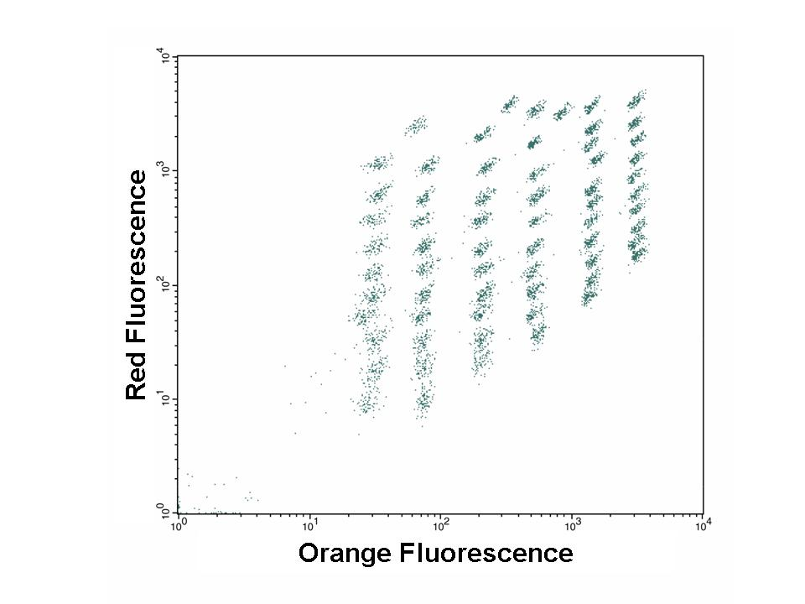
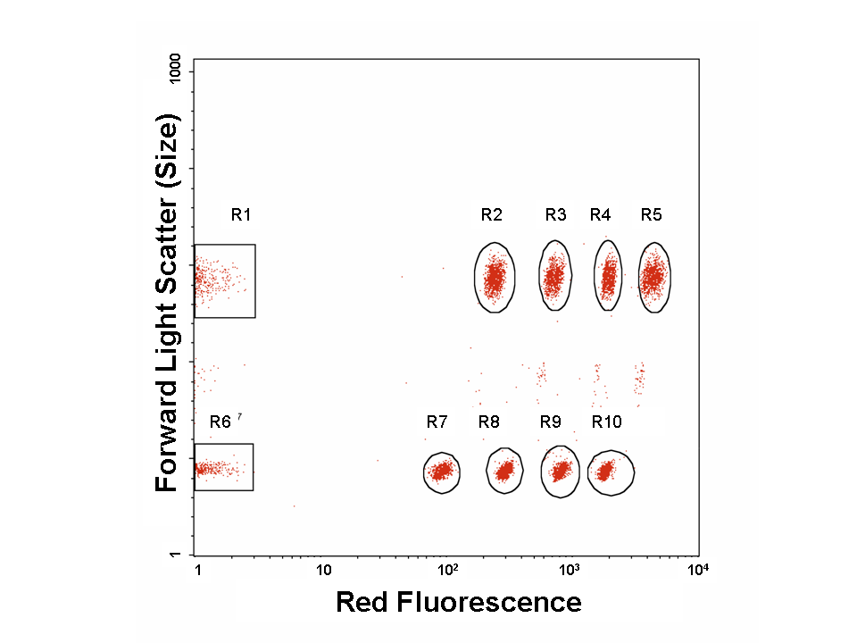
Multiplexing Microspheres
Multiple colors
Luminex
Becton Dickenson
Size and color
QuantumPlex – Polysciences
Cytoplex – Duke Scientific
Sphero - Spherotech
Size
Many, do it yourself

Slide 7
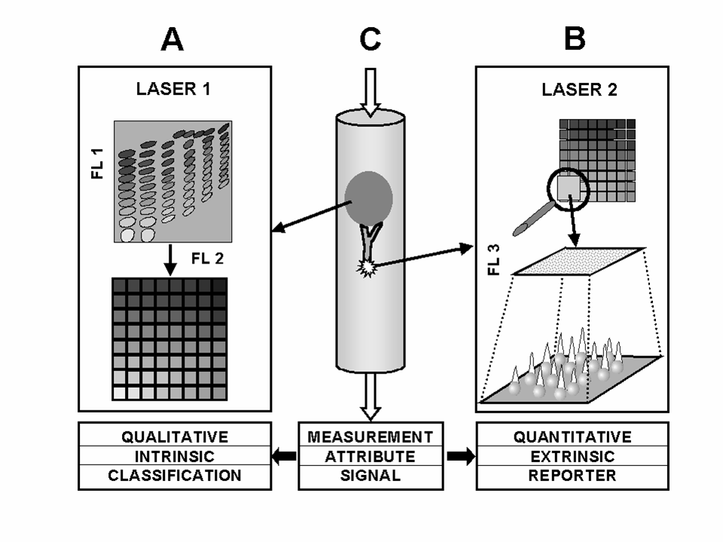
Multiplexed Assay Concept

Slide 8
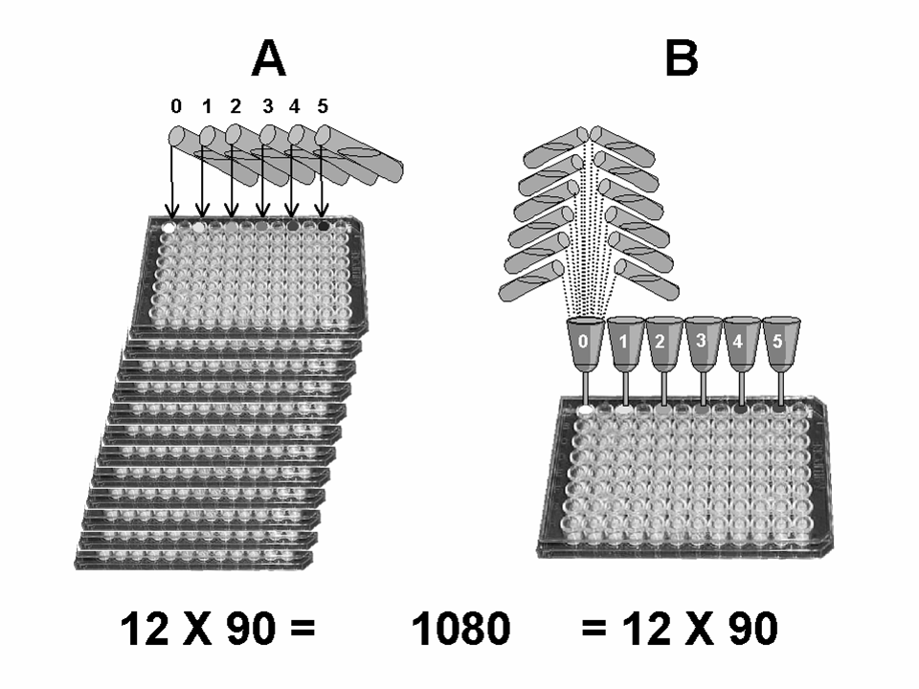
Throughput Advantages
100 X 90 = 9000 = 100 X 90

Slide 9
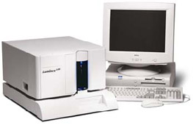
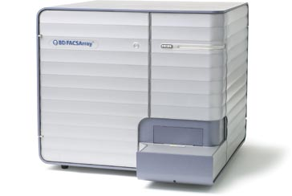
Instruments
Dedicated Bead Reader
Luminex 100 (BioPlex, LiquiChip, etc)
Multipurpose
BD FACSArray
Any flow cytometer

Slide 10
Multiplexed Analysis Methods
Immunoassays
Multiplexed ELISAs
Nucleic Acid Analysis
Soluble DNA chips
Molecular Assembly and Screening
Basic research
Drug discovery

Slide 11
Immunoassay

Slide 12
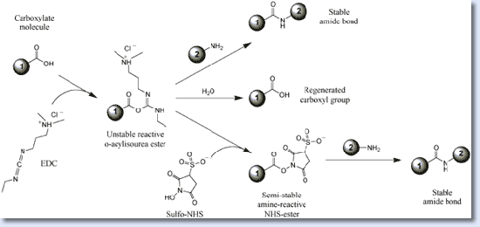
Capture Considerations
Antibody: Affinity, specificity
Good monoclonals
Immobilization: Stability, sensitivity
Physical adsorption
Protein G
Covalent attachment
Pierce

Slide 13
Capture Bead Characterization
Labeled analyte
Active binding sites
Affinity of capture
Labeled antibody
Immobilized antibody
Fluorogenic protein stain
Immobilized protein

Slide 14
Reporter Considerations
Antibody: Affinity and specificity
Good monoclonal, distinct epitope
ELISA antibody pairs
Labeling
Direct fluorescence, OK for wash protocols
Biotin/fluorescent avidin, best for no wash

Slide 15
Washing
Centrifugation + resuspension
Cumbersome for large numbers of samples; loss of beads due to clumping, sticking
Filtration
Better for large scale apps; blocking
Magnet
Should be good
None
Faster processing; higher backgrounds

Slide 16
Immunoassay Protocols
Step | Protocol A | Protocol B
1 | Sample + beads (4°C overnight) | Sample + beads (RT, 2 hours)
2 | Wash 2x | Fluorescent reporter (RT, 30 min)
3 | Biotinylated reporter Ab (RT, 1 hour) | Wash
4 | Fluorescent streptavidin (RT, 30 min) | Measure
5 | Wash 3x
6 | Measure

Slide 17
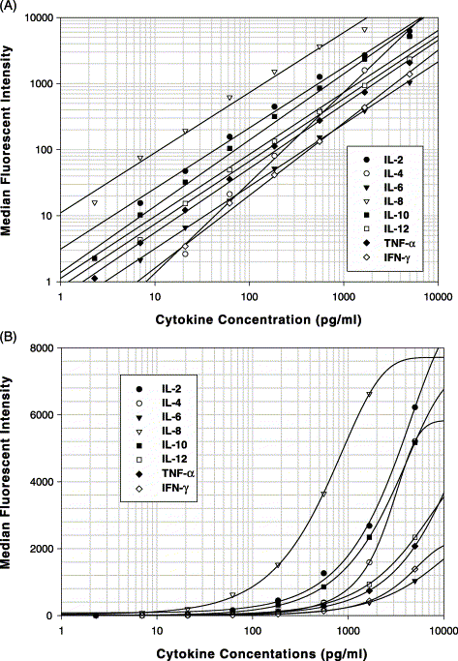
Data Analysis
Linear fit (log-log)
4 Parameter logistic fit (semilog)
5 parameter logistic fit
Kellar and Douglass (2003) J Immun Meth

Slide 18
Immunoassay Summary
Multiplexed assays provide comparable sensitivity to conventional ELISA assays
Greatly improved throughput and sample use efficiency
Many kits commercially available
Protocols for assay development well established

Slide 19
Genetic Analysis
Sequence Detection: Is it there?
Pathogen detection – Yes or No
Sequence Analysis: A or T, or C, or G
Disease diagnostics
Gene mapping
Sequence Abundance: How much is there?
Gene expression
Relative: increase/decrease relative to control
Absolute: moles or moles/L

Slide 20
Capture Considerations
DNA immobilization
Physical adsorption: glass beads
Covalent conjugation: EDC of amino oligos
Target
Oligonucleotides
Single stranded DNA
Double stranded DNA

Slide 21
Reporter Considerations
Oligonucleotide hybridization
Nucleotide incorporation
Direct Labeling
Indirect Labeling
Amplification

Slide 22
Nucleic Acid Analysis
Hybridization

Slide 23
Nucleic Acid Analysis
Single Base Extension

Slide 24
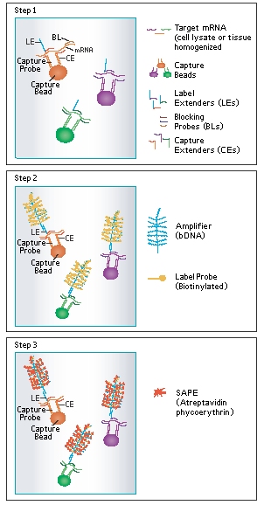
Gene Expression (mRNA)
Plex Set 1003: ABCB1, ABCB4, ABCB11, ABCC1, ABCC2, ABCC3, ABCG2, GAPDH, SLC22A1, SLC22A7
Plex Set 1006: CCL2, CSF2, CX3CL1, GAPDH, ICAM1, IL6, IL8, PTGS2, SELE, VCAM1
Plex Set 1007: AICDA, CD19, CD40, CD80, CD86, FAIM3, GAPDH, ICAM1, LTA, RIPK4
Plex Set 1010: ACTB, B2M, GAPDH, HPRT1, PGK1, RPLP0
Plex Set 1011: GAPDH, GBP1, IFIT1, IFITM1, IRF1, ISG20, MX1, OAS1, PRKRA, TNFAIP3
Plex Set 1018: ABCB1, ABCB11, ABCC2, ACTB, CDKN1A, CYP1A2, CYP2B6, CYP2C9, CYP3A4, GAPDH, IFNG, IL1B, IL8, IL10, PPIB, TNF, TNFSF6, VEGF
Plex Set 1019: EBI3, GAPDH, HPRT1, IFNG, IL1A, IL1B, IL6, IL6R, IL6ST, IL12A, IL12B, IL12RB1, IL12RB2, IL15, IL17, IL17F, IL17R, IL17RC, IL18, IL23A, IL23R, IL27, IL27RA, LTA, LTB, PPIB, SDHA, TNF, TNFRSF1A, TNFRSF1B
Plex Set 1024: BAD, BAK1, BAX, BCL2, BCL2L1, PPIB
Plex Set 1025: ABCA1, ABCB1, ABCB4 , ABCB11, ABCC2 , ABCC3 , ABCC4 , ABCG2, GAPDH, HNF4A, KEAP1, NCOA1, MPP1, MPV17, NFE2L2 , NR0B2 , NR1H3 , NR1H4 , NR1I2 , NR1I3 , NR3C1 , NR5A2 , PPARA, PPARGC1A , RXRA, SLC10A1, SLCO1A2, SLCO1B1 , SLCO1B3 , TCF1
Plex Set 1026: AHR, ALAS1, ALAS2, CEBPA, CEBPB, CYP1A2, CYP2B6, CYP2C9, CYP2C19, CYP2D6, CYP2E1, CYP3A4, CYP3A5, CYP3A7, CYP4A11, CYP7A1, GAPD, PPARG, UGT1A1, UGT1A4, UGT1A6, UGT1A9, UGT2A3, UGT2B4, UGT2B7, UGT2B10, UGT2B15, UGT2B17, UGT2B28, UGT3A1
Plex Set 1035: ACTB, CCL2, CCL3, CCL4, CCL5, CCL11, CSF2, CSF3, CXCL9, CXCL10, GAPDH, IFNG, IL1B, IL2, IL4, IL5, IL6, IL7, IL8, IL10, IL12A, IL12B, IL13, IL17, IL18, LTA, PPIB, TGFB1, TNF, VEGF
Plex Set 1037: ACTB, AHR, CYP1A2, CYP1B1, CYP2A6, CYP2B6, CYP2C9, CYP2C19, CYP3A4, CYP3A5, CYP4A11, GAPDH, NR1I2, NR2I3, PPARA
Plex Set 1039: ABCA1, ABCG1, CD36, FABP4, GAPDH, PPARG, PPIB, RXRA, SCARB1
Ebioscience Quantiplex

Slide 25
microRNA Detection
Lu et al (2005)

Slide 26
Microsphere-based Molecular Assembly
microsphere
Immobilization Fluorescent labels
DNA: avidin-biotin, covalent synthetic, enzymatic
Protein: affinity tags chemical, expressed
Lipid: adsorption, self assembly synthetic, enzymatic
Glycan: avidin-biotin, covalent synthetic

Slide 27
Nucleic Acid Analysis Summary
Kits and reagents becoming available
Oligonucleotides provide numerous opportunities for high-level multiplexing and signal amplifciation
Many potential configurations of caputer oligos, reporter probes, amplification: application-specific

Slide 28
Summary
Optically-encoded beads enable multiplexed solid phase assays
Sandwich immunoassays
Nucleic acid-based assays
Any molecular assembly or interaction

Slide 29
Protocols and More Info
Chapter 1 Flow Cytometry Instrumentation
Chapter 2 Image Cytometry Instrumentation
Chapter 3 Safety Procedures and Quality Control
Chapter 4 Molecular and Cellular Probes
Chapter 5 Specimen Handling, Storage, and Preparation
Chapter 6 Phenotypic Analysis
Chapter 7 Nucleic Acid Analysis
Chapter 8 Molecular Cytogenetics
Chapter 9 Studies of Cell Function
Chapter 10 Data Processing and Analysis
Chapter 11 Microbiological Applications
Chapter 12 Cellular and Molecular Imaging
Chapter 13 Multiplexed and Microparticle‐Based Analyses
Introduction
UNIT 13.1 Multiplexed Microsphere-Based Flow Cytometric Immunoassays
UNIT 13.2 Microsphere Surface Protein Determination Using Flow Cytometry
UNIT 13.3 Use of Microsphere-Supported Phospholipid Membranes for Analysis of Protein-Lipid Interactions
UNIT 13.4 Multiplexed SNP Genotyping Using Primer Single-Base Extension (SBE) and Microsphere Arrays
UNIT 13.5 BeadCons: Detection of Nucleic Acid Sequences by Flow Cytometry
UNIT 13.6 Characterization of Nuclear Receptor Ligands by Multiplexed Peptide Interactions
UNIT 13.7 Detection of Gene Fusions in Acute Leukemia Using Bead Microarrays
UNIT 13.8 Reagents and Instruments for Multiplexed Analysis Using Microparticles
UNIT 13.9 Multiplexed Detection of Fungal Nucleic Acid Signatures
UNIT 13.10 Multiplexed Analysis of Peptide Antigen-Specific Antibodies
UNIT 13.11 Use of Flow Cytometric Methods to Quantify Protein-Protein Interactions
UNIT 13.12 Microsphere-Based Flow Cytometry Protease Assays for Protease Activity Detection & High-Throughput Screening
UNIT 13.13 Application of the PrimRglo Assay Chemistry to Multiplexed Bead Assays
UNIT 13.14 Flow Cytometry of Extracellular Vesicles: Potential, Pitfalls, and Prospects
UNIT 13.15 Optimized MOL-PCR for Characterization of Microbial Pathogens

