Slide 1




3 - Fluidics and Intro to cell sorting
Short Course
J. Paul Robinson
The SVM Professor of Cytomics
Professor of Biomedical Engineering
Director, Purdue University Cytometry Laboratories
@Cytometryman

Slide 2
Basics of Flow Cytometry
Fluidics:
cells in suspension
flow in single-file through
an illuminated “volume” where they
scatter light and emit fluorescence
that is collected, filtered and
converted to digital values

Slide 3
Flow Cytometry:
The use of focused light (lasers) to interrogate cells delivered by a hydrodynamically focused fluidics system.
Sheath
fluid
Flow Chamber
Fluorescence
signals
Focused laser
beam

Slide 4
Fluidics - Differential Pressure System
From C. Göttlinger, B. Mechtold, and A. Radbruch

Slide 5
Fluidics Systems
Positive Pressure Systems
  Based upon differential pressure
  between sample and sheath fluid.
  Require balanced positive pressure
  via either air or nitrogen
  Flow rate varies between 2-10 ms⁻¹
Flow Chamber
+ + +
+ + +
+ + +
Positive Displacement Syringe Systems
  1-2 ms⁻¹ flow rate
  Fixed volume (50 μl or 100 μl)
  Absolute number calculations possible
  Usually fully enclosed flow chambers
3-way valve
Flow Chamber
Syringe
100 μl
Sample
Waste
Sample loop
Peristaltic Pump based Systems
  variable flow rate
  “semi” fixed volume (time based)
  Absolute number calculations possible
Flow Chamber
+ + +
+
Peristaltic
Pump

Slide 6
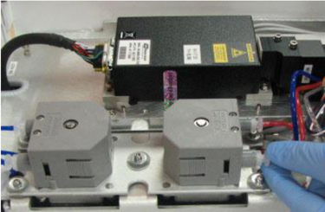
Technical Components
Fluidics
+ive Pressure Systems
      EPICS C (Coulter)
      EPICS 5 & 7, Elite series
      Altra, next Gen
      FacStar (B-D), Aria
      FacsVantage (B-D)
      MoFlo
      Brucker
      Profile (Coulter)
      XL (Coulter), FC500, Gallios
      FACScan, Canto (B-D)
      FACS Caliber
      FACSAria
      FACSJaz
      Influx
+ive Displacement Systems
      Attune Cytometer
      Harald Steen’s instrument
      Some early Partec systems
Peristalitc Pumps
      BD Accuri’
      BC Cytoflex
Syringe Drive Systems
      Bryte HS
      Cytotron Absolute
Peristaltic pump from Accuri
(from BD website)

Slide 7
Hydrodynamics and Fluid Systems
Cells are always in suspension
The usual fluid for cells is saline
The sheath fluid can be saline or water
The sheath must be saline for sorting
Samples are driven either by syringes or by pressure systems

Slide 8
Fluidics
Need to have cells in suspension flow in single file through an illuminated volume
In most instruments, accomplished by injecting sample into a sheath fluid as it passes through a small (50-300 µm) orifice

Slide 9
Fluidics
When conditions are right, sample fluid flows in a central core that does not mix with the sheath fluid
This is termed Laminar flow

Slide 10
Fluidics - Laminar Flow
Whether flow will be laminar can be determined from the Reynolds number
When R_{e} < 2300, flow is always laminar
When R_{e} > 2300, flow can be turbulent

Slide 11
Fluidics
The introduction of a large volume into a small volume in such a way that it becomes “focused” along an axis is called Hydrodynamic Focusing

Slide 12
Fluidics
The figure shows the mapping between the flow lines outside and inside of a narrow tube as fluid undergoes laminar flow (from left to right). The fluid passing through cross section A outside the tube is focused to cross section a inside.
From V. Kachel, H. Fellner-Feldegg & E. Menke - MLM Chapt. 3

Slide 13
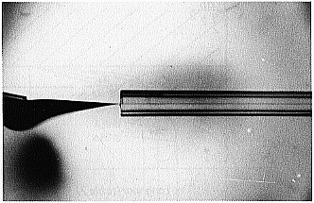
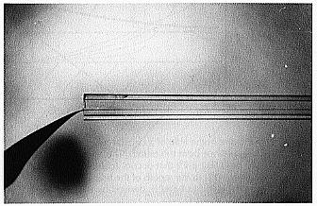
Fluidics
Notice how the ink is focused into a tight stream as it is drawn into the tube under laminar flow conditions.
Notice also how the position of the inner ink stream is influenced by the position of the ink source.
V. Kachel, H. Fellner-Feldegg & E. Menke - MLM Chapt. 3

Slide 14
Fluidics
How do we accomplish sample injection and regulate sample flow rate?
  Differential pressure
  Volumetric injection
  Peristaltic Pump
[RFM]

Slide 15
Fluidics - Differential Pressure System
Use air (or other gas) to pressurize sample and sheath containers
Use pressure regulators to control pressure on each container separately
[RFM]

Slide 16
Fluidics - Differential Pressure System
Sheath pressure will set the sheath volume flow rate (assuming sample flow is negligible)
Difference in pressure between sample and sheath will control sample volume flow rate
Control is not absolute - changes in friction cause changes in sample volume flow rate
[RFM]

Slide 17
Fluidics - Volumetric Injection System
Use air (or other gas) pressure to set sheath volume flow rate
Use syringe pump (motor connected to piston of syringe) to inject sample
Sample volume flow rate can be changed by changing speed of motor
Control is absolute (under normal conditions)
[RFM]

Slide 18
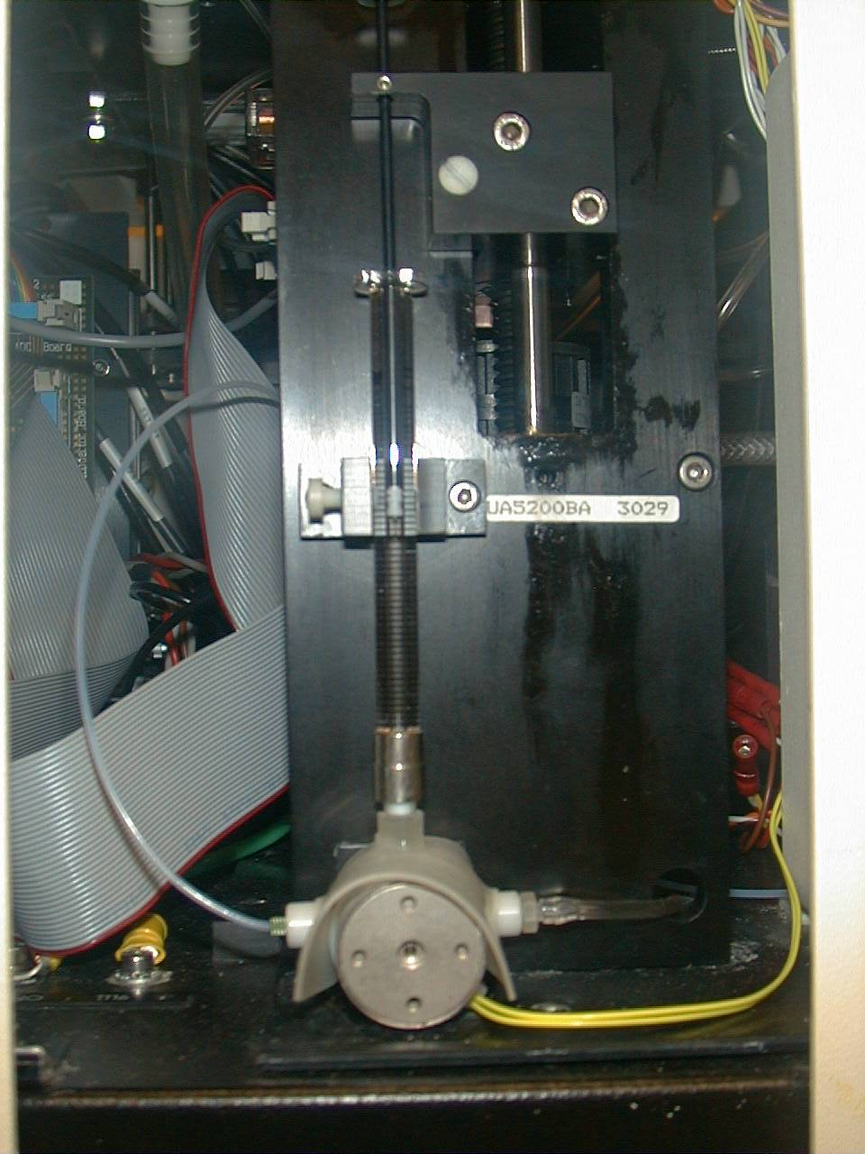
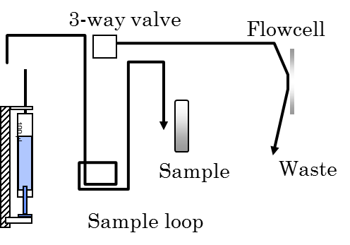
Syringe systems
Bryte HS
Cytometer
Syringe
3 way valve
Photo: J. P Robinson

Slide 19
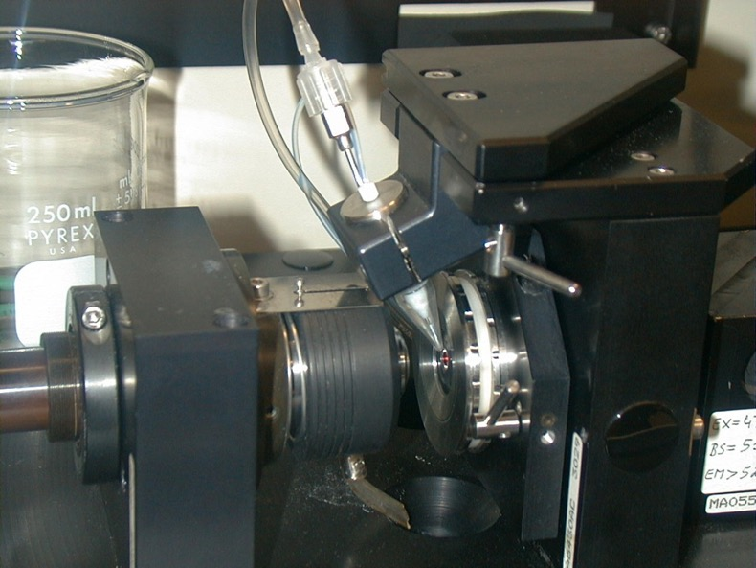
Fluidics - Volumetric Injection System
Photo: J. P Robinson
Source: H.B. Steen - MLM Chapt. 2

Slide 20
Hydrodynamic Systems – Steen system
Signals
Flow
Chamber
Coverslip
Waste
Flow
Chamber
Coverslip
Signals
Microscope
Objective
Microscope
Objective
Waste

Slide 21
Fluidics - Particle Orientation and Deformation
When cells (or other particles) are hydrodynamically focused, they experience shear stresses on different points on their surfaces (and in different locations in the stream)
These stresses cause cells to orient with their long axis (if any) along the axis of flow
The shear stresses can also cause cells to deform (e.g., become more cigar-shaped)

Slide 22
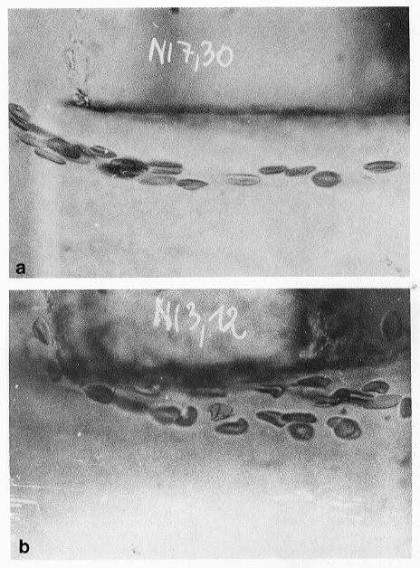
Fluidics - Particle Orientation and Deformation
“a: Native human erythrocytes near the margin of the core stream of a short tube (orifice). The cells are uniformly oriented and elongated by the hydrodynamic forces of the inlet flow.
b: In the turbulent flow near the tube wall, the cells are deformed and disoriented in a very individual way. v>3 m/s.”
Image fromV. Kachel, et al. – Melamed Chapt. 3

Slide 23
Fluidics - Flow Chambers
The flow chamber
  defines the axis and dimensions of sheath and sample flow
  defines the point of optimal hydrodynamic focusing
  can also serve as the interrogation point (the illumination volume)

Slide 24
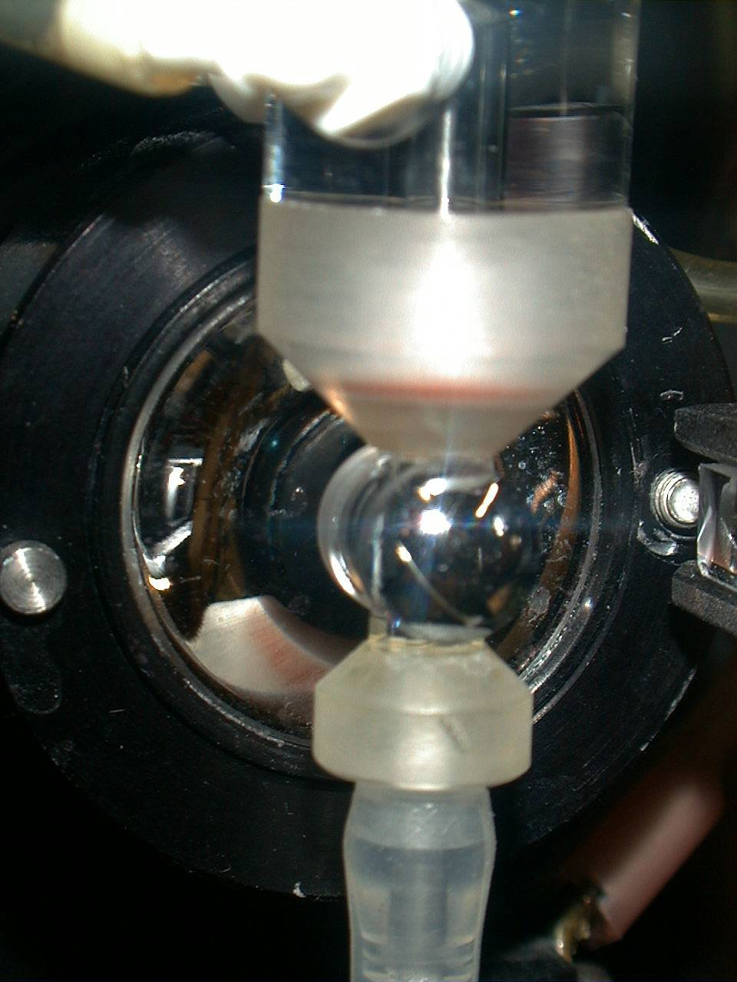
Closed flow Chambers
Laser direction
Forward Scatter detector
Fluorescence
signals
Photo: J. P Robinson

Slide 25
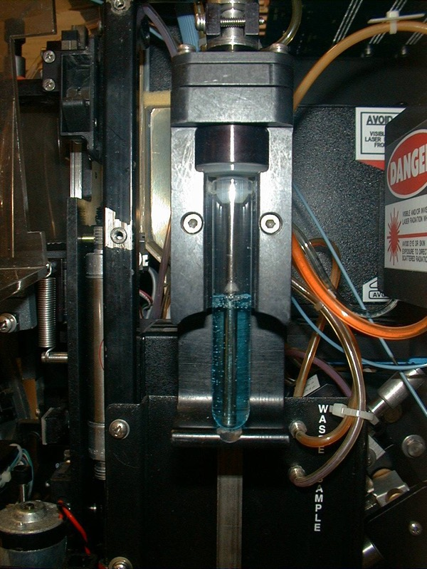
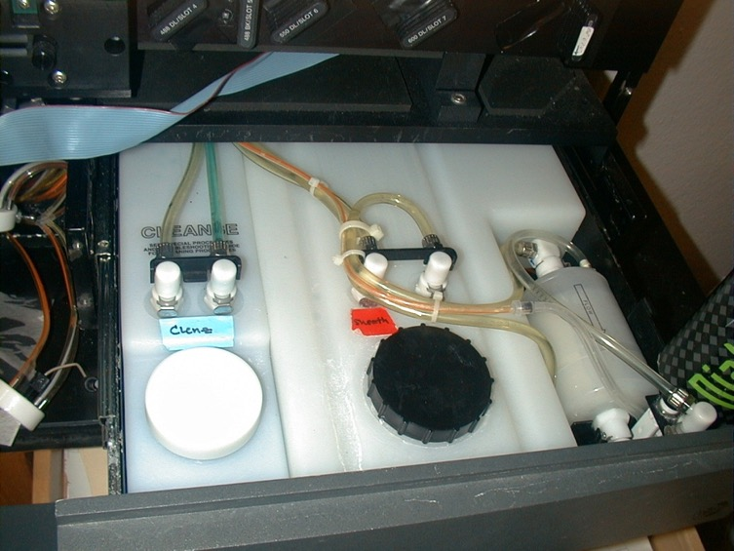
Coulter XL
Sheath and waste system
Sample tube
Photo: J. P Robinson

Slide 26
Fluidics - Flow Chambers
Four basic flow chamber types
  Jet-in-air
    best for sorting, inferior optical properties
  Flow-through cuvette
    excellent optical properties, can be used for sorting
  Closed cross flow
    best optical properties, can’t sort
  Open flow across surface
    best optical properties, can’t sort

Slide 27
Fluidics - Flow Chambers
Flow through cuvette (sense in quartz)
H.B. Steen - MLM Chapt. 2

Slide 28
Fluidics - Flow Chambers
Closed cross flow chamber
H.B. Steen - MLM Chapt. 2

Slide 29
Hydrodynamic Systems
Sample in
Sheath
Piezoelectric
crystal oscillator
Sheath in
Fluorescence
Sensors
Laser beam
Scatter Sensor
Sheath
Core

Slide 30
Hydrodynamically focused fluidics

Slide 31
Hydrodynamically focused fluidics
Signal
Increase sample pressure:
Widen Core
Increase turbulence

Slide 32
Hydrodynamic Systems
Injector
Tip
Flow Chamber
Sheath
fluid
Fluorescence
signals
Focused laser
beam

Slide 33
Hydrodynamic Systems – Increase Sample Pressure
Injector
Tip
Flow Chamber
Sheath
fluid
Fluorescence
signals
Focused laser
beam
Increase sample pressure:
Widen Core
Increase turbulence

Slide 34
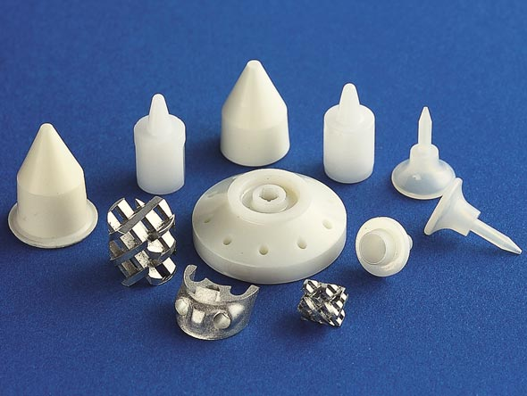
Example of manufacturer of chambers
http://www.smallprecisiontools.com/products-and-solutions/fine-ceramics-solutions/introduction-in-ceramic-technologies/?oid=697&lang=en

Slide 35
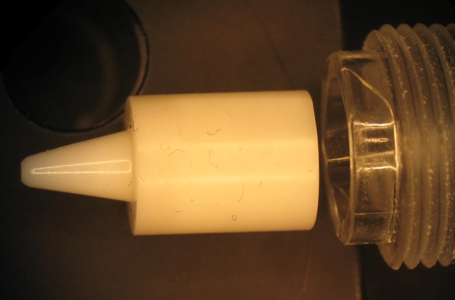
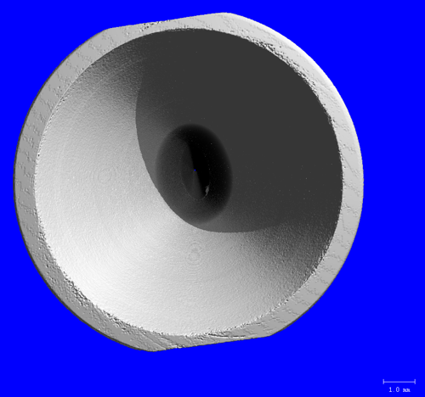
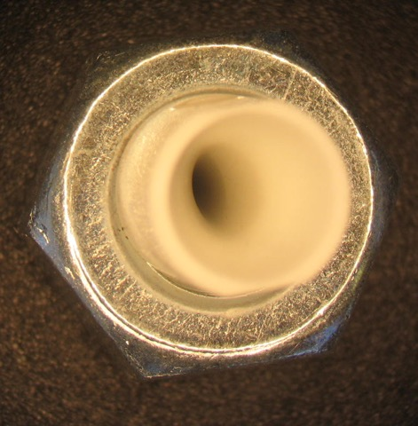
Inside a flow chamber
A 3D reconstruction from a flow chamber
http://www.smallprecisiontools.com/products-and-solutions/fine-ceramics-solutions/introduction-in-ceramic-technologies/?oid=697&lang=en

Slide 36

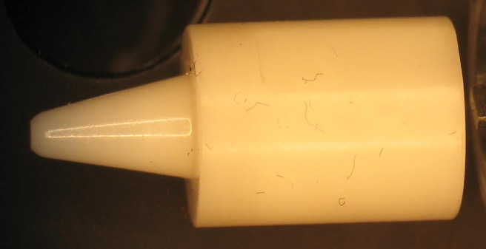
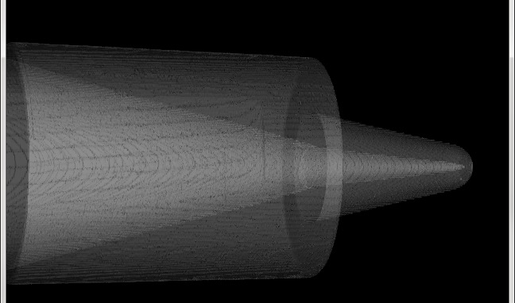
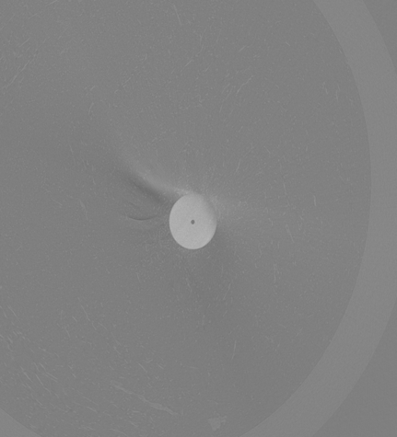
Different chambers can have variable internal shapes
Solid Nozzle
Nozzle
50-250 microns

Slide 37
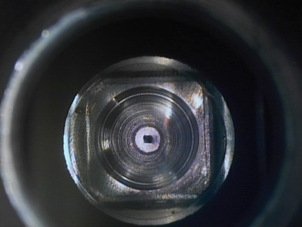
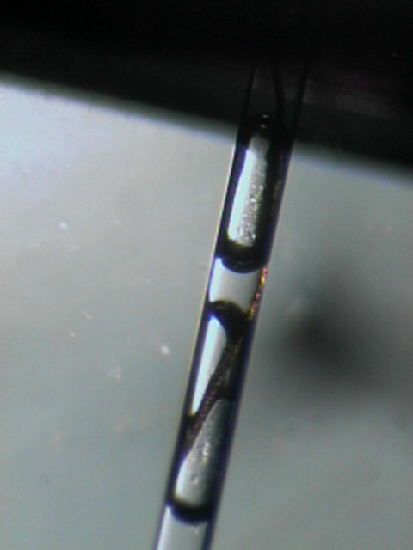
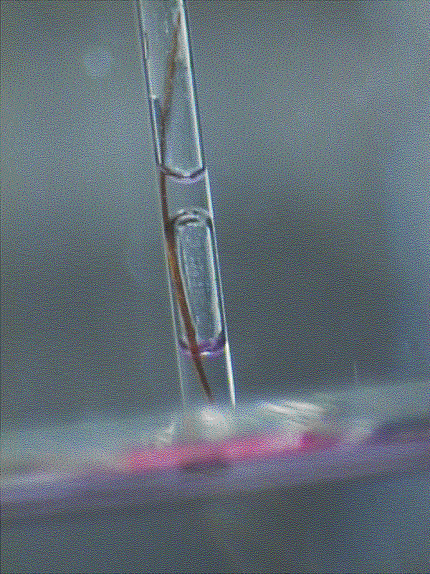
Flow chamber blockage
A human hair blocks the flow cell channel. Complete disruption of the flow results.
Photos: J. P Robinson

Slide 38
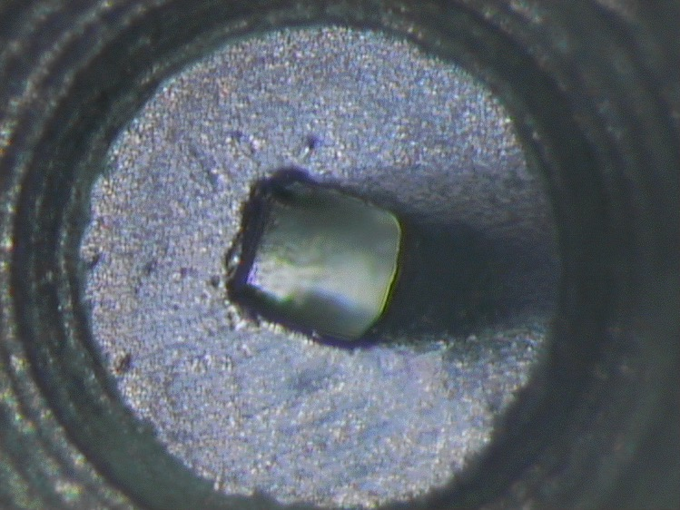

What happens when the channel is blocked?
Photo: J. P Robinson

Slide 39
Note about analyzers
Closed tube
Carrying waste
Sample in
Sheath
Analyzers typically run their flow chambers upside down!
This is to allow any bubbles to rise and not cause problems with the sample
Most are closed systems that are safer and have no open sample
Sheath in
Laser beam
Sheath
Core

Slide 40
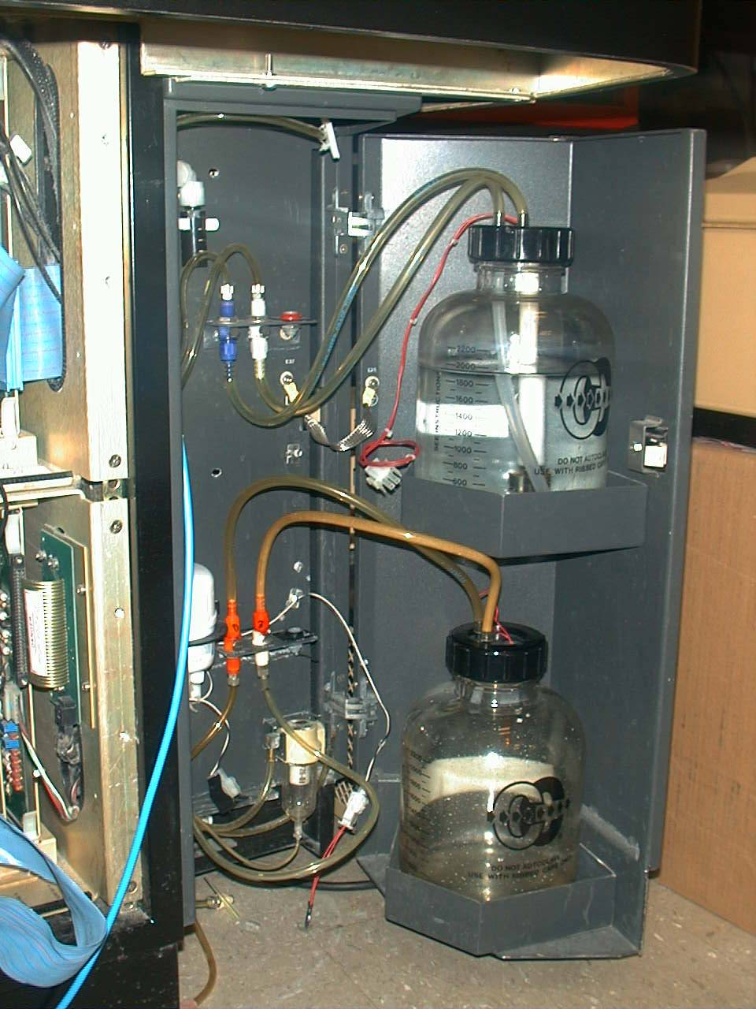
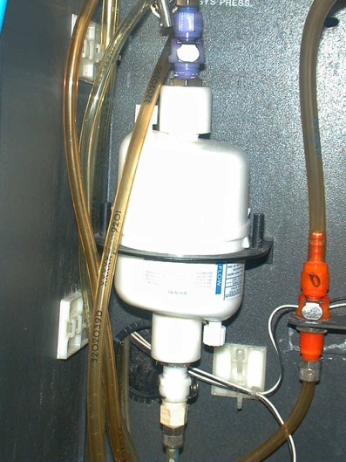
Sheath and waste systems
Epics Elite
Sheath
fluid
Waste
container
Sheath Filter Unit
Low Pressure
Sheath and
Waste bottles
Photo: J. P Robinson

Slide 41
The Elements of Flow Sorting
Sample Preparation
Hardware Setup
Droplet formation
Timing
Coincidence - Purity and Efficiency
Sterile Sorting Concepts

Slide 42
Optical Design
PMT 5
PMT 4
Sample
PMT 3
Dichroic
Flow cell
Filters
PMT 2
Scatter
PMT 1
Laser
Sensor
Bandpass
Filters

Slide 43
Sample Preparation for Sorting
The sample must be a single cell suspension
The suspending fluid must be an electrolyte i.e. must conduct electricity
High sample concentration is required to obtain adequate numbers
Rare populations are very difficult to sort and require special attention (not dealt with in this section)

Slide 44
Cell Sorting
The basics...
Cell sorters are different from cell analyzers.
Both can analyze but only one can physically sort.
Cell sorters can physically separate particles or cells into pure or almost pure populations based on a variety of criteria.
In the 1970s, Len and Lee Herzenberg (at Stanford) created the acronym FACS which became a BD trademark – it stood for Fluorescence Activated Cell Sorting.
Many people use FACS to refer to flow cytometry, but it really is both really referring to sorting, and since it is a corporate trade-name, it is probably best to just use the generic term “cell sorting”
Sorters can operate at low ( hundreds/second) or high speed (100,000 per second)
There are lots of terms used – sort rate, frequency, sort yield, purity, last attached droplet, and many other terms….

Slide 45
Cell Sorting
488 nm laser
FALS Sensor
Fluorescence detectors
-
+
Charged Plates
(1k-10k volts)
Single cells sorted
Into left test tubes
Cells going to
waste
Single cells sorted
Into right test tubes

Slide 46
Sample in
Sheath
Stream
Charge
Figure 1 The central component of a flow cytometer is the flow cell. A cutdown of a typical flow cell indicates the salient features. Sample is introduced via the sample insertion rod. Sheath fluid (usually water or saline) is introduced to surround the insertion rod causing hydrodynamic focussing of flowing cells which are contained within a core fluid. The laser intersects the fluid either outside the flowcell (in air) or in a slightly extruded portion of the flow cell tip (in quartz).
Piezoelectric
crystal oscillator
Sheath in
Sensors
SORT DECISIONS
Laser beam
Sensor
SMALL BEAD
LARGE BEAD
Last attached
droplet
SORT LEFT
SORT RIGHT
+4KV
-4KV
Frequency Histogram
LEFT
RIGHT
Signals are collected from several sensors placed forward or at 90° to the laser beam. It is possible to “sort” individual particles. The flow cell is resonated at a frequency of approximately 32KHZ by the piezoelectric crystal mounted on the flow cell. This causes the flowing stream to break up into individual droplets. Gating characteristics can be determined from histograms (shown right) and these can be used to define the sort criteria. These decisions are all controlled by the computer system and can be made at rates of several thousand per second.
Waste
SMALL BEAD
LARGE BEAD

Slide 47
Droplet formation
As liquid is ejected into air, it will form droplets. By vibrating the nozzle at a defined frequency, the size of these droplets and the position along the stream where they form can be controlled with great precision.
Last Attached Droplet
Satelite droplet
T. Lindmo, D.C. Peters & R.G Sweet - MLM Chapt. 8

Slide 48
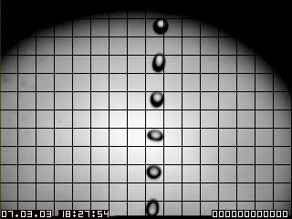
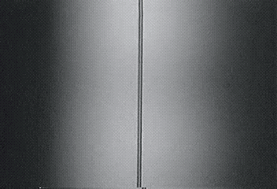
Cell Sorting
Video of the droplet formation in a sort stream from a Cytomation instrument. Source: Purdue CDROM vol 4, 1998
Video2.mpg

Slide 49
Sorting
More details on Cell Sorting will be in the Advanced Flow Course this afternoon

Slide 50
Lecture Summary
Flow must be laminar (appropriate Reynolds #)
  When R_{e} < 2300, flow is always laminar
Samples can be injected or flow via differential pressure, or pumped via a peristaltic pump
There are many types of flow chambers – it depends on what you are evaluating
The orifice of chambers can be from about 50 to 250 microns – but a rule of thumb is not to try to run particles more than about 30% of the size of the orifice
Blockages must be properly cleared to obtain high precision
Sorters can physically separate particles/cells
Sorting hazardous samples is dangerous and should only be done with proper precautions

