Slide 1
Introduction to Flow Cytometry
J. Paul Robinson & John Nolan

Slide 2
Intro to Flow Cytometry 8:30-12:00
What is flow cytometry and what is it used for
1 - How do flow cytometers work? | 30min | JPR
2-Light sources, detectors and data acquisition | 30 min | JPN
3-Fluidics and sorting | 20 min | JPR
Discussion and break | 10 min | JN
4. Basic Immunophenotyping | 30 min
5-Data processing and analysis | 20 Min | JPR
6-Multiplexedanalysis of soluble analytes | 30 min | JN
7-Measurement of cell Function | 20 min | JPR
Conclusion and discussion | 15 min | JN

Slide 3
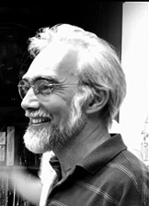



Background and History of Flow Cytometry
Short Course
J. Paul Robinson
The SVM Professor of Cytomics
Professor of Biomedical Engineering
Director, Purdue University Cytometry Laboratories
@Cytometryman

Slide 4
Learning Objectives
At the conclusion of this lecture you should know
What is flow cytometry
What is it used for
Why is it important in biology
Important historical contributions to the development of flow technology
The driving force for instrument development
Basic concepts used in flow cytometry

Slide 5
What is flow cytometry and what it it used for?
Single cells technology
Which means it is designed to evaluate properties of every cell in a sample
It uses a variety of techniques that focus on LIGHT SCATTE and FLUORESCENCE
Cells or particles in a liquid sample are pushed past a laser beam at very high speed
The signals from the intersection of the laser and the particle are the measured signals

Slide 6
What is flow cytometry and what it it used for?
Because the sample is a fluid…
Flow cytometry is very useful for biological samples
Blood, urine, cell cultures, water samples, microbial samples, beer, wine, milk
It is not useful for
solid tissue (unless it is disaggregated)
It is not useful for non-liquid-based samples

Slide 7
What is flow cytometry and what it it used for?
Flow cytometers can measure Fluorescence –
so we can use antibodies labeled with fluors
Dyes that label nucleic acids (DNA, RNA)
Dyes that label lipids
Dyes that label organelles
Dyes that have membrane potential properties
Dyes that label proteins
Flow cytometers can use laser light scatter to measure
The approximate size of cells or particles
The density or complexity of cells or particles
The number of cells or particles in a sample

Slide 8
Why is flow cytometry so useful?
We can take virtually any liquid sample and analyze it for particles or cells
We can disaggregate tissue into single cells or single nuclei and analyze these cells or nuclei
We can obtain very detailed analysis of the cellular content of a liquid sample – we can determe
How many are present
What are the sizes of all the particles (many different sizes simultaneously)
We can determine how many populations are present in a sample
We can tag cells with antibodies and determine what the cells are or where they are derived from

Slide 9
Before Flow cytometry
Before flow cytometry was developed most techniques used
spectroscopy
Imaging
Spectroscopy was moderately basic and had difficulty in defining single cells
Imaging focused on electron microscopy and fluorescence microscopy

Slide 10
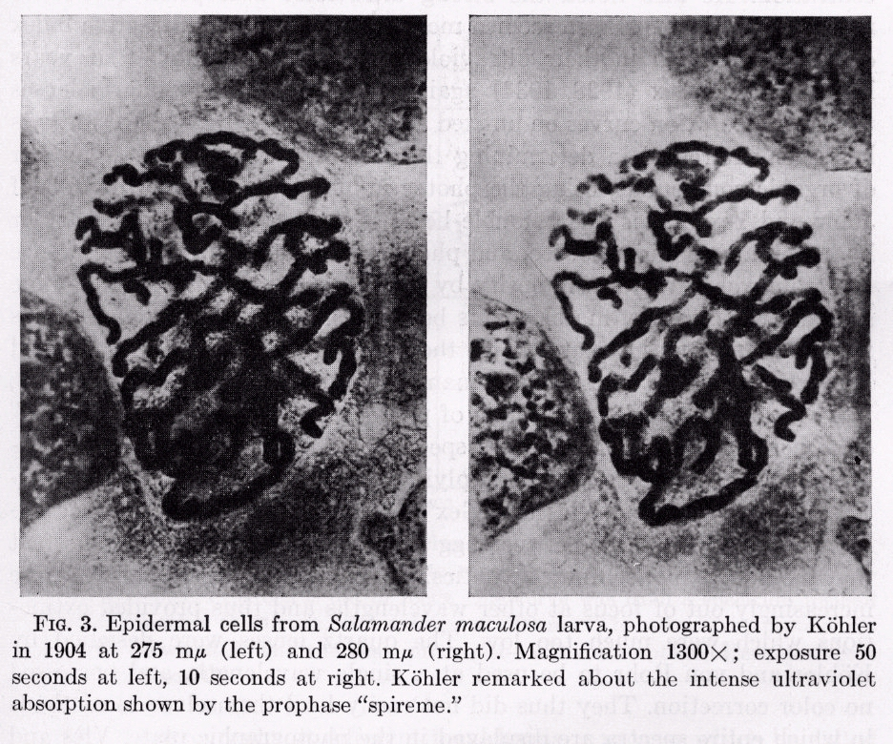
Fluorescence Imaging -A. Kohler 1904
275 nm
280 nm
Salamander maculosa larva epidermal cells - 1300 X
A. Kohler, Mikrophotographische Untersuchungen mit ultraviolettem Licht, Z. Wiss. Mikroskopie 21, 1904

Slide 11
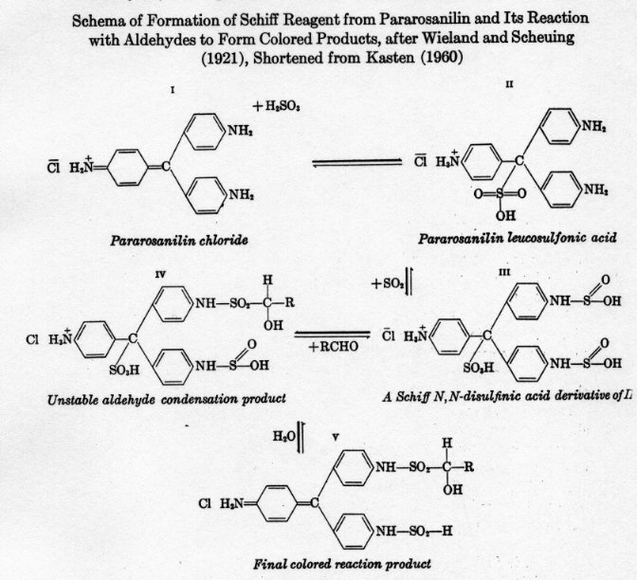
Feulgen Reaction 1924
Schema of formation of Schiff Reagent from Pararosanilin and its reaction with aldehydes to form colored products
After Wieland and Scheuing (1921)
Shortened from Kasten (1960)
R. Feulgen & H. Rossenback, Microskopisch-chemischer Nachweis einer Nucleinsaure von
Typus der Thymonucleinsaure und auf die darauf berunhende elektive Farbung von
Zellkernen in mikroskopischen Präparaten, Hoppe Seyler Z. Physiol. Chem. 135, 1924

Slide 12
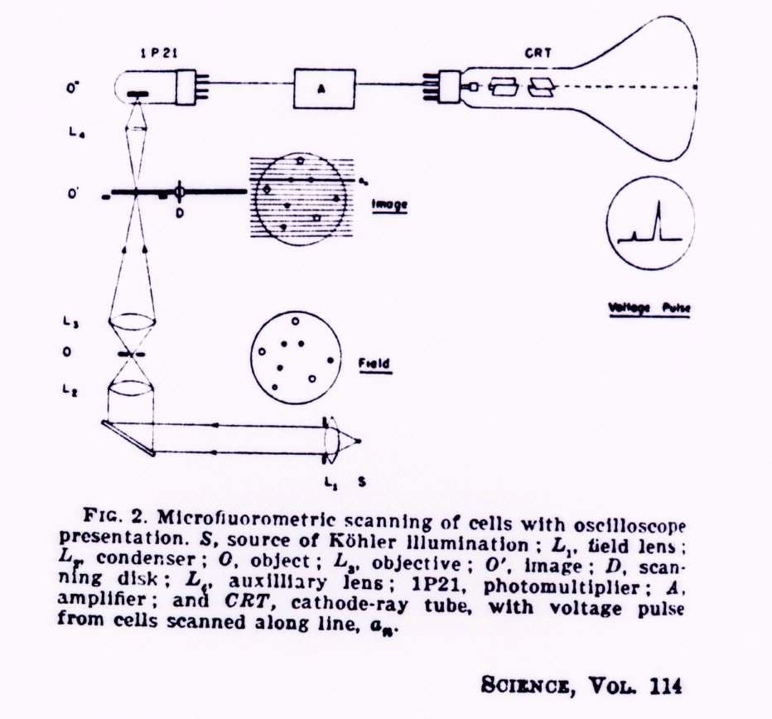
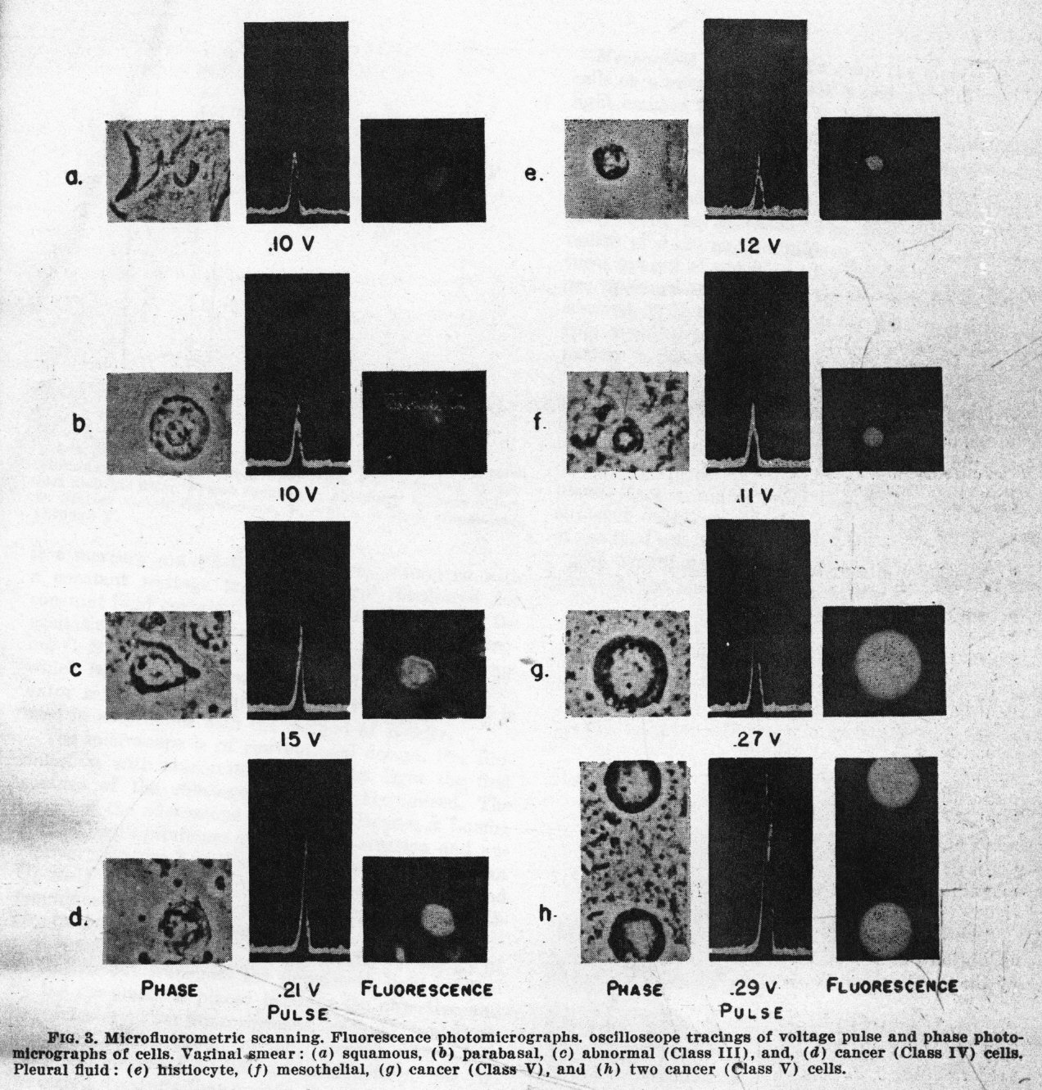
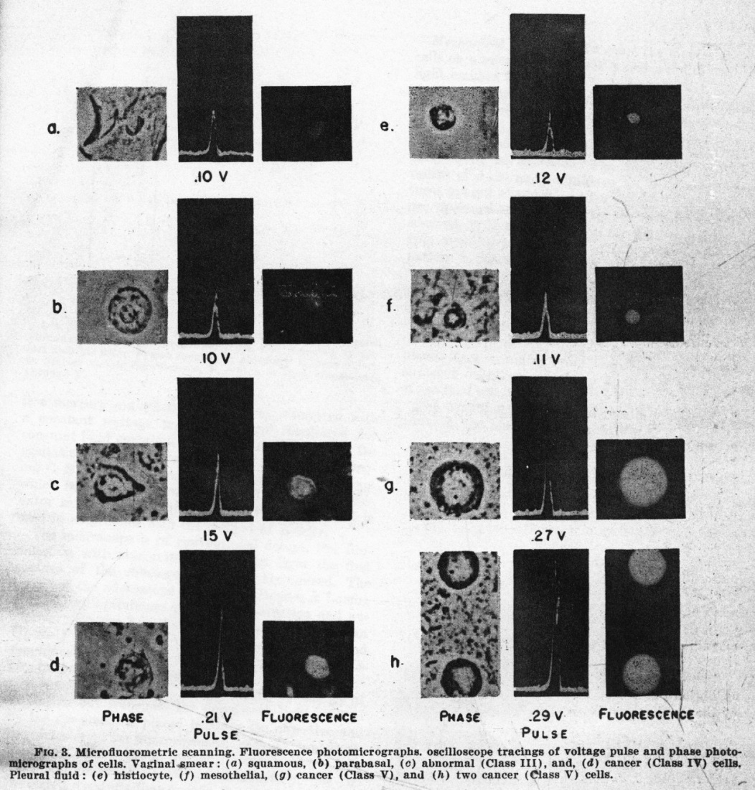
Early Microfluorometric Scanner - Robert Mellors 1951

Slide 13
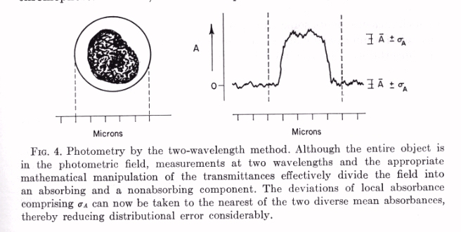
Cytometry Analytic Techniques
M.R. Mendelsohn 1958
The Two-Wavelength Method of Microspectrophotometry
J. Biophys. Biochem Cytol. 4, 1958

Slide 14
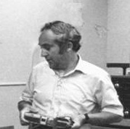
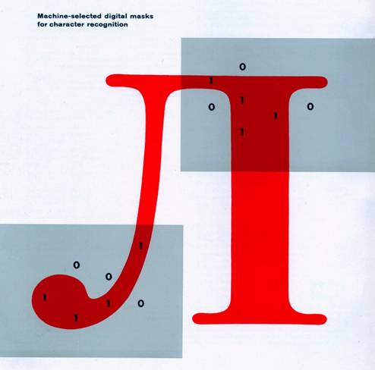
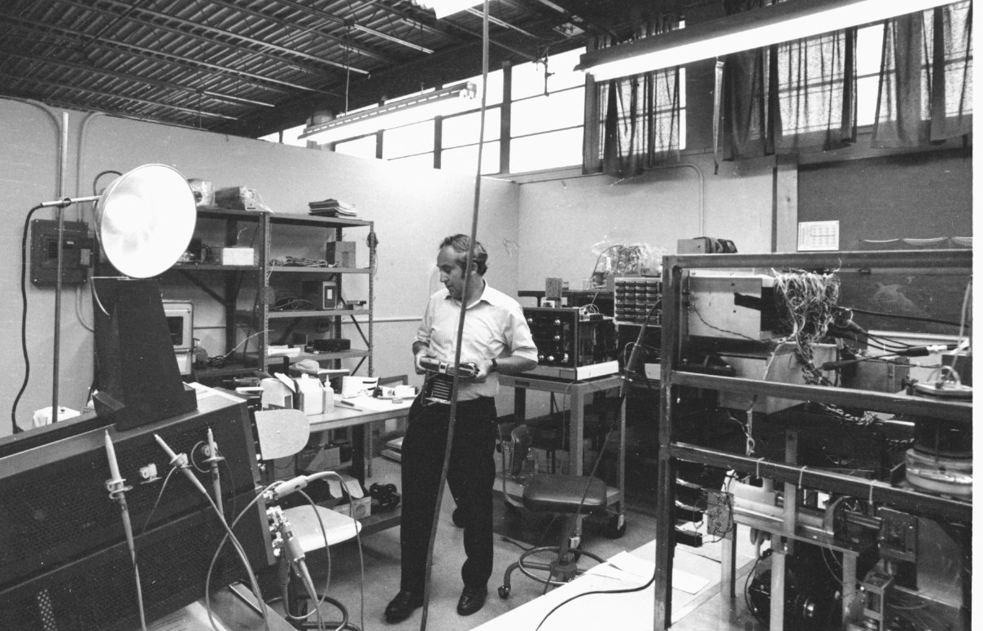
Before Cytometry
Dr. Kamentsky
LA Kamentsky & CN Liu, Computer-automated design of multifont print recognition
logic, IBM J. Research & Development 7, 1963 (ref 40705)
Slide Kindly Supplied by Compucyte
9:07 AM

Slide 15
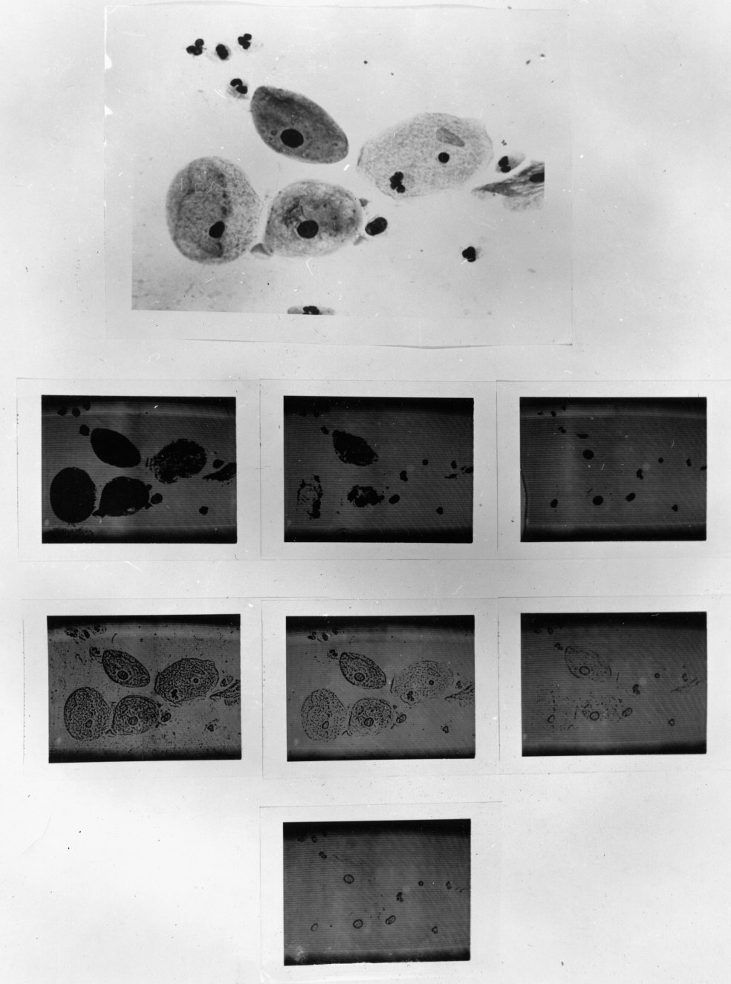
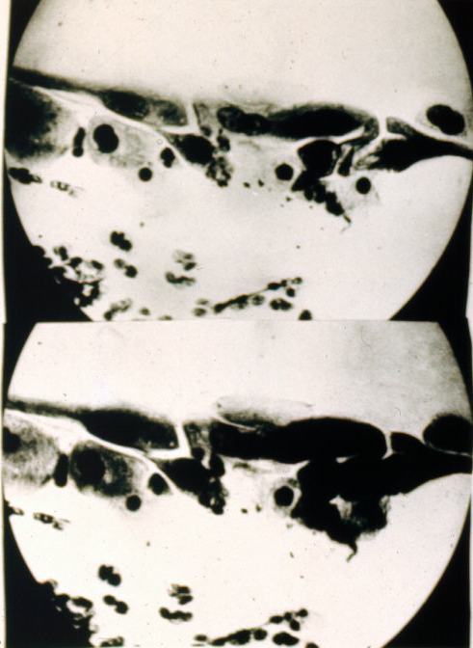
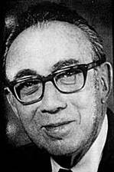
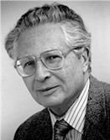
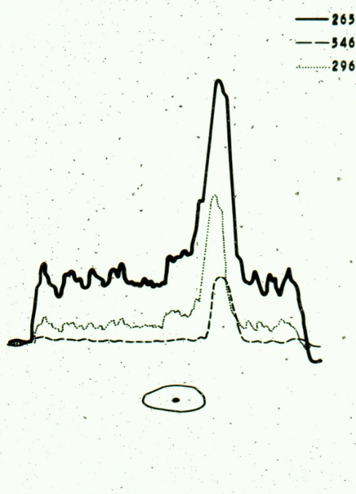
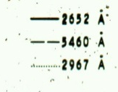
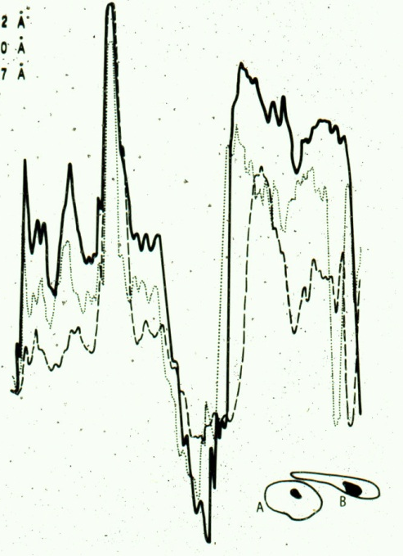

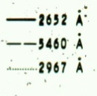
Visible & UV Scanning
Dr. Kamentsky
Brightfield Image
Dr. Melamed
Dr. Koss
UV Images
Ultraviolet Absorption in Epidermoid Cancer Cells LA Kamentsky, H. Derman,
and MR Melamed, Science 142, 1963 (ref 40210)

Slide 16
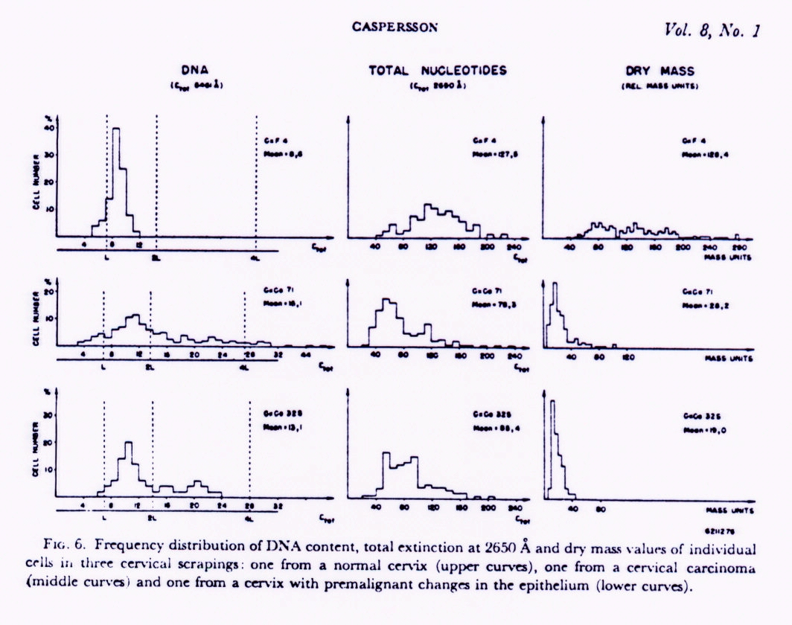
Relating Cytometry to Pathology - O. Caspersson 1964
Cells from a normal cervix
Frequency distribution of DNA content (by UV absorption)
Cells from a cervical carcinoma
Quantitative cytochemical studies on normal, malignant, premalignant and atypical cell populations from the human uterine cervix, Acta Cytologica 8, 1964
(ref 49068)
Premalignant cells from the epithelium

Slide 17
Trying to look at single cells in fluid
Next came techniques to try to look at cells in fluids – particularly blood
The goal was to extract some kind of electrical signal as this was considered the best options

Slide 18
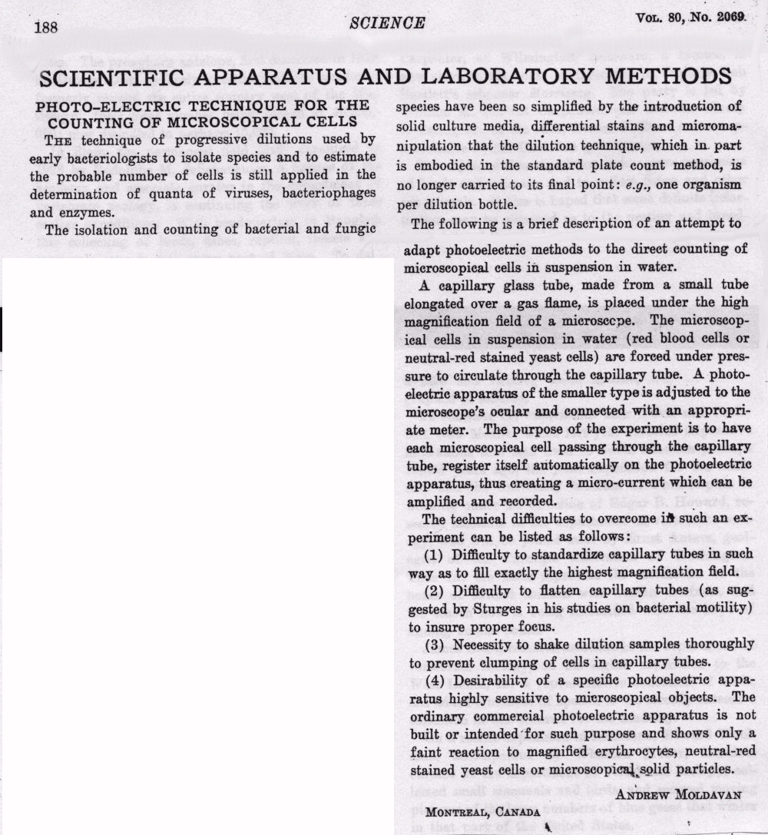
Flow Cell Counter - First Try
Andrew Moldavan 1934

Slide 19
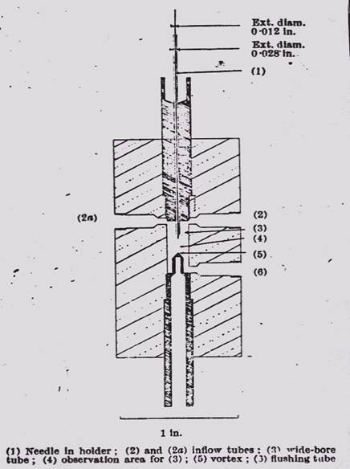
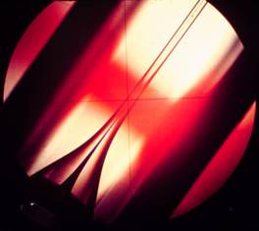
Sheath Flow
PJ Crosland-Taylor 1953
A device for counting small particles suspended in fluid through a tube, Nature 171, 1953 (ref 4756)
An Electronic Blood-Cell Counting Machine, Blood 13, 1958 (ref 40974)

Slide 20
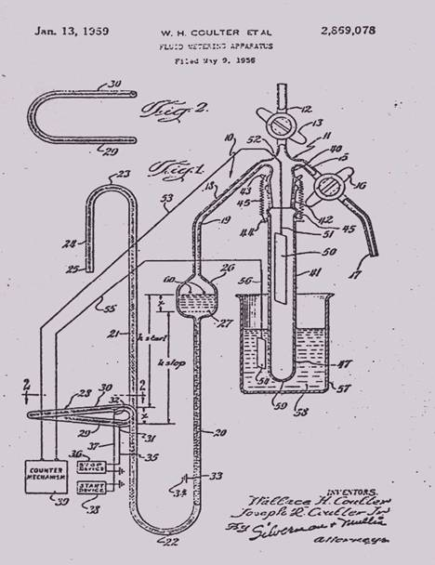
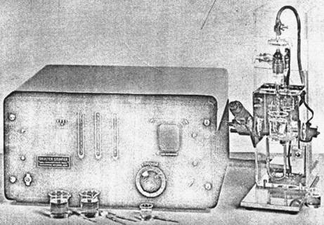
Coulter Counter - Wallace Coulter 1956

Slide 21
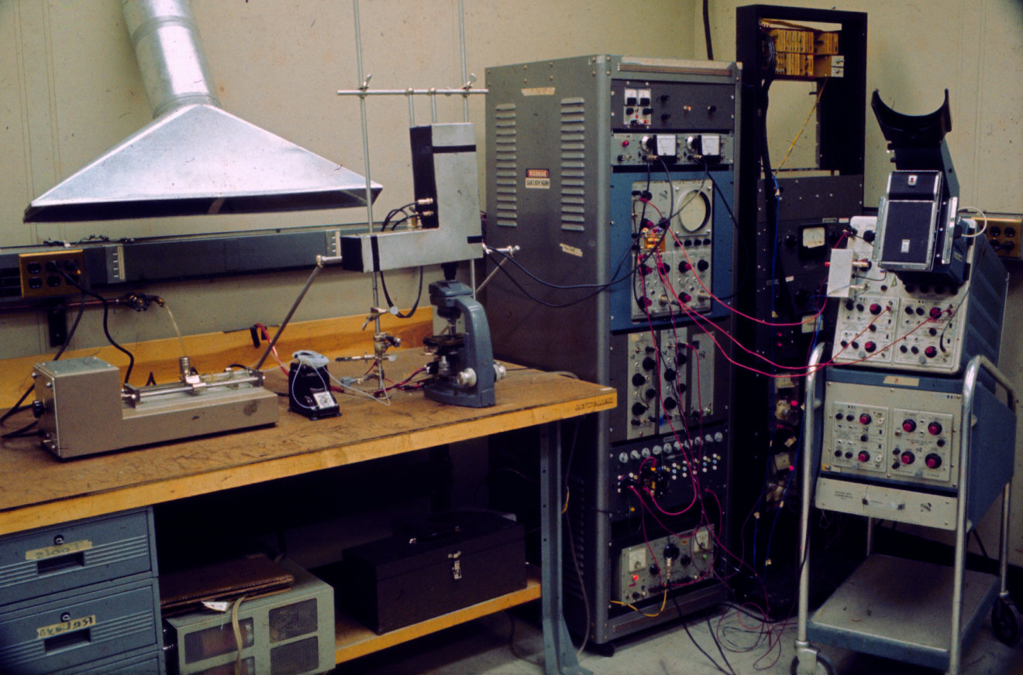
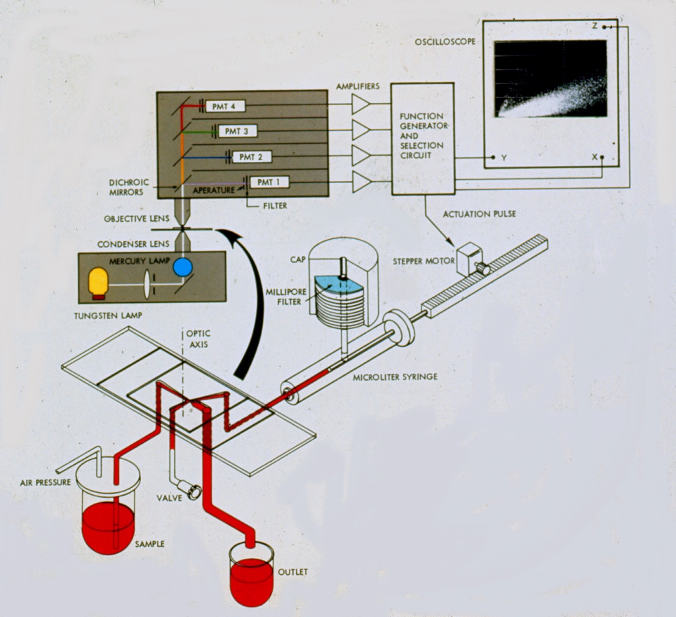
First Analytic Flow Instrument –Kamentsky 1963

Slide 22
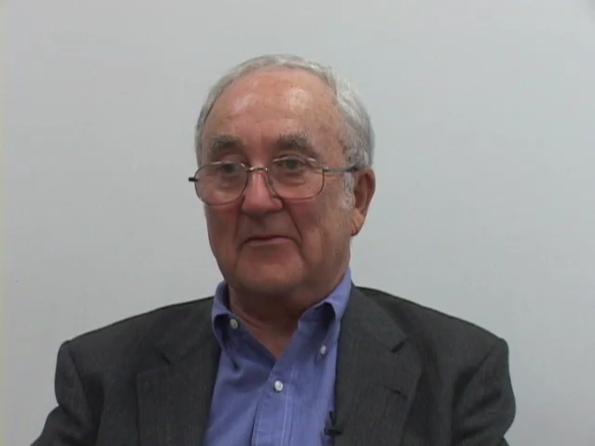
Kamenstsky’s work at IBM and Character recognition

Slide 23
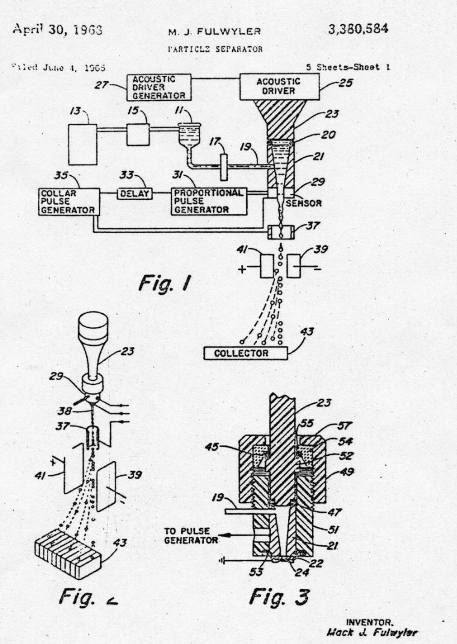
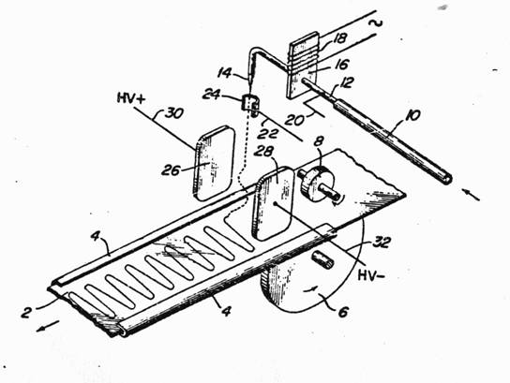
Electrostatic Printing and Droplet Sorting
RG Sweet - MJ Fulwyler
Key invention for
flow cytometry
RG Sweet, Fluid Droplet Recorder
U.S. Patent 3,596,275
filed 3/25/64 (ref 40975)
MJ Fulwyler, Particle Separator, U.S.
Patent 3,380,584 filed 6/4/65

Slide 24

Here is Mack Fulwhyler telling the story

Slide 25
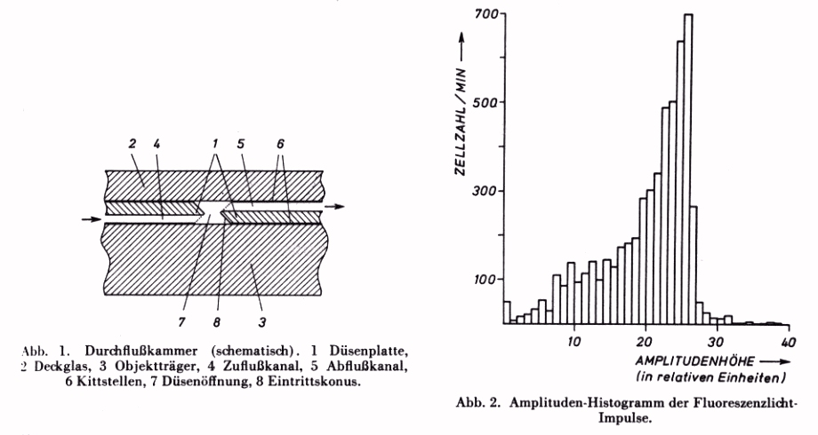
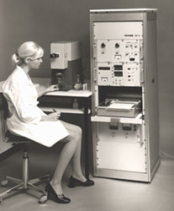
Impulse-cytophotometer
W. Dittrich and W. Gohde 1969
Combining imaging with fluidic systems
Dittrich & Gohde - 1969 - Impulscytophotometer (ICP)- used ethidium bromide for a DNA stain and a high NA objective used as a condenser and collection lens
ICP 11 (1969)
Distributed by Phywe, Göttingen
The first commercial flow cytometer
PDP 11 computer
W. Dittrich and W. Gohde, Impulsfluorometrie bei Einzelzellen in Suspensionen,
Zeit. F Naturforschung 24b, 1969 (ref 4755)

Slide 26
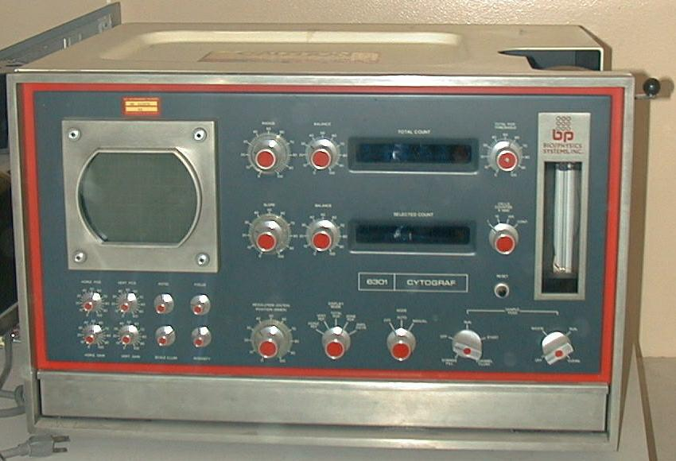
Kamentsky - 1970
Kamentsky - Bio/Physics Systems - 1970 commercial cytometer - the “Cytograph” He-Ne laser system at 633 nm for scatter (and extinction) - supposedly the first commercial instrument incorporating a laser. It could separate live and dead cells by uptake of Trypan blue. A fluorescence version called the “Cytofluorograph” followed using an air cooled argon laser at 488 nm excitation
Original instrument only measured light scatter – no fluorescence
1970 Cytograph presently at the Purdue University Cytometry Laboratories
Photo ©2000 – J.P. Robinson

Slide 27
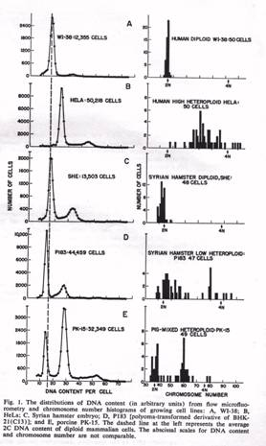
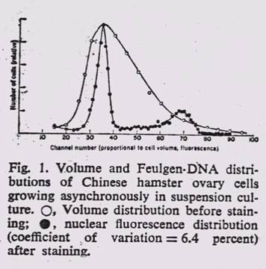
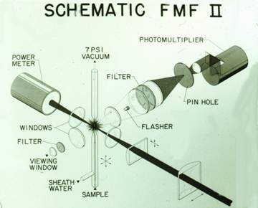
Los Alamos National Lab Contributions
MA VanDilla, TT Trujillo, PF Mullaney &
JR Coulter, Cell Microfluorometry: A
Method for Rapid Fluorescence Measurement,
Science 163, 1969
PM Kraemer, DF Petersen & MA Van Dilla, DNA Constancy in Heteroploidy and the Stem
Line Theory of Tumors, Science 174, 1971

Slide 28
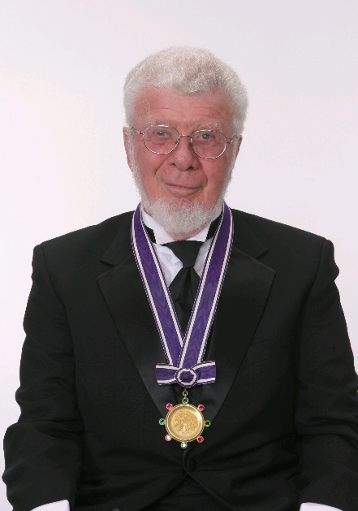
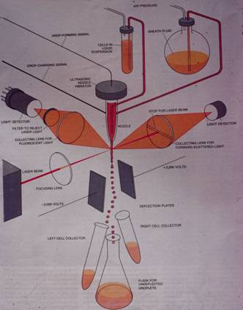
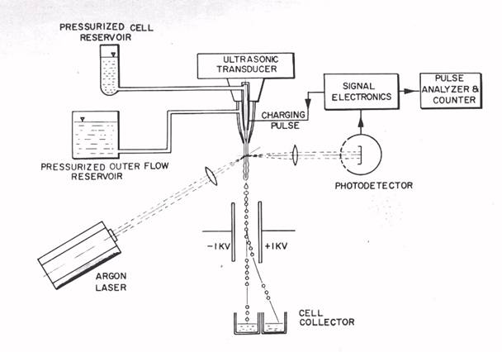
Evolution of Flow Instruments – 1970s
WA Bonner, HR Hulett, RG Sweet and LA Herzenberg,
Fluorescence Activated Cell Sorting, Review of Scientific Instruments 43, 1972

Slide 29
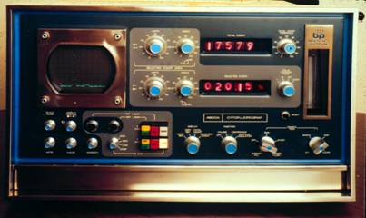
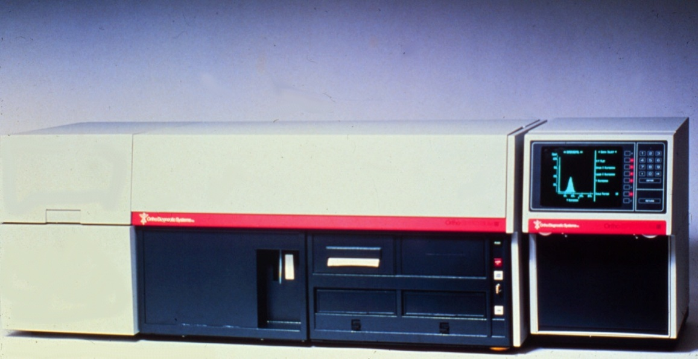
Biophysics- Ortho – 1970’s
Spectrum (1979)
Cytofluorograf (1970)
Flow Cytometry was the first major technology to capture the use of MAbs

Slide 30
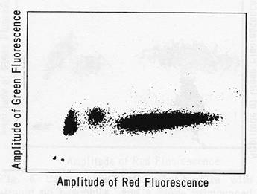
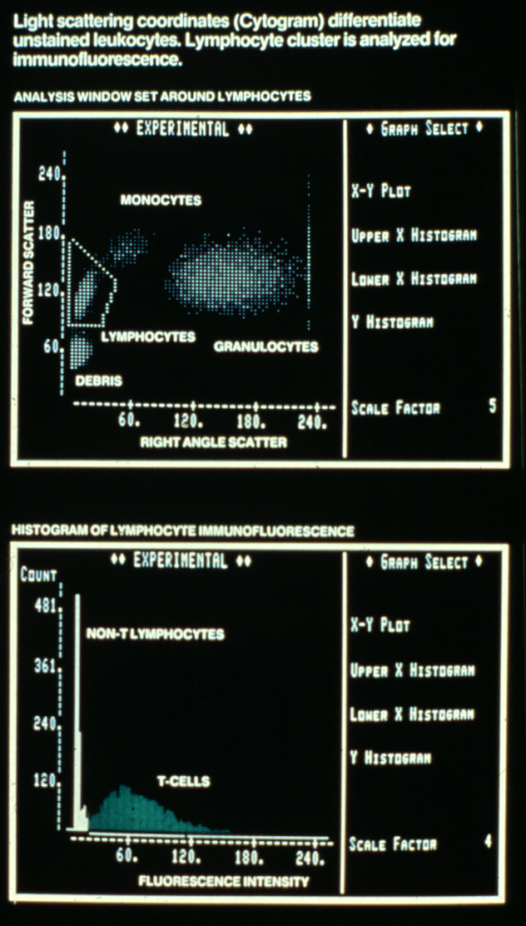
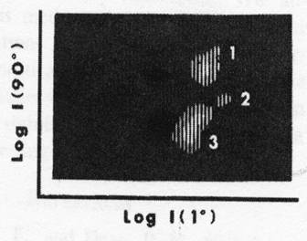
Evolution of Leukocyte Gating Strategy for Cluster Subsetting
GC Salzman, JM Crowell,
JC Martin, TT Trujillo,
A. Romero, PF Mullaney, & PM LaBauve, Cell classification by laser light scattering: identification and separation of unstained leukocytes,
Acta Cytologica 19, 1975
RA Hoffman, PC Kung,
WP Hansen, Simple & rapid
measurement of human T
lymphocytes and their
subclasses, PNAS 77, 1980

Slide 31
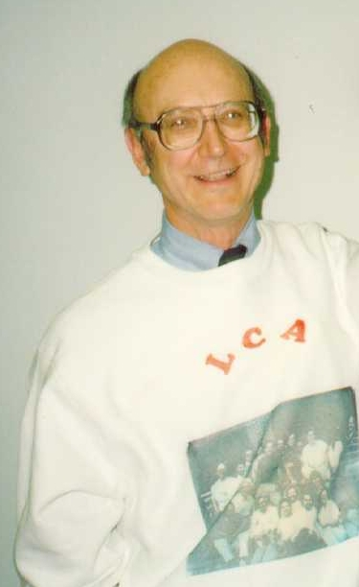
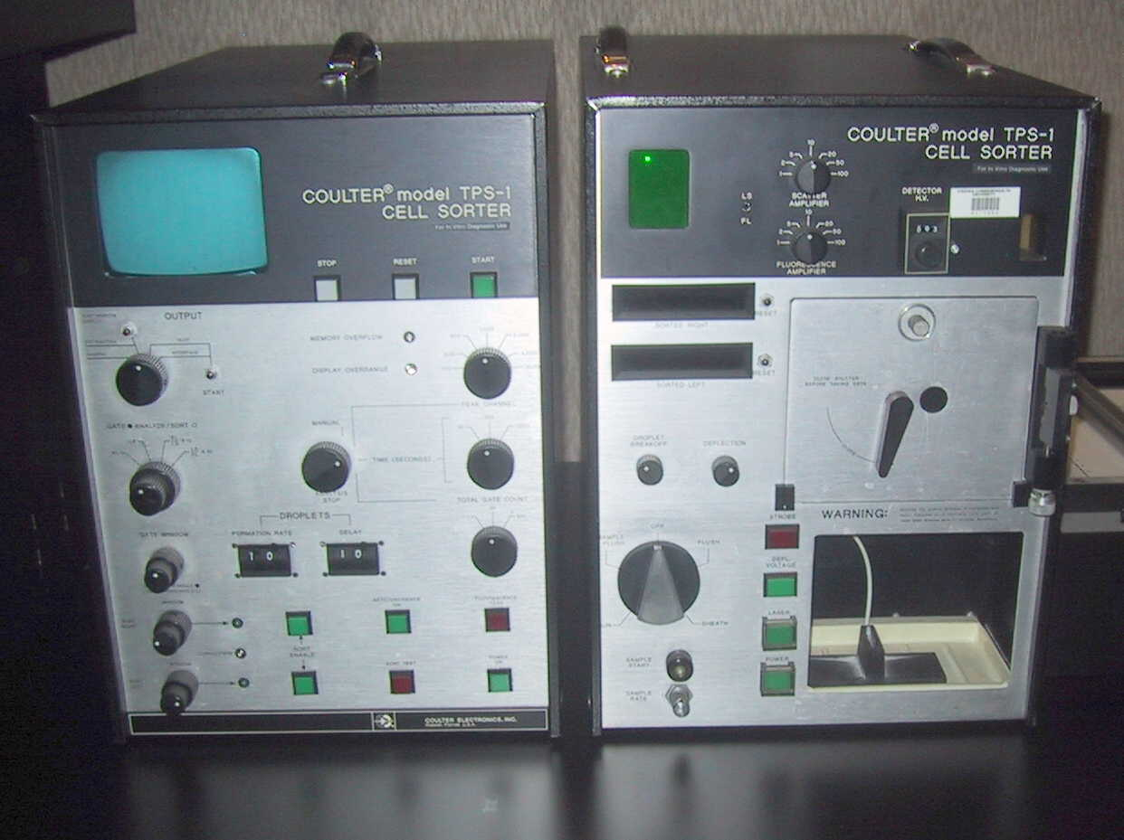
Mack Fulwyler
Coulter Electronics manufactured the TPS-1 (Two parameter sorter) in 1975 which could measure forward scatter and fluorescence using a 35mW argon laser.
This photo (left) (©2000 – J.P. Robinson) is one of only one or two surviving TPS Instruments. It is very similar to the Coulter Counter of the day.
Photo ©2000 – J.P. Robinson

Slide 32
Hemalog D – Clinical hematology and flow
Technicon - Hemalog D - 1974 - first commercial differential flow cytometer - light scatter and absorption at different wavelengths - chromogenic enzyme substrates were used to identify neutrophils and eosinophils by peroxidase and monocytes by esterase, basophils were identified by the presence of glycosaminoglycans using Alcian Blue - the excitation for all measurements was a tungsten-halogen lamp
Insert photos on page 60
Image from Shapiro “Practical Flow Cytometry”, 3rd. Ed.Wiley-Liss, 1994

Slide 33
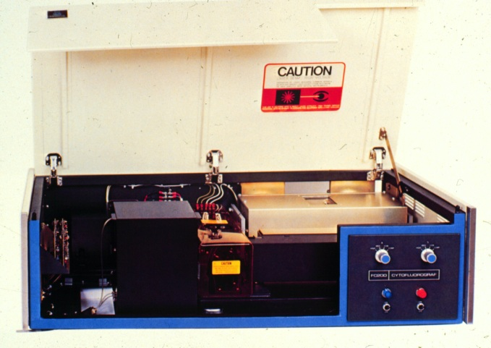
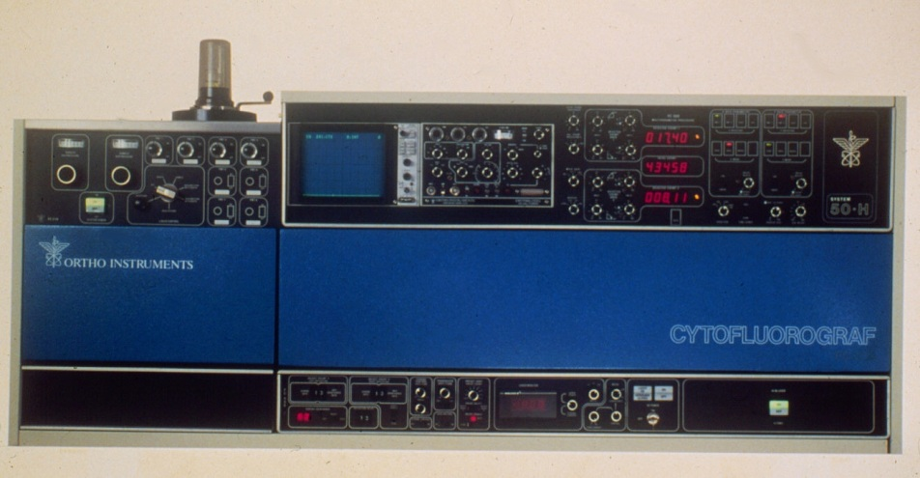
Biophysics -Ortho
Ortho Diagnostics (Johnson and Johnson) purchased Biophysics in 1976 and in 1977 the System 50 Cytofluorograph was developed - this was a droplet sorter, with a flat sided flow cell, forward and orthogonal scatter, extinction, 2 fluorescence parameters, multibeam excitation, computer analysis option.
1979 - NIH scientists had added a krypton laser at 568 nm to excite Texas Red fluorescence at 568 nm and emit at 590-630 nm. Argon (488 nm FITC was measured simultaneously without signal cross-talk - thus the FACS IV was developed (B-D).
FC 200(1975)
System 50H (1978)

Slide 34
BD FACS instruments

Slide 35
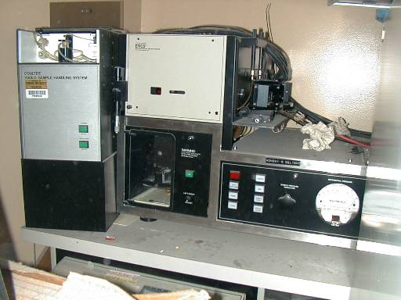
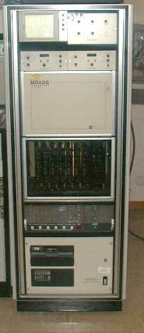
Coulter Electronics
1977-78 developed the Epics series of instruments which were essentially 5 watt argon ion laser instruments, complete with a multiparameter data analysis system, floppy drive and graphics printer.
Photo ©2000 – J.P. Robinson
Epics V front end (left) and MDADS (right)

Slide 36
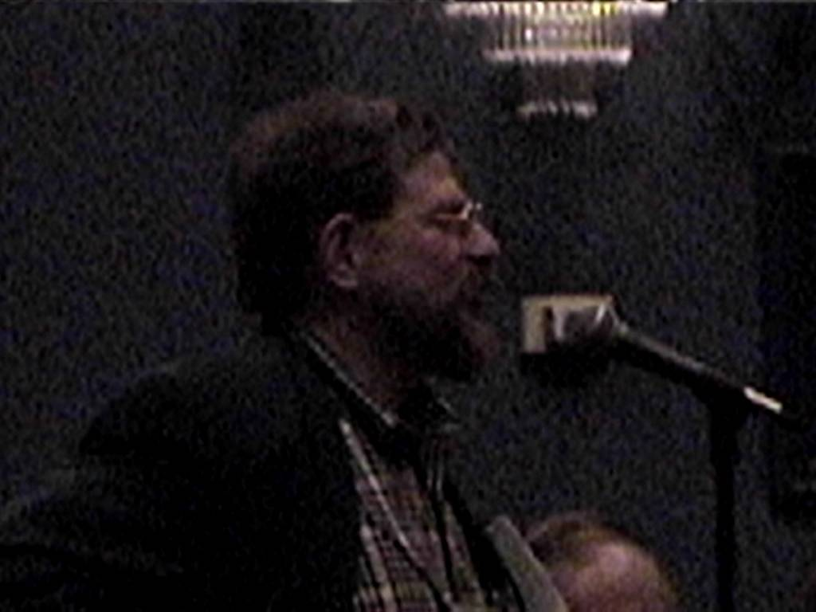



Shapiro
Shapiro and the Block instruments (1973-76) - a series of multibeam flow cytometers that did differentials and multiple fluorescence excitation and emission
Photos ©2000 – J.P. Robinson

Slide 37
Stuart Schlossman 1979
Schlossman at the Farber Institute in Boston, began to make monoclonal antibodies to white blood cell antigens in 1978. Eventually he collaborated with Ortho Diagnostics who distributed the famous “OK T4” etc., Mabs
BD as well as Coulter Immunology also distributed his antibodies and this resulted in some interesting legal issues in the late 1980’s and early 1990’s
Monoclonal Antibodies:
Kohler G, Milstein C. Continuous cultures of fused cells secreting antibody of predefined specificity. Nature Lon. 1975;256:495-497.
Science, Vol 206, 19 Oct 1979, P348
Received 7 May 1979; revised 20 June 1979
Monoclonal antibodies defining distinctive human T cell surface antigens
P Kung, G Goldstein, EL Reinherz and SF Schlossman Science 19 October 1979: Vol. 206 no. 4416 pp. 347-349 DOI: 10.1126/science.314668

Slide 38
Flow Cytometry and HIV 1981-2000s
In the 1980s with the development of monoclonal antibodies, flow cytometry was a key technology in analyzing blood samples for loss of CD4 population
During the 1980s and 1990s the principle tool for HIV patient analysis was flow cytometry for CD4-CD8 analysis

Slide 39
Introductory Terms and Concepts
Variable/Parameter (see Note below)
Light Scatter- Forward (FALS), narrow (FS)
- Side, Wide, 90 deg, orthogonal
Fluorescence - Spectral range
Absorption/axial light loss
Time
Count
Note: People in the field of flow cytometry interchangeably use the term “parameter”
with “variable”. While it is technically incorrect to use the term parameter unless we are
talking about a derived value, it is common usage and we will use this term frequently.

Slide 40
Concepts
    Scatter: Size, shape, granularity, polarized scatter (birefringence), effective refractive Index
    Fluorescence:
    Intrinsic: Endogenous pyridines and flavins
    Extrinsic: All other fluorescence profiles
    Absorption
    Axial Light loss: Loss of light (blocked)
    Time: Useful for kinetics, QC
    Count: Always part of any collection
    Tube Number or Identifier/well number/plate number

Slide 41
Instrument Components
Electronics: System control, pulse collection, pulse analysis, triggering, time delay, data display, gating, sort control, light and detector control
Optics: Light source(s), detectors, optical filters, spectral separation
Fluidics: Specimen control, sorting, rate of data collection
Data Analysis: Data display & analysis, multivariate/ simultaneous solutions, identification of sort populations, quantitation, ratios

Slide 42
Data Analysis Concepts
    Data plotting
    Single parameter - Histogram
    Dual parameter – Dot plot
    Multiple parameter – 3 D plot or a variety of plots such as PCA* or other analytical displays
    Complex plots – time course, concentration curves, cell cycle analysis, etc are also possible,
    tSNE (T-Distributed Stochastic Neighbor Embedding - unsupervised nonlinear dimensionality reduction algorithm useful for visualizing high dimensional data
    SPADE –(Spanning tree Progression of Density normalized Events) -visualization tool for high-dimensional data
Note: these terms are introduced here, but will be discussed in more detail in later lectures
* PCA – Principal Component Analysis

Slide 43
Data Presentation Formats
How flow cytometry data are presented:
Examples
    Histogram
    Dot plot
    Contour plot
    3D plots
    Dot plot with projection
    Overviews/composites (multiple histograms)
    Various analytical plots (tSNE, SPADE etc

Slide 44
Data Analysis Concepts
    Gating
    Single parameter
    Dual parameter
    Multiple parameter
    Back gating
    Complex gating
    Boolean operators
Note: these terms are introduced here, but will be discussed in more detail in later lectures

Slide 45
Sorting- Overview
Sorting is the process of physically separating a cell from a population
Sorting can be accomplished by a number of techniques but the primary one is electrostatic sorting
Sorting can be 1 way, 2 way, 4 way or 7 way in modern sorters
Sorting can be accomplished under sterile conditions for subsequent cell culture
Sorting can be achieved at high speeds approaching 100,000 events per second

Slide 46







Sources of information
Flow Cytometry and Sorting, 2nd ed. (M.R. Melamed, T. Lindmo, M.L. Mendelsohn, eds.), Wiley-Liss, New York, 1990 - referred to here as MLM
Flow Cytometry: Instrumentation and Data Analysis (M.A. Van Dilla, P.N. Dean, O.D. Laerum, M.R. Melamed, eds.), Academic Press, London, 1985 – referred to as VDLM
Practical Flow Cytometry 3nd edition (1994),4th Ed (2003) H. Shapiro: Alan R. Liss, New York - referred to as PFC
Introduction to Flow Cytometry. J. Watson, Cambridge Press, 1991 referred to as IFC
Methods in Cell Biology: v.40,41, 63, 64 Darzynkiewicz, Robinson & Crissman, Academic Press, 1994, 2000 MCB
Data Analysis in Flow Cytometry:A Dynamic Approach-Book on CDROM M. Ormerod referred to as DAFC
Flow Cytometry: First Principles. (2nd Ed) Alice Longobardi Givan, Wiley-Liss, 2001 referred to as AFCFP
More information on flow cytometry books can be found on our website at:
http://www.cyto.purdue.edu/flowcyt/books/bookindx.htm
Note: All of these books are in Prof. Robinson’s library in Hansen Hall, Room B50 and may be checked out for 24 hour periods with permission.
Notes:
Sources
This slide is intended to show students supplementary materials if they are interested in learning more about flow cytometry.

Slide 47


Methods and Practical Assistance
For help with protocols there are several choices including the MCB references on the previous slide (Methods in Cell Biology)
The Handbook of Flow Cytometry Methods
Current Protocols in Cytometry

Slide 48











Additional Sources
Powerpoint presentations references as J.Paul Robinson (JPR); Robert Murphry (RFM), Carleton Stewart (CS)
Web sources of these presentation are:
http://www.cyto.purdue.edu/flowcyt/educate/pptslide.htm
http://www.cyto.purdue.edu/flowcyt/educate1.htm
Vol. 1 Vol. 2 Vol. 3 Vol. 4
Additional Sources include the Purdue Cytometry CD-ROM series
Vol. 5 Vol. 6 Vol. 7 Vol. 8 Microscopy 1 Microscopy II
DVD V10
cyto.purdue.edu/flowcyt/cdseries.htm
Notes:
Sources
This slide is to show students supplementary materials that ison CDs. These CDs are from the Purdue Cytometry CD-ROM series that include information about cytometry as well as a web browser that links the user to other cytometry web sites.

Slide 49
Summary
What is Flow Cytometry
What is it used for
How did it become developed
Introduction to terms of use in flow cytometry

