Slide 1
Advanced Flow Cytometry
J. Paul Robinson & John Nolan

Slide 2
5-Exosomes and Nanoparticles
Advanced Short Course
John P. Nolan
Scintillon Institute
San Diego, CA
jnolan@scintillon.org

Slide 3
Learning Objectives
Biological nanoparticles
  Exosomes and microvesicles
Differences between cells and vesicles
Detection approaches
Calibration and data reporting

Slide 4
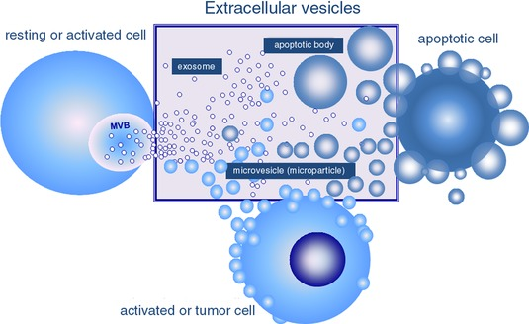
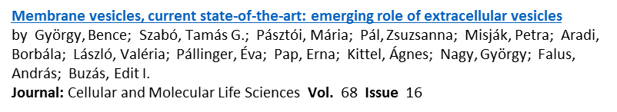
All cells release small vesicles

Slide 5
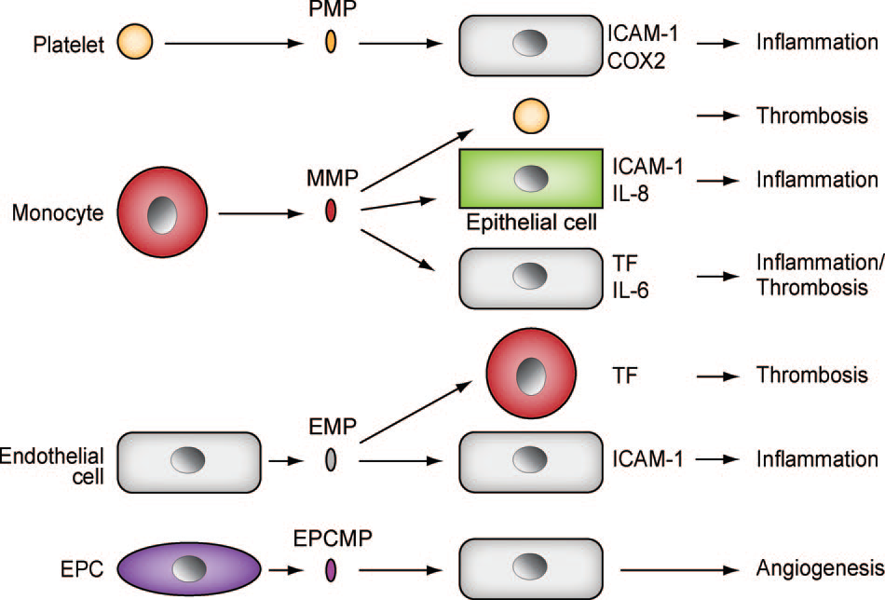
In biofluids, vesicles come from many different cells

Slide 6
EV Analysis Opportunities and Challenges
Biomarkers
Therapeutic targets
Therapies
EVs are heterogeneous
  Shed from the surface or secreted
  Come from many different cell types
  Require multiparameter analysis
EVs are small and dim
  They don’t scatter much light
  They don’t have many antigens
  Conventional FC performs poorly

Slide 7
Cell-derived EVs
80 - 400 um diameter
Cell
10 um diameter
CD16: 10,000 copies (50/um²)
CD11a: 55,000 copies (274/um²)
CD14: 110,000 copies (547/um²)
1 um
100 um

Slide 8
EV Analysis Methods
EV Isolation – Blood, urine, saliva, CSF, culture media
  Differential/gradient/ultra centrifugation, filtration, precipitation
Bulk Analysis
  Dynamic light scattering
    Size distribution
  Immunoassay
    Total antigen
  Genomics
    miRNA
  Proteomics
    Mass spec
Single Particle Analysis
  Electron microscopy, cryo EM, AFM
    Size, immuno-gold
  Nanoparticle tracking analysis
    Size, intensity
  Resistive pulse spectroscopy
    Size, zeta potential
  Flow cytometry
    Size (?), multiple antigens

Slide 9
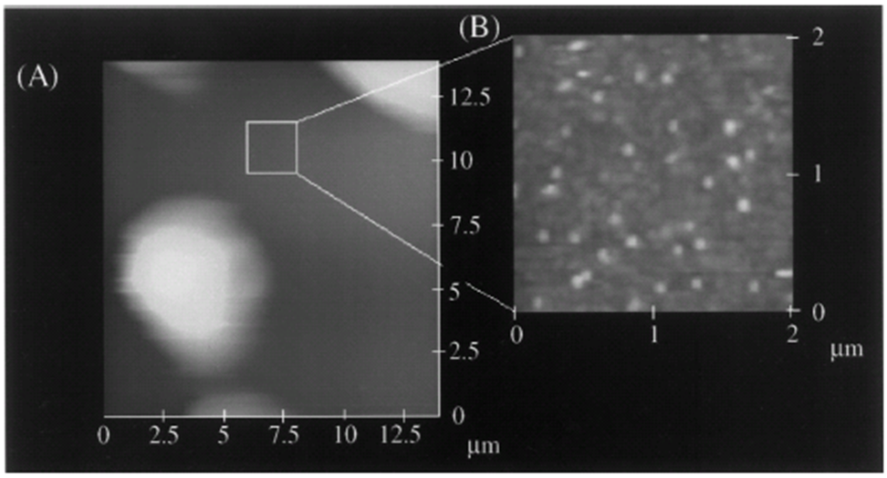
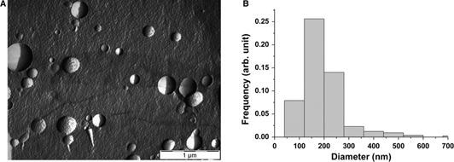
Microscopies
Cryo EM (+immunogold)
Freeze fracture EM
AFM

Slide 11
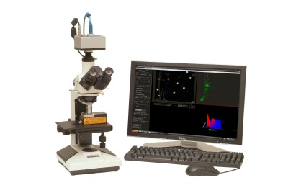
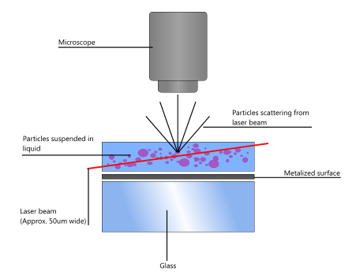
Nanoparticle Tracking Analysis (NTA)
Individual vesicles are detected via laser light scatter
Brownian motion tracked
Size estimated from diffusion constant
Nanosight.com

Slide 12
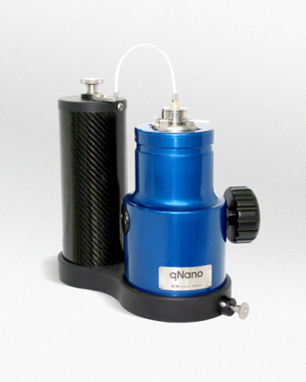
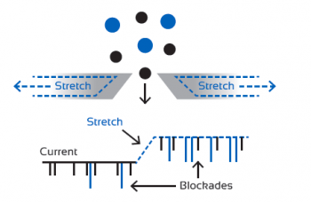
Resistive Pulse Spectroscopy (RPS)
Coulter principle using nanopores
Particles in an electrolyte solution impede current when they enter pore
Magnitude of impedance is proportional to size
www.izon.com

Slide 13
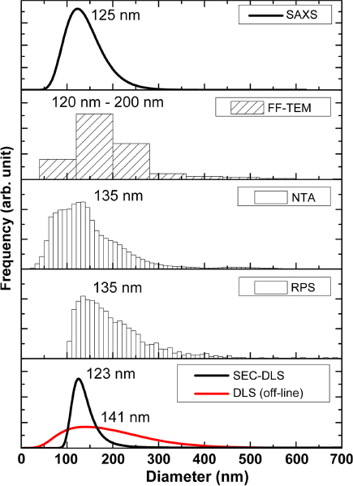
How big are EVs?
~70-200 nm diameter as measured by many different methods
Many exceptions:
oncosomes
red cell ghosts/fragments
tubules
are minority
Varga et al 2014 J Extracell Ves

Slide 14
Why flow cytometry?
EVs are heterogeneous
  Ectosomes, exosomes, others
Biological fluids contain EVs from different cells
Multiparameter analysis will distinguish these
Enumeration (EVs/mL)
Marker quantification (molecules/EV)

Slide 15
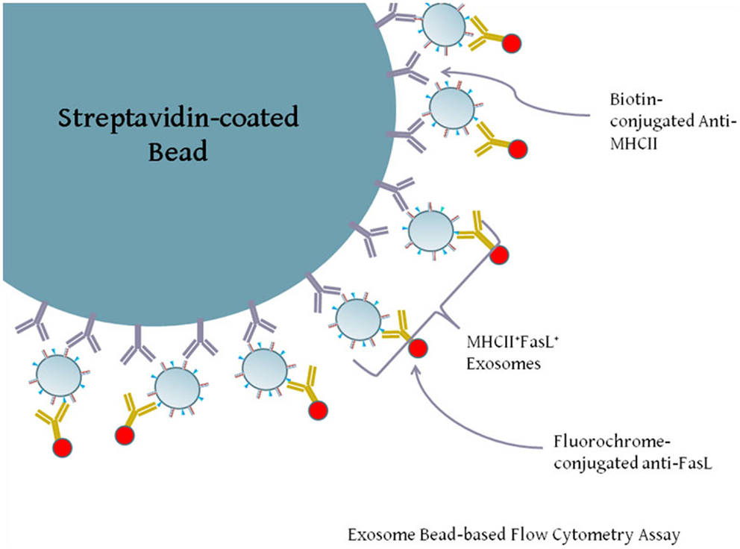
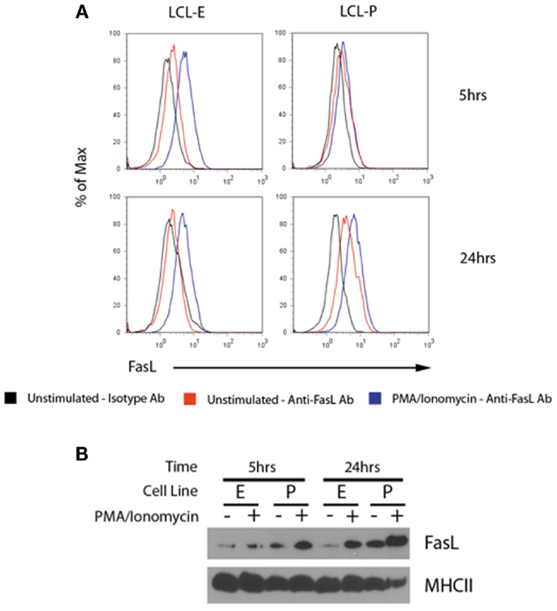
Bead-based Flow Cytometry
Microspheres functionalized with anti-exosome capture antibodies
  CD9, CD63, MHC II
Captured EVs labeled with fluorescent anti-exosome antibody
Bead fluorescence measured by flow cytometry
Kinker et al (2014) Frontiers in Immunology

Slide 16
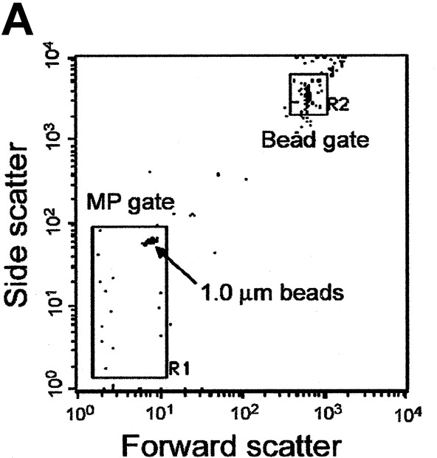
Single EV Analysis:
“Calibrated” Size Discrimination
“ Microparticles are defined as small (0.1-1 um) diameter anucleoid phospholipid vesicles released from different cells …[ref]“

Slide 17
Facts of Light Scatter
Light scatter does not measure size (or granularity)
Light scatter can, under certain circumstances, be proportional to size (or granularity)
Light scatter intensity is a complex function of wavelength, particle size and shape, angle of collection, and refractive index
Light scatter is well described mathematically
www.philiplaven.com/mieplot.htm

Slide 18
Angle of Collection and Size
Calculated for 488 nm excitation
Above λ, light scatter is highly angle dependent
LS is much stronger at small (forward angles)
background is also higher (obscuration)
Below λ, particles behave as points, and little angular dependence is observed
- Lower background makes 90⁰ better for measurement of small particles
www.philiplaven.com/mieplot.htm

Slide 19
Particle Diameter
Calculated at 488 nm excitation and 80-100⁰ collection
Above λ, monotonic increase in scatter with increasing radius (but be careful with FALS)
Below λ, scatter decreases with an r⁶ dependence (small particles get very dim, very fast)
www.philiplaven.com/mieplot.htm

Slide 20
Refractive Index and Size
Calculated for 488 nm excitation and 80-100⁰ collection
Light scatter from a lipid vesicle is predicted to be >100 fold lower compared to a polystyrene bead
www.philiplaven.com/mieplot.htm

Slide 21
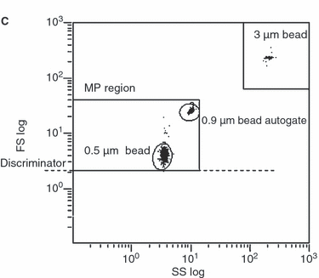
Reference Particles
Polymer beads have a long history of use for standardization and calibration of FC measurements, however caution is warranted in using them for light scatter measurements
Robert et al 2009 Journal of Thrombosis and Haemostasis

Slide 22

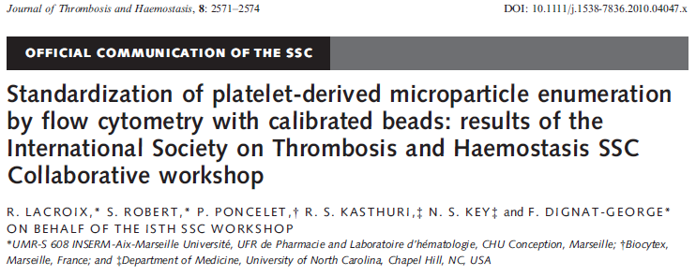
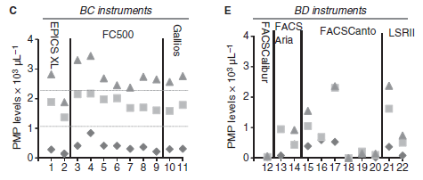
ISTH Standardization Effort

Slide 23
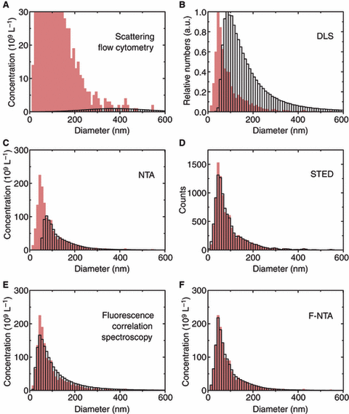
How big are EVs?
Comparison of various methods to
Small Angle X-ray Scattering (SAXS)
van der Pol et al 2010 J Thromb Haem

Slide 24
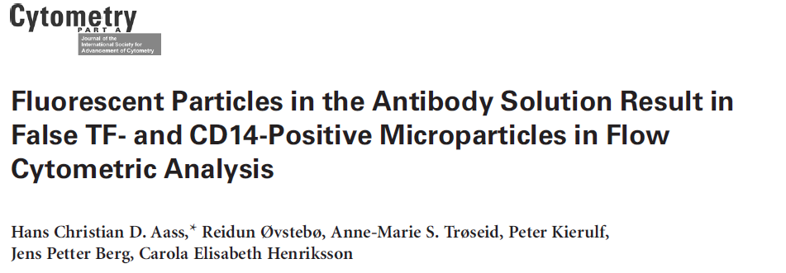
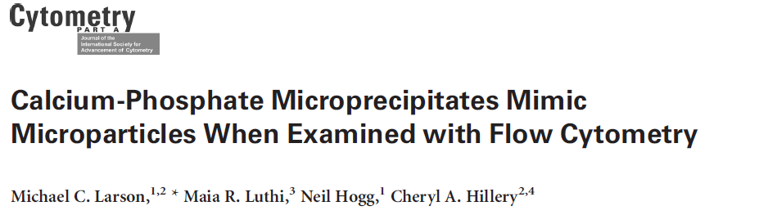
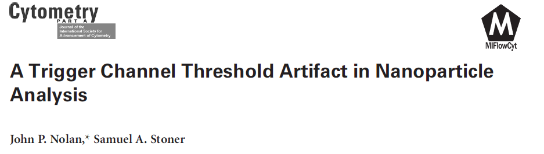
FC of Individual EVs: Pitfalls
Lack of sensitivity
Artifacts!!!
Irreproducibility
Difficulty of standardization
Lack of appropriate calibration

Slide 25
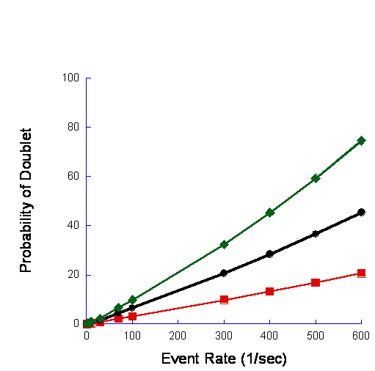
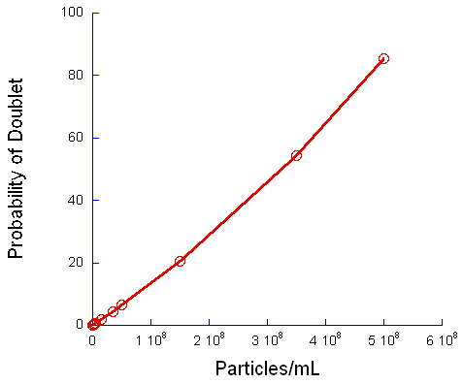
Coincidence?
probability of having n particles within the probe volume simultaneously
where h is the height of the laser beam, R is the event rate, and v is the linear flow velocity
Notes:
The probability of coincident events can be calculated using the following equation: where is the probability of having n particles within the probe volume simultaneously, and Г is defined by the following relation: , where h is the height of the laser beam, R is the event rate, and v is the linear flow velocity. Coincidence calculations were limited calculating the probability of a doublet (2 coincident particles).

Slide 26
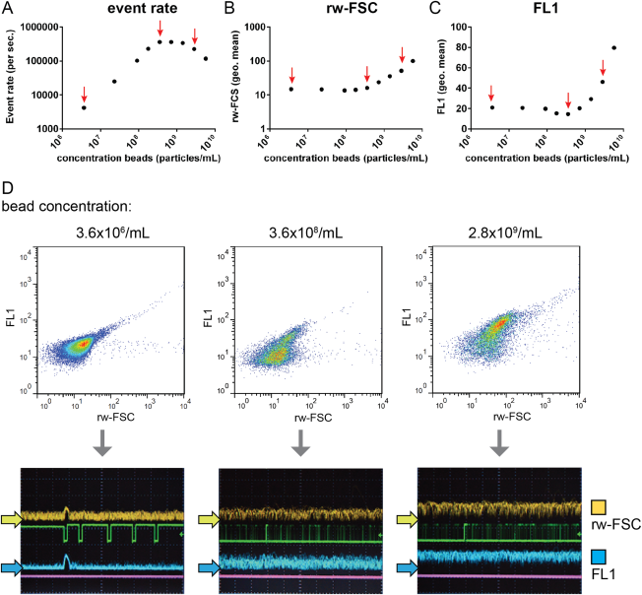
High concentrations of small dim particles can result in coincidence artifacts (aka “swarm”)
Cytometry Part A
16 FEB 2015 DOI: 10.1002/cyto.a.22644
http://onlinelibrary.wiley.com/doi/10.1002/cyto.a.22644/full#cytoa22644-fig-0001
Notes:
Coincident detection of 100 nm fluorescent beads at high bead concentrations. Serial dilutions from a highly concentrated 100 nm bead suspension were prepared and analyzed using a 140 μm nozzle and 5 psi sheath fluid pressure. (A) Analysis of event rate, (B) light scattering (rw‐FSC) and (C) fluorescence (FL1). (D) Scatter plots (rw‐FSC vs. FL1) of bead samples indicated by arrows in A–C. Scatter plots display 20,000 recorded events. Below are images of the digital oscilloscope captured during the analysis of low bead concentrations (left), during coincident particle detection (middle), and during clear swarm (right). Yellow and blue arrows indicate the level of the baseline signal. Shown is a representative experiment out of three experiments. [Color figure can be viewed in the online issue, which is available at wileyonlinelibrary.com.]
© IF THIS IMAGE HAS BEEN PROVIDED BY OR IS OWNED BY A THIRD PARTY, AS INDICATED IN THE CAPTION LINE, THEN FURTHER PERMISSION MAY BE NEEDED BEFORE ANY FURTHER USE. PLEASE CONTACT WILEY'S PERMISSIONS DEPARTMENT ON PERMISSIONS@WILEY.COM OR USE THE RIGHTSLINK SERVICE BY CLICKING ON THE 'REQUEST PERMISSION' LINK ACCOMPANYING THIS ARTICLE. WILEY OR AUTHOR OWNED IMAGES MAY BE USED FOR NON-COMMERCIAL PURPOSES, SUBJECT TO PROPER CITATION OF THE ARTICLE, AUTHOR, AND PUBLISHER.

Slide 27
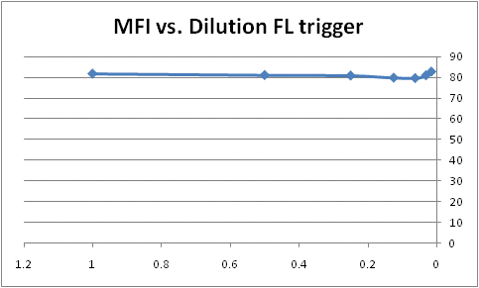
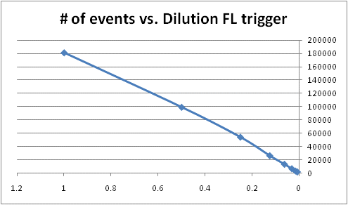
Coincidence detection: Dilution

Slide 28
Limitations of Conventional FC
PS Beads
Light scatter as a trigger channel
  Depends on size, shape, λ, collection angle, refractive index
  Well described by Mie theory
  Vesicles scatter 10-100x <beads
Coincidence
  Depends on [EV], probe volume
  Frequency is readily calculated
  Can be identified/eliminated by dilution
Fluorescence calibration
  Required for data/methods sharing
  Well-established protocols, reagents
  No one does it
Vesicles

Slide 29
Fluorescence triggering based on surface marker staining

Slide 30
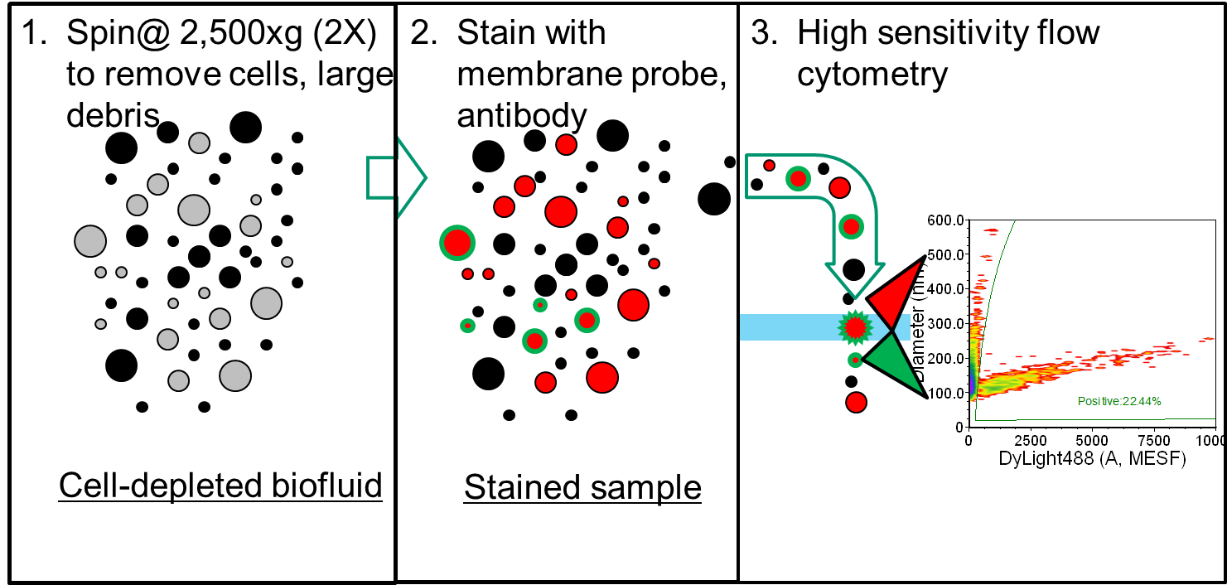

Slide 31
Vesicle Flow Cytometry
Spin@ 2,500xg (2X) to remove cells, large debris
Stain with membrane probe, antibody
High sensitivity flow cytometry
Cell-depleted biofluid
Stained sample

Slide 32
Vesicle Flow Cytometry
Lipid Probe:
EV Surface area
calibrated using liposomes
All particles introduced into FC
Marker Probe:
Marker abundance estimated through fluorescence calibration
Only membranous particles (EVs) are detected and measured
Instrument calibration enable estimation of surface marker abundance
1980 AnnV
molecules
Bivariate plot:
correlated data

Slide 33
Summary
Extracellular vesicles and other biological nanoparticles are potentially important
Nanoparticles are not cells,
Accurate measurement of small, dim particles requires different approaches
Calibration and controls are essential

Slide 34


Resources
Current Protocols in Cytometry
Unit 1.3 Standardization, Calibration, and Control in Flow Cytometry
Unit 1.4 Establishing and Maintaining System Linearity
Unit 1.20 Characterization of Flow Cytometer Instrument Sensitivity
Unit 6.4 Enumeration of CD34+ Hematopoietic Stem and Progenitor Cells
Unit 6.8 Enumeration of Absolute Cell Counts Using Immunophenotypic Techniques
Unit 6.24 Flow Rate Calibration for Absolute Cell Counting Rationale and Design
Unit 6.26 Calibration of Flow Cytometry for Quantitative Quantum Dot Measurements
Unit 13.2 Microsphere Surface Protein Determination Using Flow Cytometry
Unit 13.14 Flow Cytometry of Extracellular Vesicles: Potential, Pitfalls, and Prospects
CYTO 2013 Scientific Tutorial:
Cytometer Performance Characterization and Standardization Robert Hoffman
CYTO U Webinar:
Predicting the best resolution and sensitivity in panel development and reducing inter-instrument variability in flow cytometry. Steve Perfetto and Jim Wood

Slide 35


More Resources

Slide 36

Protocols and More Info
Chapter 1 Flow Cytometry Instrumentation
Chapter 2 Image Cytometry Instrumentation
Chapter 3 Safety Procedures and Quality Control
Chapter 4 Molecular and Cellular Probes
Chapter 5 Specimen Handling, Storage, and Preparation
Chapter 6 Phenotypic Analysis
Chapter 7 Nucleic Acid Analysis
Chapter 8 Molecular Cytogenetics
Chapter 9 Studies of Cell Function
Chapter 10 Data Processing and Analysis
Chapter 11 Microbiological Applications
Chapter 12 Cellular and Molecular Imaging
Chapter 13 Multiplexed and Microparticle‐Based Analyses
  Introduction
  UNIT 13.1 Multiplexed Microsphere-Based Flow Cytometric Immunoassays
  UNIT 13.2 Microsphere Surface Protein Determination Using Flow Cytometry
  UNIT 13.3 Use of Microsphere-Supported Phospholipid Membranes for Analysis of Protein-Lipid Interactions
  UNIT 13.4 Multiplexed SNP Genotyping Using Primer Single-Base Extension (SBE) and Microsphere Arrays
  UNIT 13.5 BeadCons: Detection of Nucleic Acid Sequences by Flow Cytometry
  UNIT 13.6 Characterization of Nuclear Receptor Ligands by Multiplexed Peptide Interactions
  UNIT 13.7 Detection of Gene Fusions in Acute Leukemia Using Bead Microarrays
  UNIT 13.8 Reagents and Instruments for Multiplexed Analysis Using Microparticles
  UNIT 13.9 Multiplexed Detection of Fungal Nucleic Acid Signatures
  UNIT 13.10 Multiplexed Analysis of Peptide Antigen-Specific Antibodies
  UNIT 13.11 Use of Flow Cytometric Methods to Quantify Protein-Protein Interactions
  UNIT 13.12 Microsphere-Based Flow Cytometry Protease Assays for Protease Activity Detection & High-Throughput Screening
  UNIT 13.13 Application of the PrimRglo Assay Chemistry to Multiplexed Bead Assays
  UNIT 13.14 Flow Cytometry of Extracellular Vesicles: Potential, Pitfalls, and Prospects
  UNIT 13.15 Optimized MOL-PCR for Characterization of Microbial Pathogens

