Slide 1
Advanced Flow Cytometry
J. Paul Robinson & John Nolan

Slide 2
4- Mass Cytometry – A new Technology Impacting Flow Cytometry
Advanced Short Course
J. Paul Robinson
The SVM Professor of Cytomics
Professor of Biomedical Engineering
Director, Purdue University Cytometry Laboratories
I wish to thank Dr. Hervé Luche from the
Centre d’Immunophenomique Marseille, France
For providing most of the slides on mass cytometry

Slide 3
Key Links
Purdue List Serve &
Robinson Lab
cyto.purdue.edu
isac-net.org
scintillon.org/nolan_lab
ISAC
Nolan Lab
John P. Nolan - jnolan@scintillon.org
J. Paul Robinson – wombat@purdue.edu

Slide 4
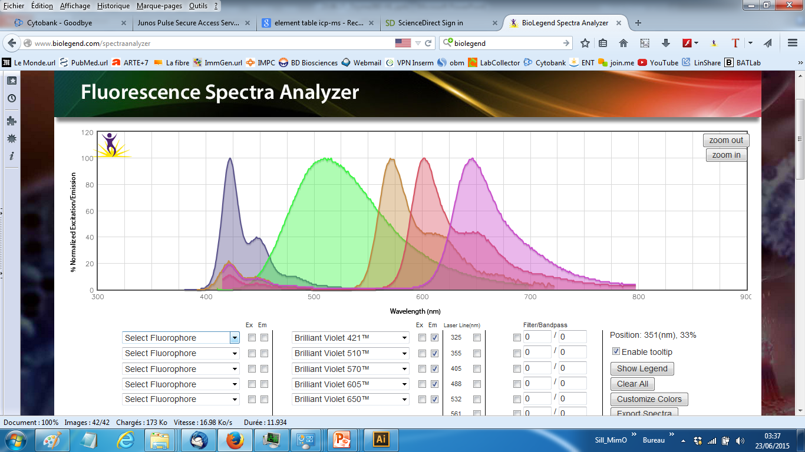
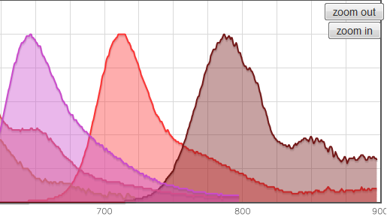
What is the issue with Fluorescence based Flow Cytometry?
Emission spectra
Wave Length (nm)
There are a limited number of bands that we can handle using fluorescence
What are the alternatives?

Slide 5
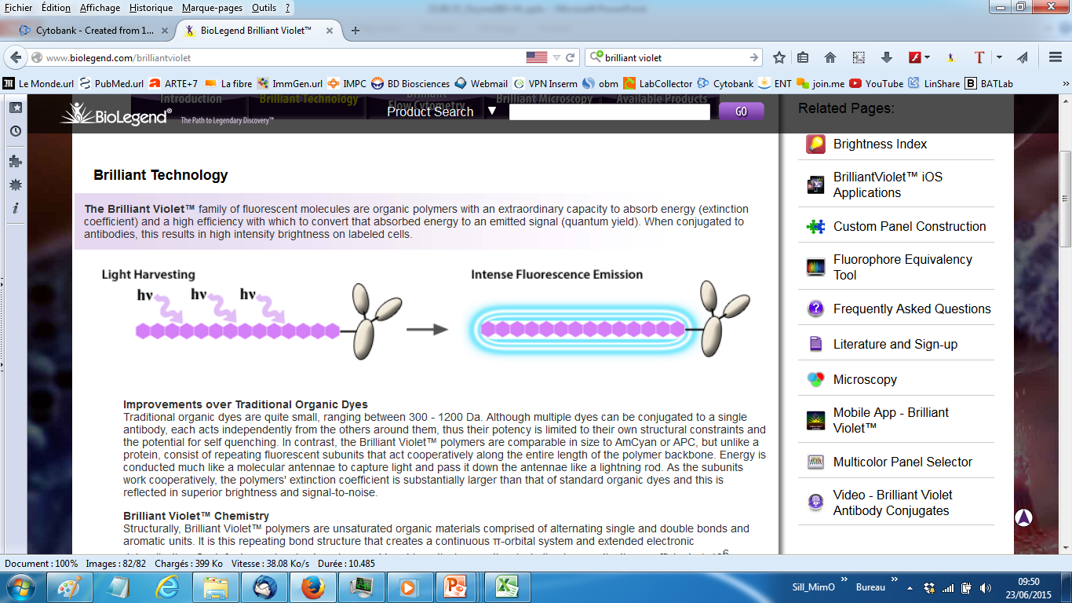
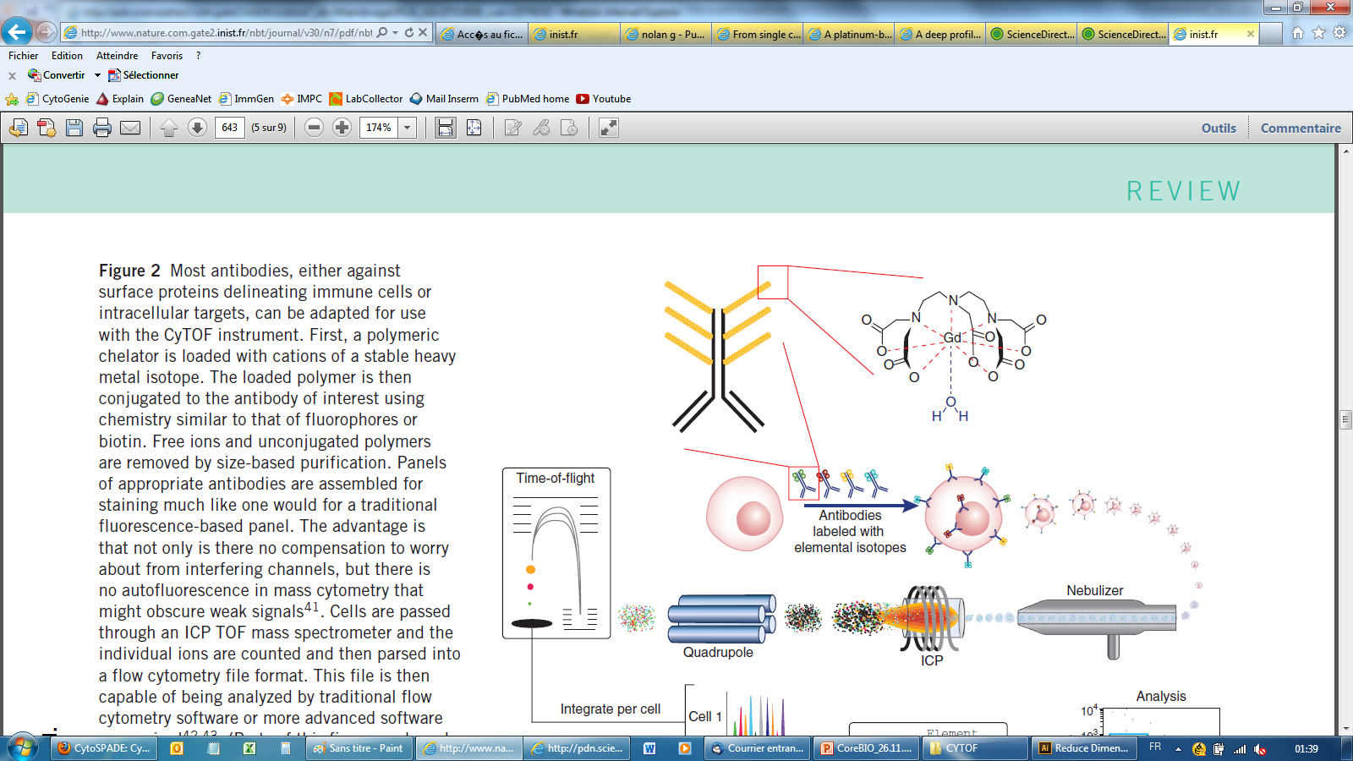
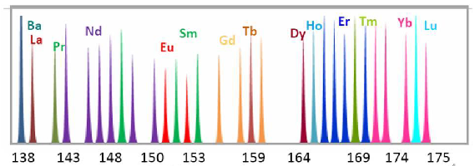
The immuno-technology behind mass cytometry…
Syrigen dye – Antibody
Emission spectra
MaxPAR Antibodies
Wave Length (nm)
4-5 polymer per antibody
16-22 chelating unit per polymer
100-80 atoms coupled per antibody
Isotopic Mass (Da)

Slide 6
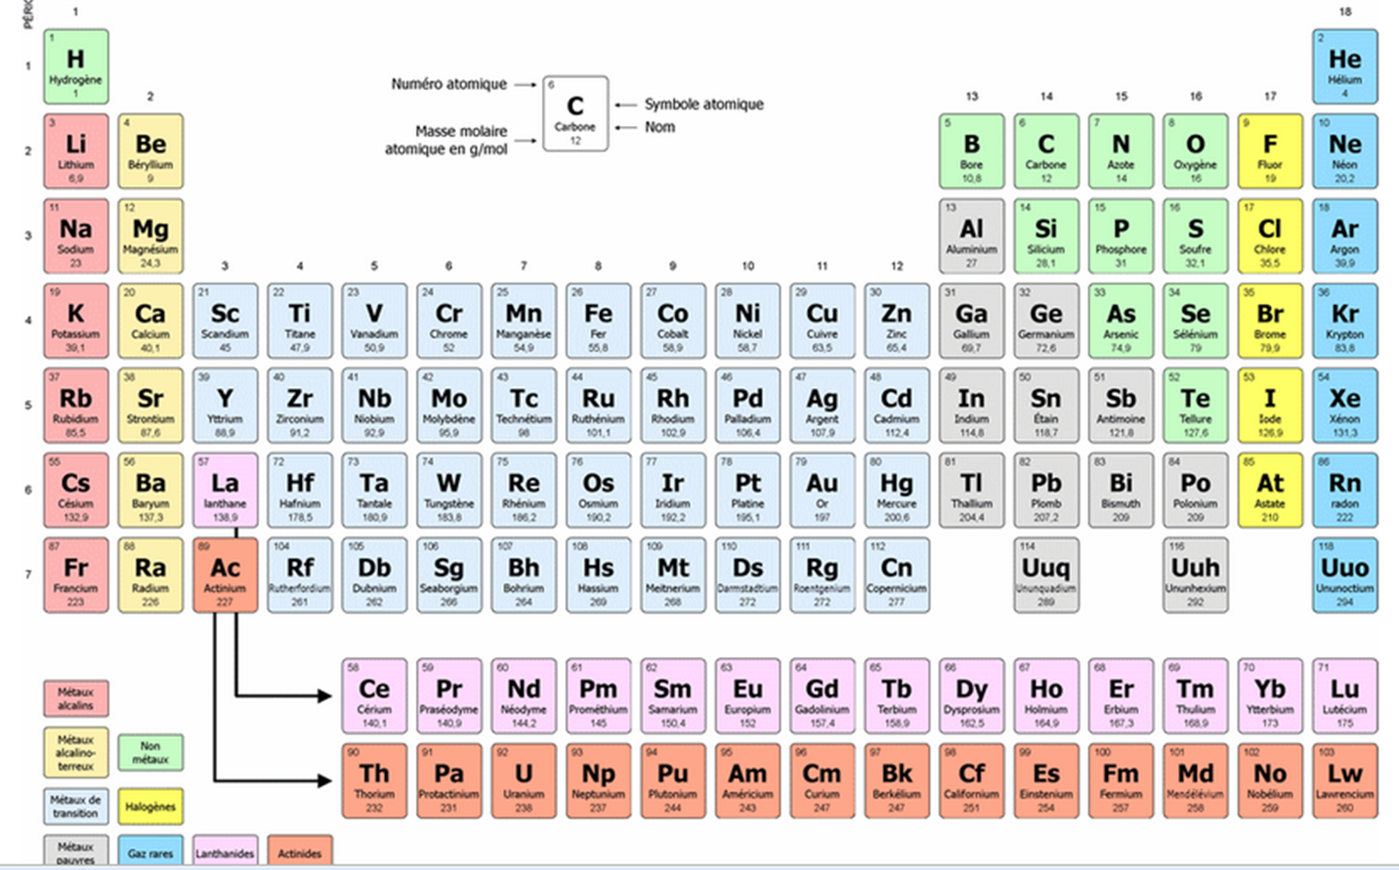
….allied to the analytical power of ICP-MS
Helios
135 channels
45 mAb Tags
6 Dyes
www.editions-petiteelisabeth.fr/tableau_periodique_des_elements_2.php

Slide 7
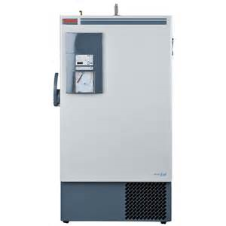
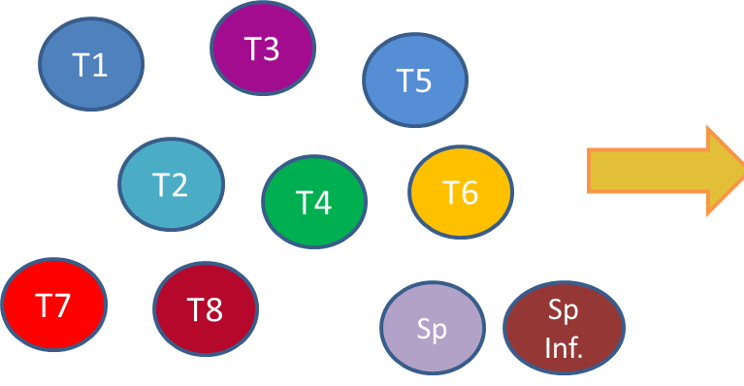
Combined immuno-phenotyping and functional workflow

Slide 8
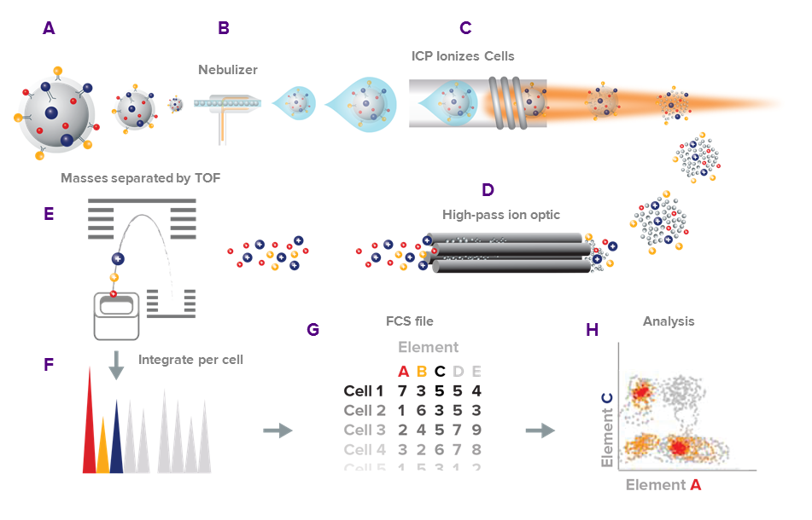
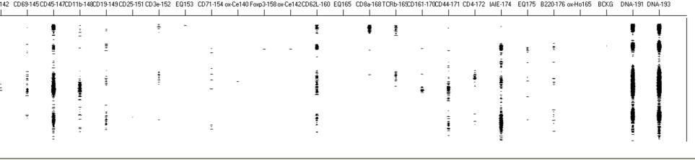
Mass cytometry principle

Slide 9
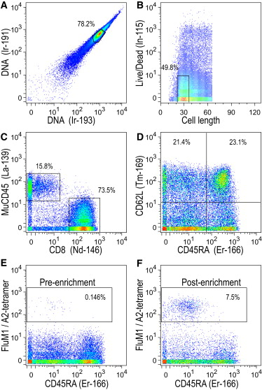
How does the raw data look like ?
Newel, Immunity, 2012

Slide 10
How to immuno-phenotype ?
Variations
Operator
Reagents
Instrument
Data Analysis
NEUTRAL
I
ZE

Slide 11
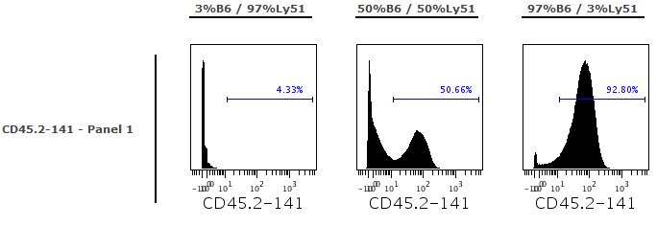
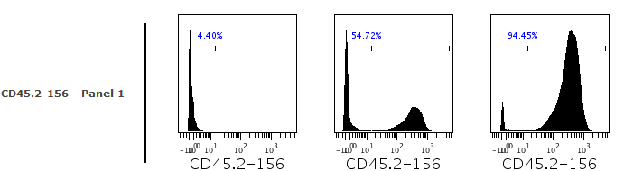
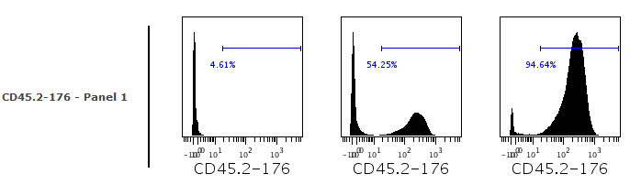
The difference in sensitivity is really minimal
1µg of CD45.2-141Nd
CD45.2-141Nd-2013JL26
61 atoms/mAb
Intensity signal : 63
1µg of CD45.2-156Gd
CD45.2-156Gd-2013SE03
61 atoms/mAb
Intensity signal : 342
1µg of CD45.2-176Yb
CD45.2-176Yb-2013JL05
47 atoms/mAb
Intensity signal : 207
Same trend observed fitting with intrument sensitivity curves but this has no impact on the frequencies observed. Even in the worst combination, we can accurately measure the cell frequency of each genotype
Experiment: 13-SE19-TEST-MMK

Slide 12
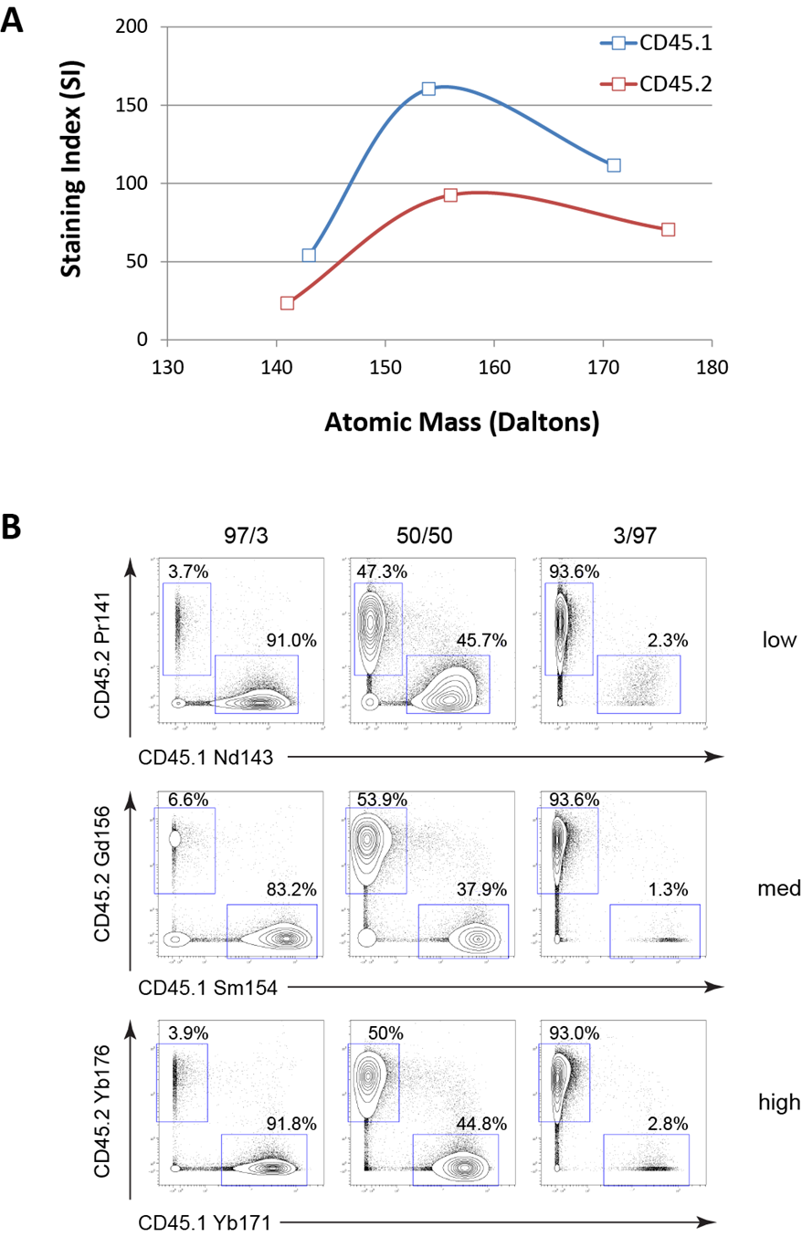
Implication for panel design
All metals are not equals in terms of sensitivity
As for other cytometry method, panel design is required
Tricot et al., Cytometry A (2015)

Slide 13
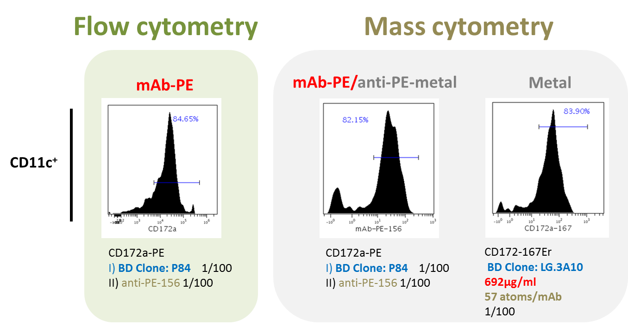
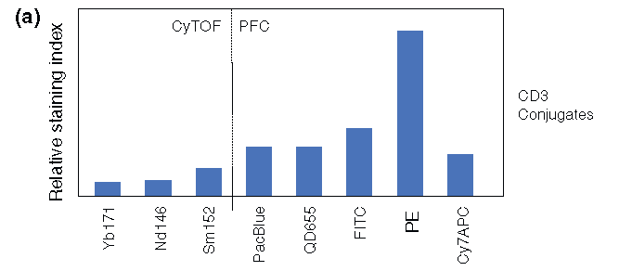
Systematic validation method for new antibodies/metal conjugates
    Staining intensity
The stain index in mass cytometry is less than conventional fluorescent dyes

Slide 14
Main types of contamination in mass cytometry
¹⁴⁵Nd
Impurities (-1)
Abondance (+1)
Oxydes (+16)
¹⁴⁶Nd
Signal Cross-talks are due to:
Isotopic impurities of metals (+ and/or – several Da)
Abundance sensitivity (+ and/or – 1 Da)
Oxidation (+16 Da) of reporter ions during the acquisition
Takahashi, Cytometry Part. A, Cytometry A. 2016 Sep 15

Slide 15
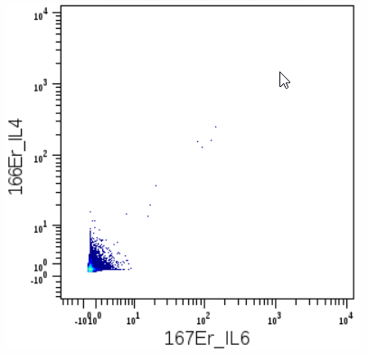
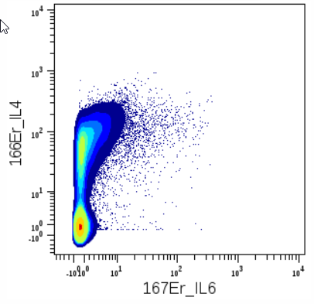
Cold case: impurity issue
Lat^{Y136F} CD4 Tc
Unstimulated
Stimulated

Slide 16
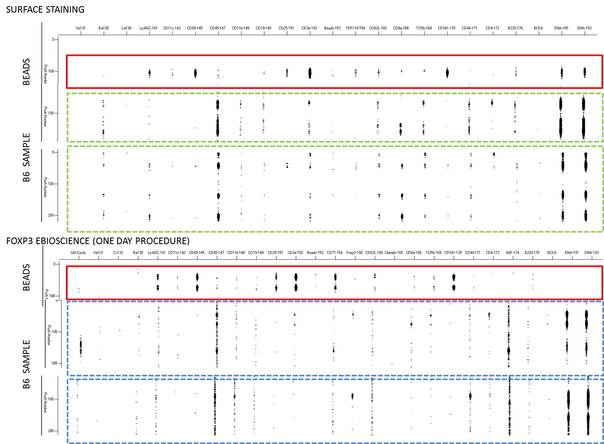
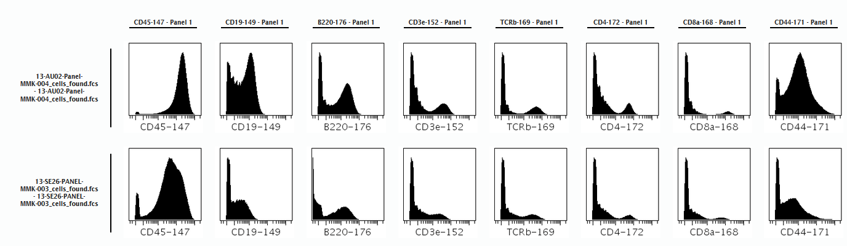
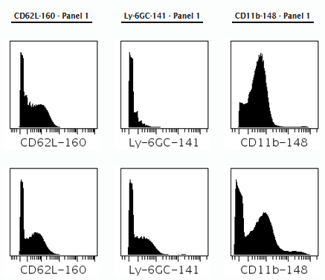
Sample preparation is key: Effect of inappropriate initial fixation
for intranuclear staining

Slide 17
Molecules below 100 molecules/cell cannot be identified due to ion detection efficiency (1 in 10.000 ion)
30% (CyTOF1) to 60% (Helios) of the cells injected are actually acquired by the system
All metals are not equals (2-3 X difference between chanels). This difference in sensitivity is not in the same range than flow (40-50 X)
Dynamic range of measurement is smaller than by fluoresence flow cytometry
No spectral overlaps but cross-talks and impurities that can spoil your measured signals
Carefully design marker/metal pair
Carefully choose conjugates combinations for a meaningful analysis
Hudge responsability in the field of mass cytometry to seriously consider this step :
  unprecedented combinations of cellular marker investigated: QC ?
  Unravel heterogeneity that is real not artefactual

Slide 18
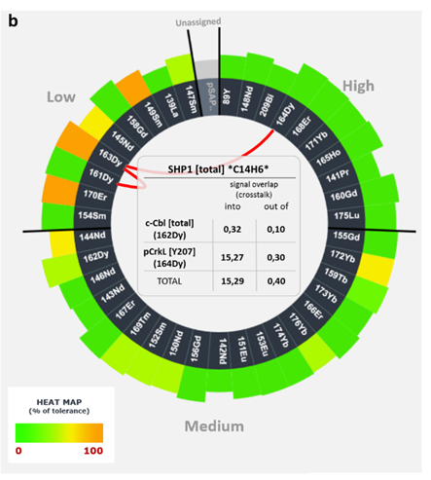
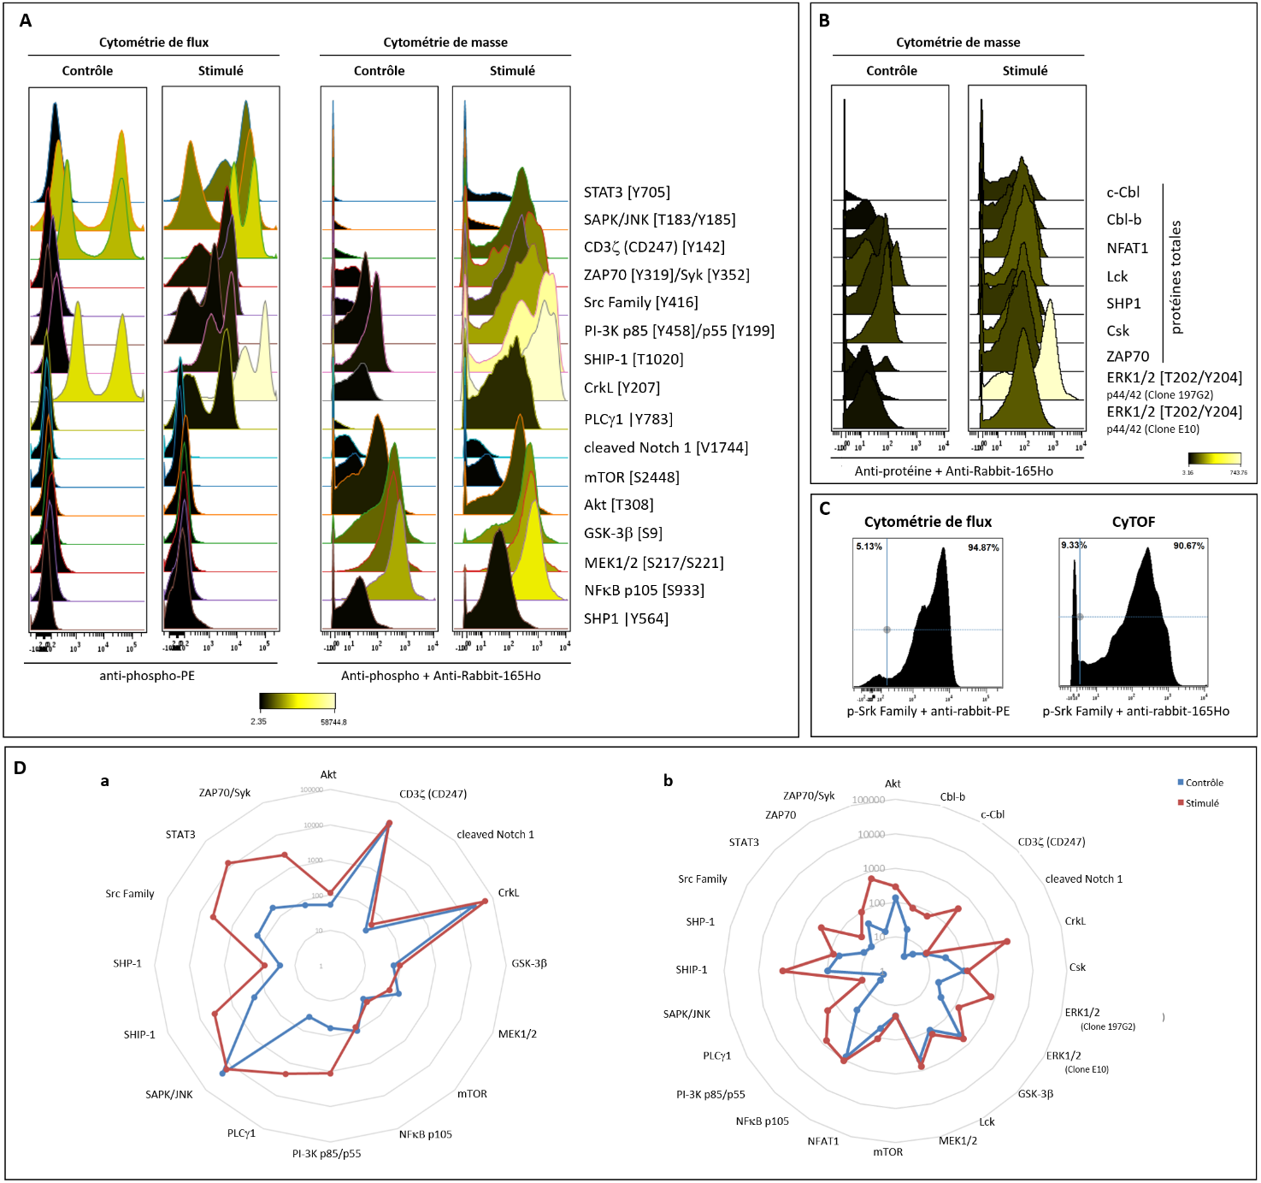
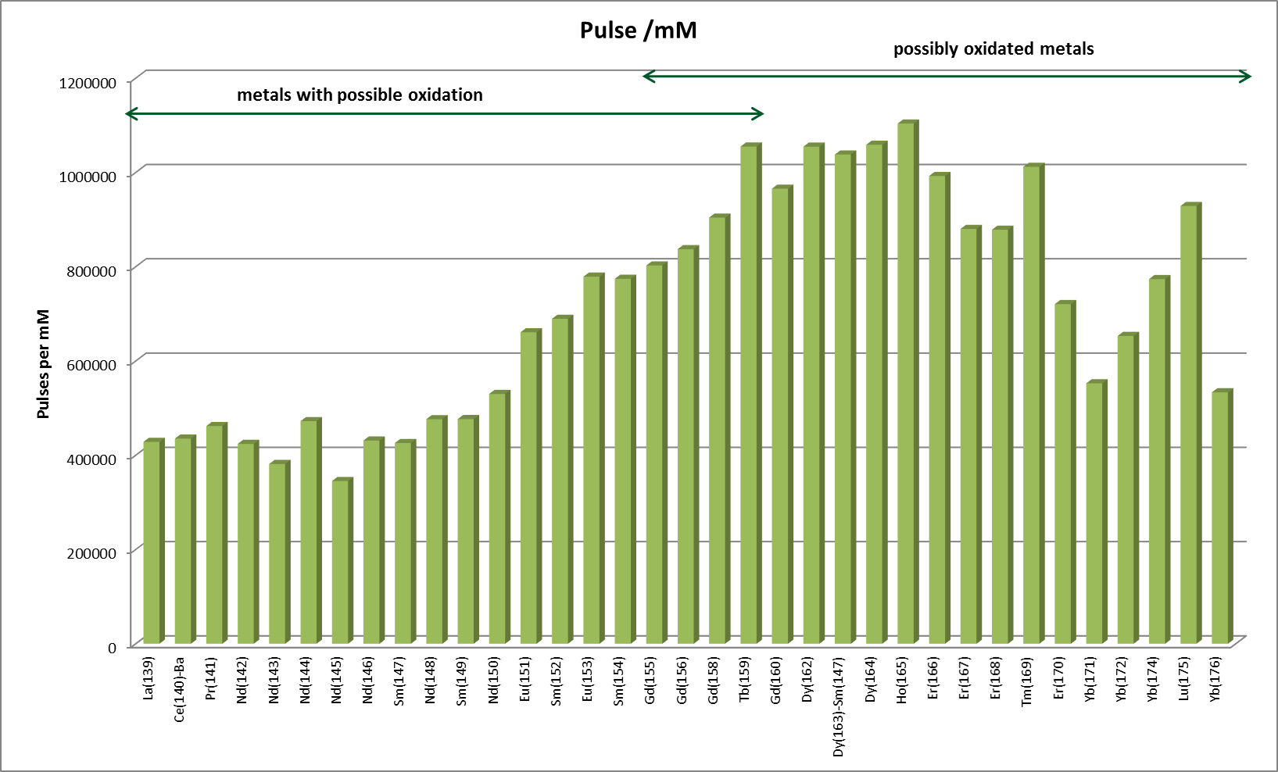
Strategy for careful panel design
Basal
Stimulated
Validate all you protocols by conventional flow
Establish ranking of marker you want to adress in one chanel
Use your mass response curve as a normaliser to predict signal intensity in a given chanel
Use Panel designer tool to minimize crosstalks

Slide 19
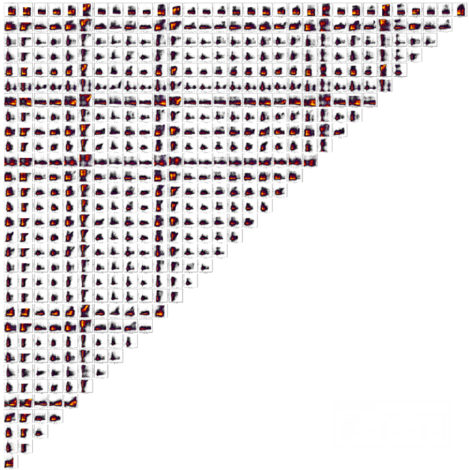


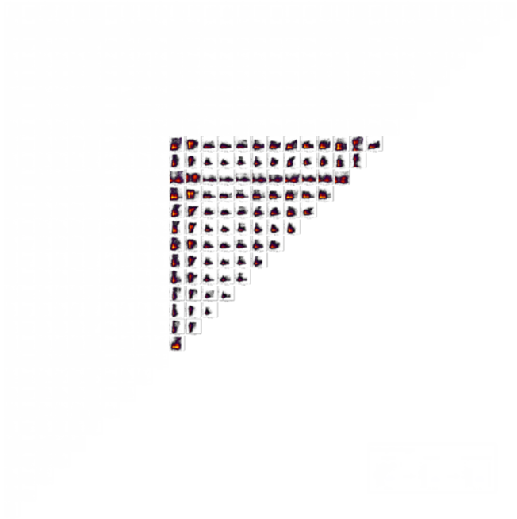
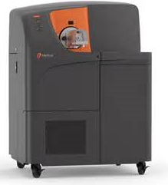
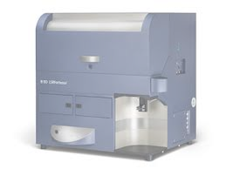
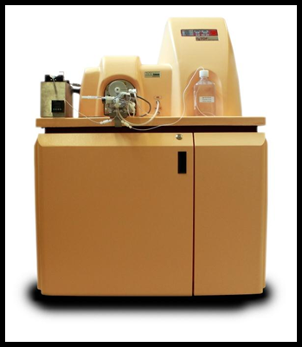
How to apprehend the multi-parametric headache
1983
Parameters:0004
Plots:0006
2011
Parameters:0032
Plots:0496
2016
Parameters: 40
Plots: >600
2000-2010
Parameters:0014
Plots:0091
1989
Parameters:0008
Plots:0028

Slide 20
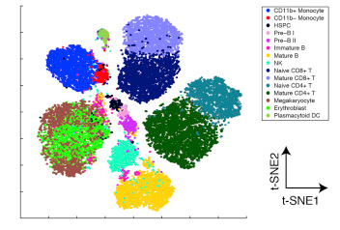
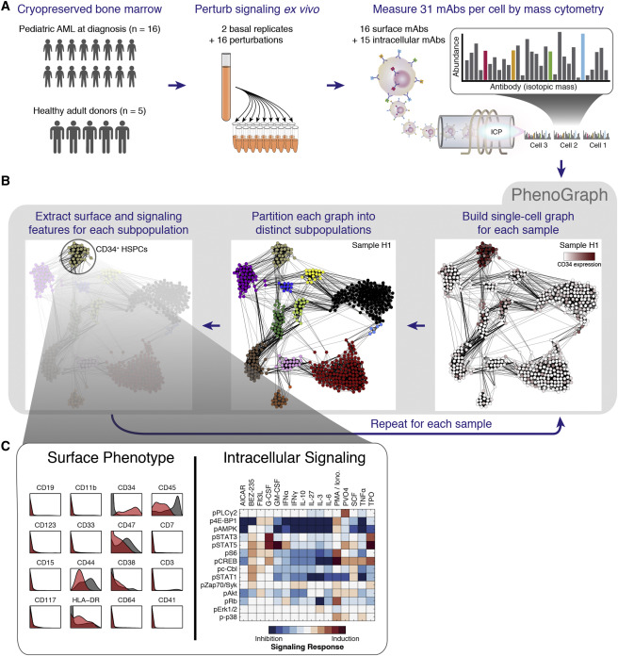
Unsupervised analysis methods to handle this amount of data
FlowSOM
ViSNE
OneSense
Van Gassen, Cytometry, 2015
Cheng, JI, 2015
Levine, Cell, 2015

Slide 21

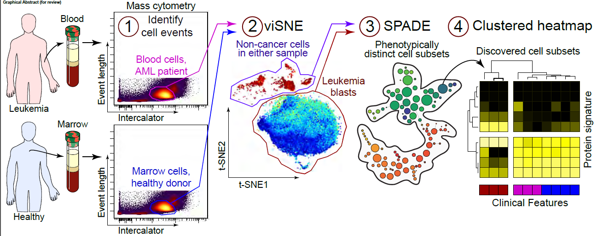
Concept of analysis pipelines
Diggins, Methods, 2015

Slide 22
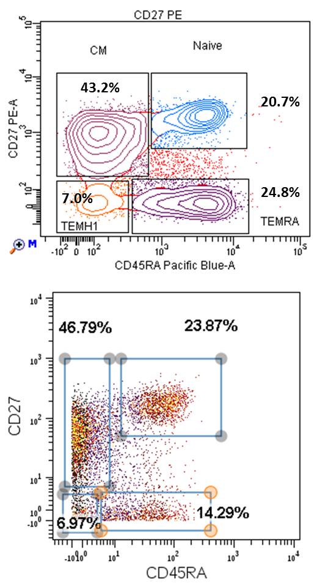
Mass/flow correlation for CD8 Tc sub-populations
CD8+ L-T
Mass
Flow

Slide 23
How to setup a CyTOF experiment ?
Configure your instrument (laser power, BP/LP/ND filters)
Characterize your instrument (CSTs and QCs)
Design your panel accordingly
Optimize settings for your assay (2,5 SDEN, Lin Max)
Run appropriate controls (Comp Beads, FMOs for continuums)
QC your data (Dead cells, Doublets, Clogs, Mis-annotations) !
Use adapted analysis tools
Configure your instrument (QC, Mass Range, Dual Calibration)
Characterize your instrument (Sensitivity across Mass range)
Optimize settings for your assay (Nebular Flow for Oxydation)
Design your panel accordingly
Run appropriate controls (Eu/eQ/Comp Beads, Cells + DNA)
QC your data (Dead cells, Ion Cloud Fusion, Doublets)
Use adapted analysis tools (Cytobank + SPADE, VisNE)

Slide 24

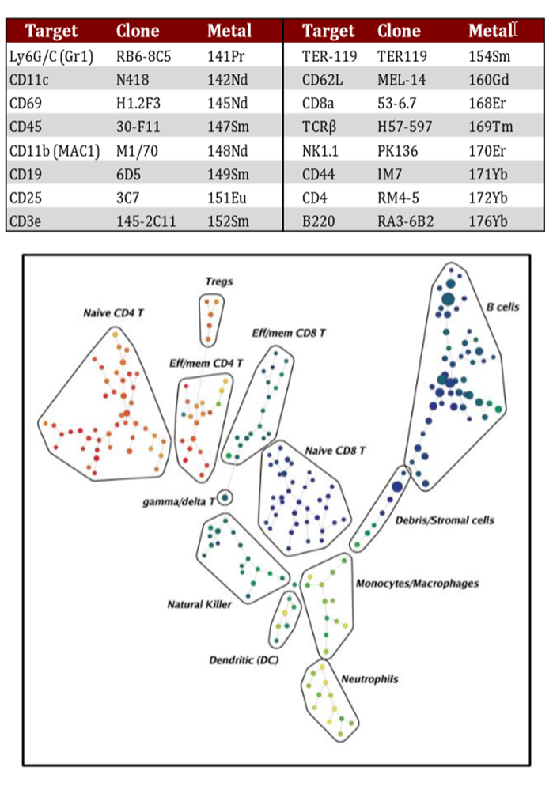
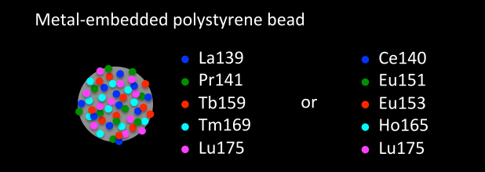
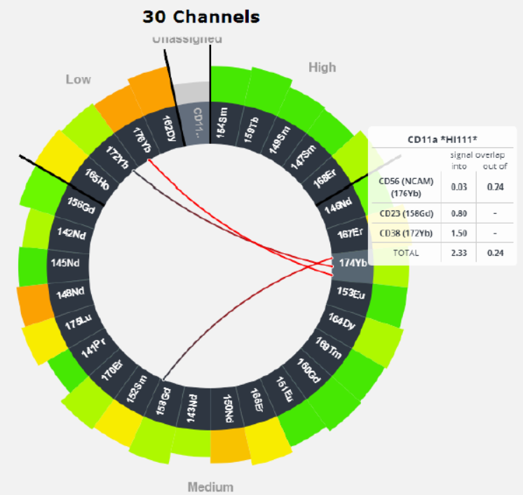
Available tools to help in mass cytometry
Normalisation Beads
Panel Kits
Panel Designer tool

Slide 25
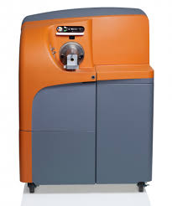
A rapidly evolving suite of instruments
2011
2013
2015
CyTOF1
CyTOF2
Helios

Slide 26
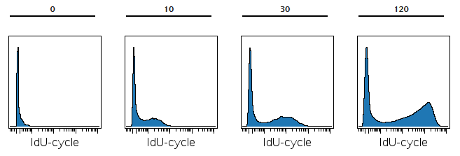
Proliferation assay made simple:
IdU incorporation and detection on CyTOF
hCD45⁺ JURKAT cells
Incubation time
1%
35%
46%
55.7%
IdU detection is easier than BrdU assay by conventional flow

Slide 27
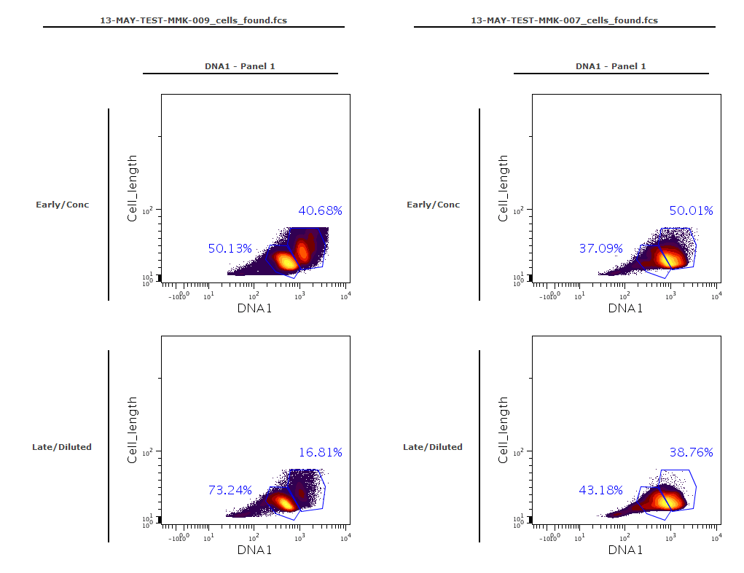
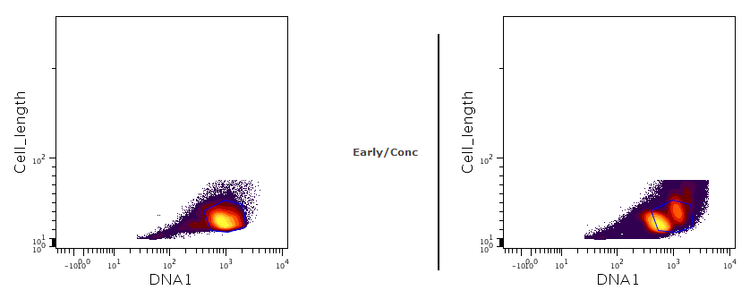
Classical gating method is not appropriate
Splenocytes
Activated Tc
« Singlets » gate
Proliferating cells
Splenocytes
« Proliferation » gate
65
Loss of proliferating cells

Slide 28

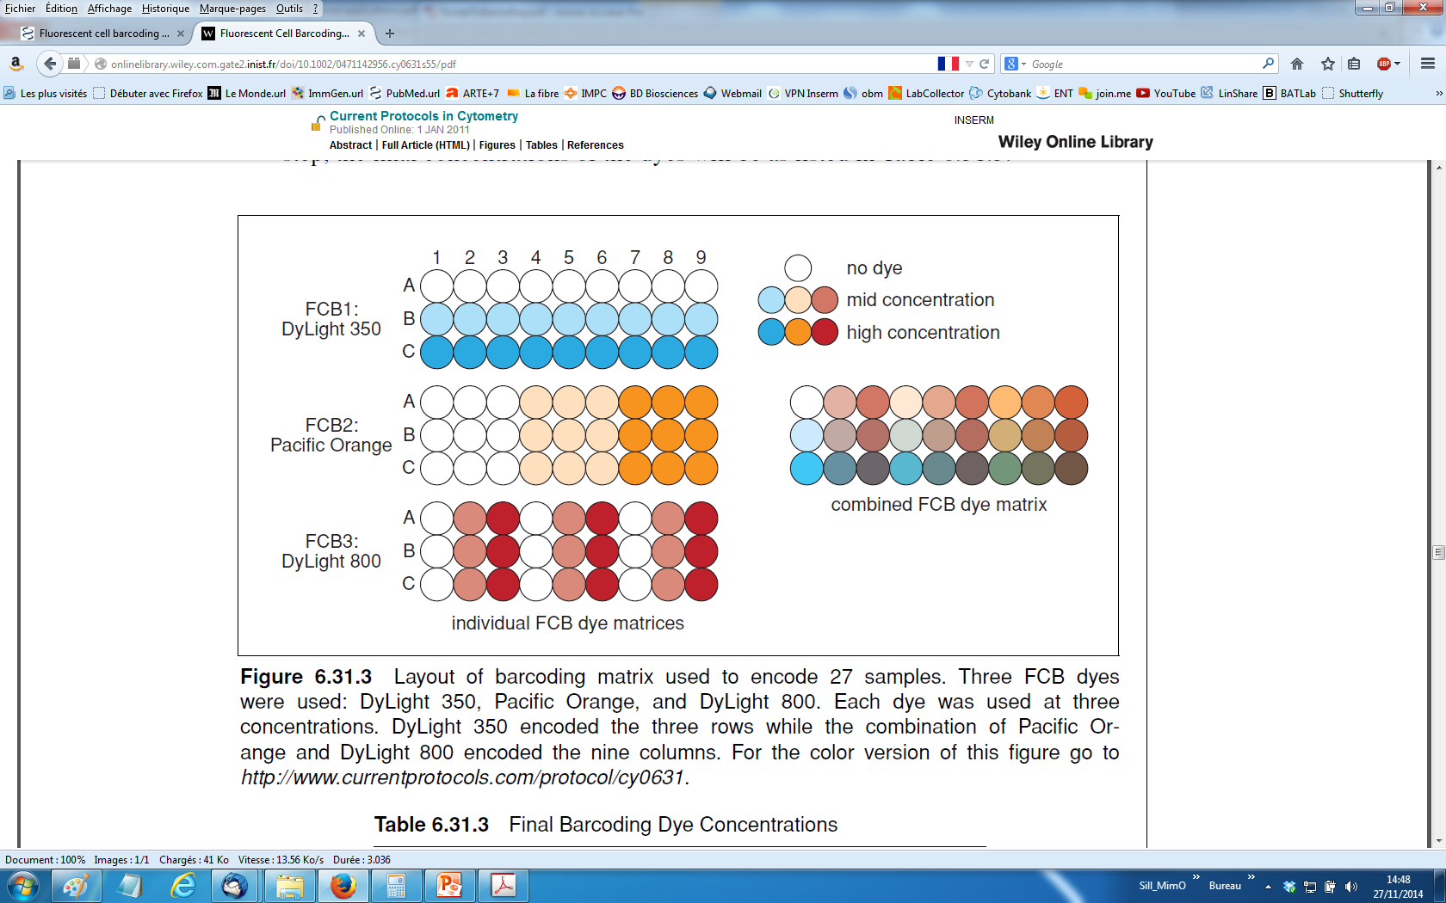
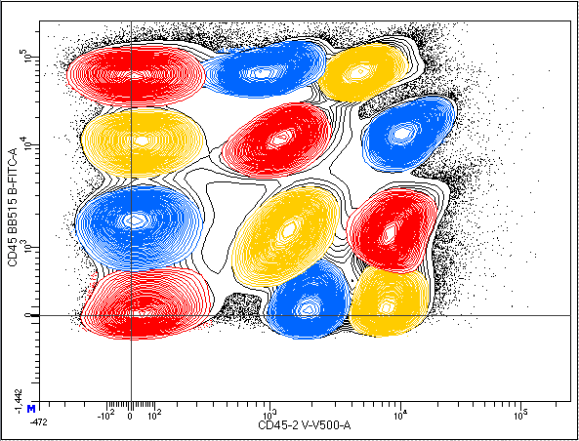
Sample multiplexing via Barcoding
Cells are encoded with combinations of various dyes
Each combination is unique and refers to a given well
All wells can later be combined for simultaneous staining and acquisition
Barcode 1
Barcode 2
CD45 (30F11)
Barcode 3
CD45.2 (104)
Thymus/Spleen/LN

Slide 29
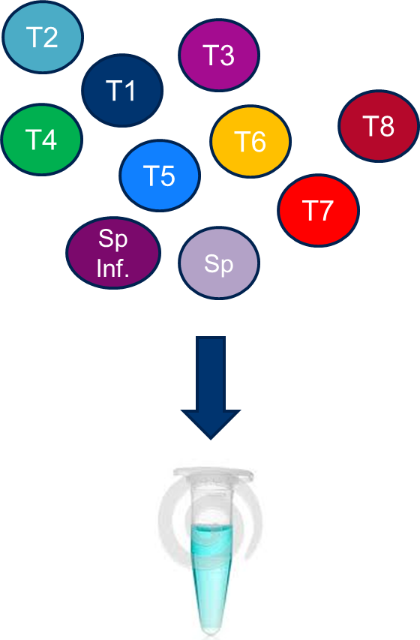
Sample Barcoding for multiplexed analysis
Minimize experimental variations
Decrease experimental artefacts
Decrease cell loss
Reduce time at washing steps
Allow simultaneous analysis
Improved data comparison

Slide 30
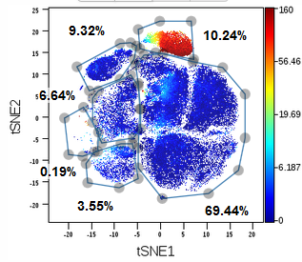
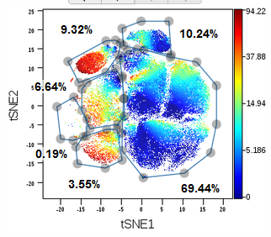
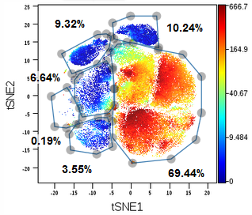
Acquisition and standardized analysis
Same panel used on all samples at once
Antibody staining done one the same day for all samples
Same analysis strategy can be used
CD8
CD4
MHCII
Ly6G/C
All frequencies are determined on similar VISNE plot for all mutants

Slide 31
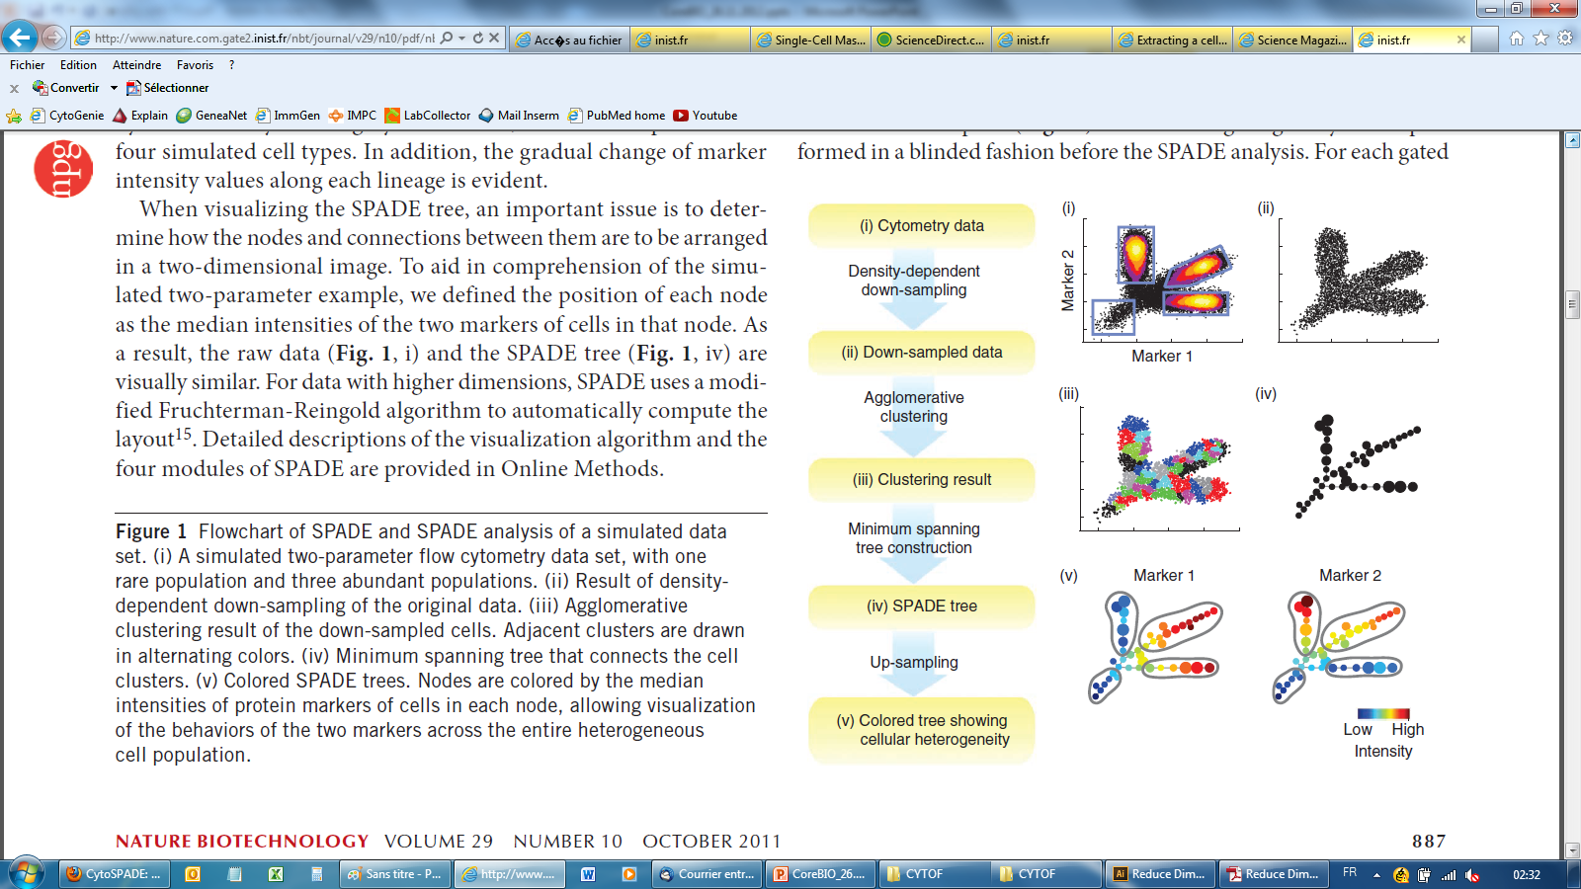
How does SPADE work ?
(Spanning-tree Progression Analysis of Density-normalized Events)
Qiu, Nat. Biotech, 2011, “Extracting a cellular hierarchy from high-dimensional cytometry data with SPADE”
SPADE (Spanning-tree Progression Analysis of Density-normalized Events) is a way to automatically identify populations in multidimensional flow cytometry data files.

Slide 32
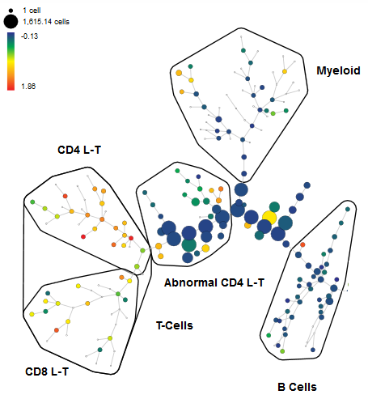
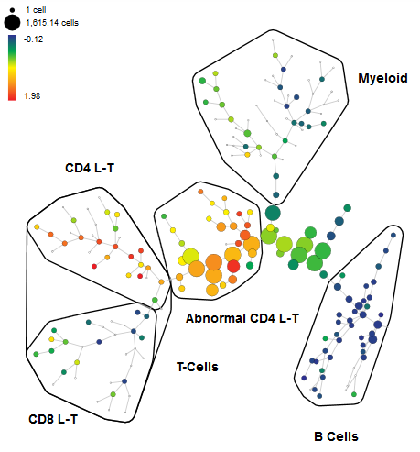


Unsupervised analysis and visualization using SPADE trees
CD3
CD4
CTRL
MUT
CTRL
MUT

Slide 33


Cytokine and Transcription factor detection in dLN and tumor infiltrating leukocytes
IL17A
TNFα
IL2
IL4
IFNγ
CD4+ TILs
IL2
CD4 Tc
CD8 Tc

Slide 34

PlateAnalyzer from Purdue can also analyze mass cytometry data
14 Phospho markers
14 lymphoid markers
12 Act’ Molecules/8 conc
http://www.cyto.purdue.edu/Purdue_software

Slide 35
The Bottom line – There are alternatives to traditional flow cytometry
Mass Cytometry is
Mass Cytometry provides similar results to flow cytometry
It uses the same antibodies, but they are conjugated with heavy metals not fluorescent molecules
The data analysis is more complex than flow cytometry as there are usually more parameters
Flow cytometry has demonstrated an increased number of parameters probably because of mass cytometry
There are advantages of both technologies as there are disadvantages

