Slide 1
Advanced Flow Cytometry
J. Paul Robinson & John Nolan

Slide 2
3-Spectral Flow Cytometry
Advanced Short Course
John P. Nolan
Scintillon Institute
San Diego, CA
jnolan@scintillon.org

Slide 3
Learning Objectives
Principles of spectral flow cytometry
Instrument approaches
Applications of spectral flow cytometry

Slide 4
Flow Cytometer Schematic
Sample Inlet
Sheath Inlet
Data Acquisition System
Sample
Stream
Detectors
Collection
Optics
Filters
Sheath
Stream
Dichroic mirrors
Beam Shaping Optics

Slide 5
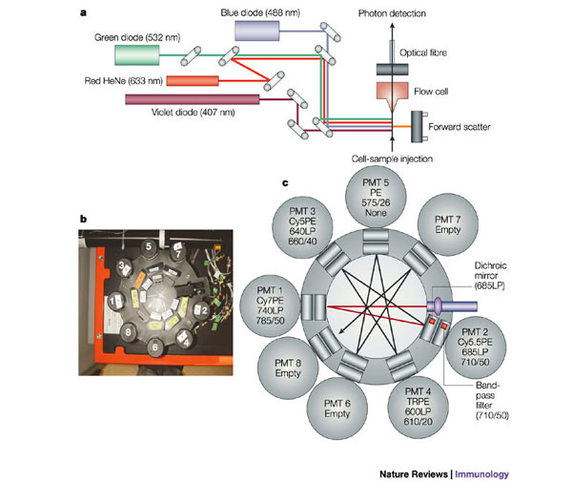
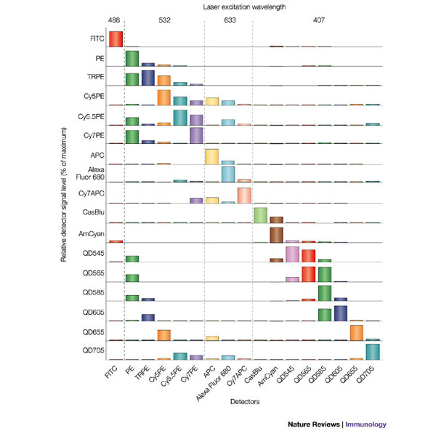
Polychromatic Flow Cytometry
Perfetto, 2004
Notes:
Instrumentation for multiparameter measurements
Violet, blue, green, and red lasers
Efficient light collection and spectral separation
Cross talk occurs, dealt with through compensation
System is maxed out from and instrument standpoint, but what about reagents?

Slide 6
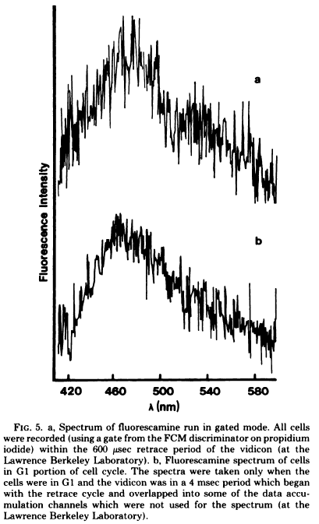
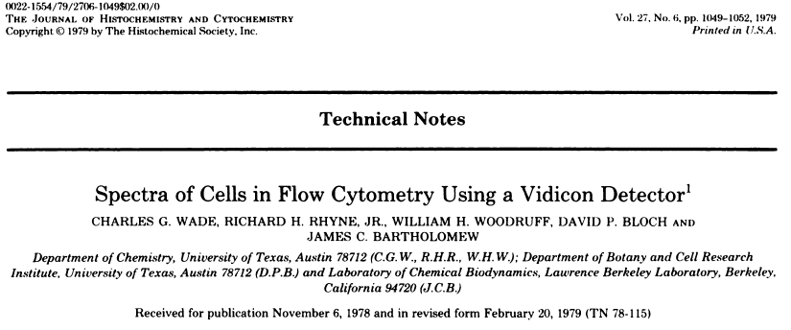
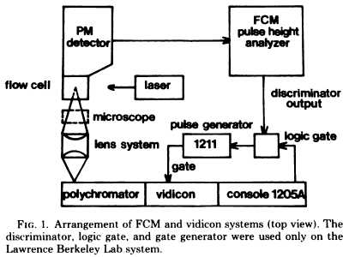
Spectral FC: The first report…

Slide 7
Spectral FC: Grating and CCD

Slide 8
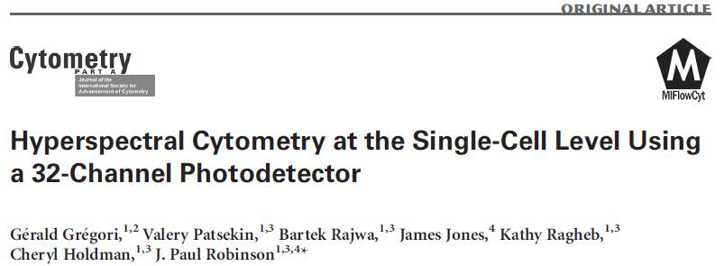
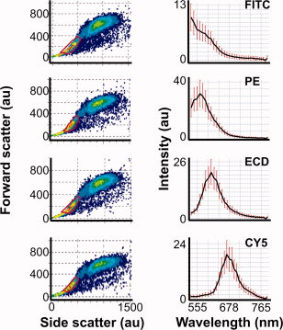
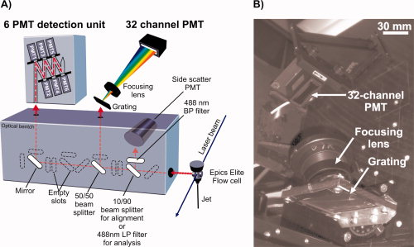
Diffraction grating and multianode PMT

Slide 9
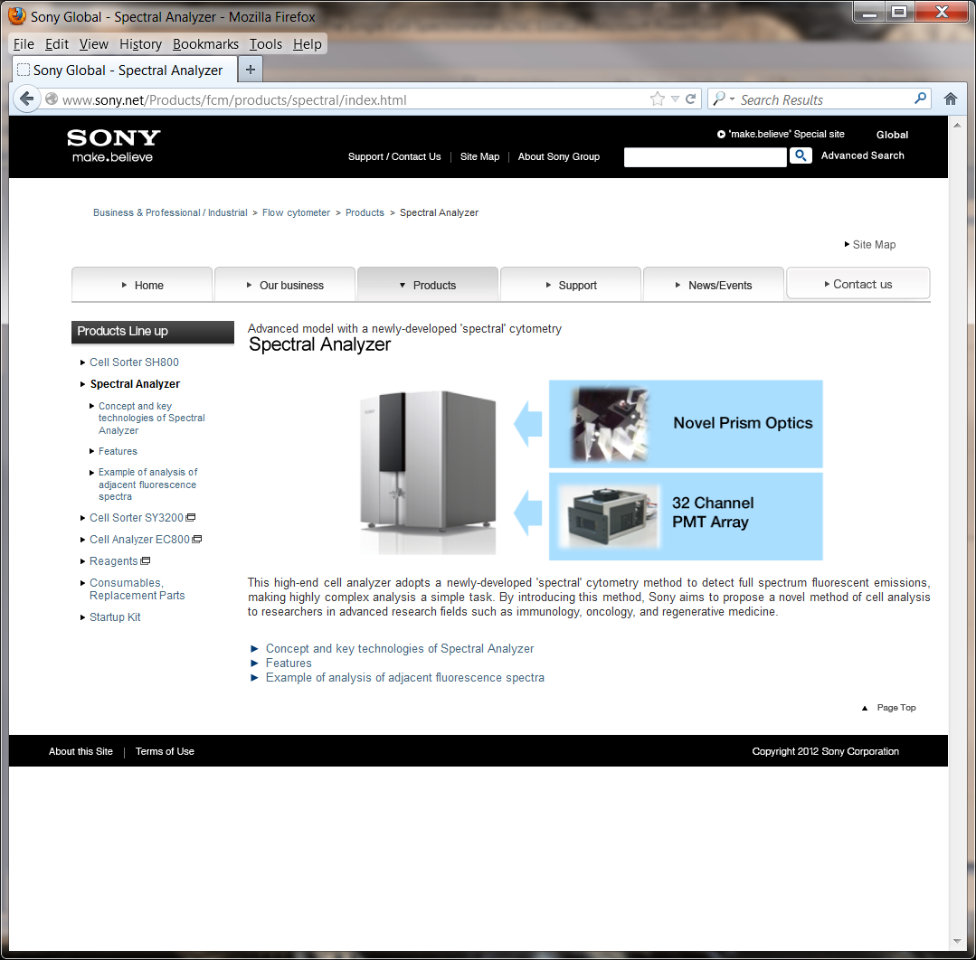

Slide 10
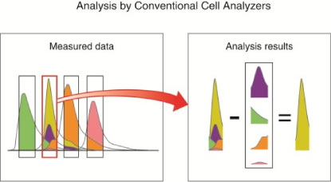
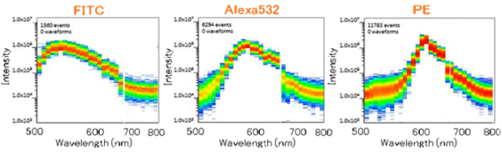
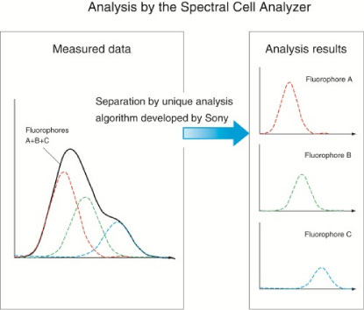
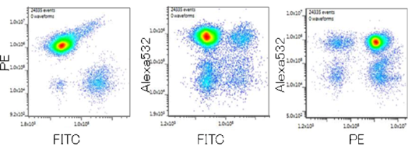
Sony Spectral Analyzer

Slide 11
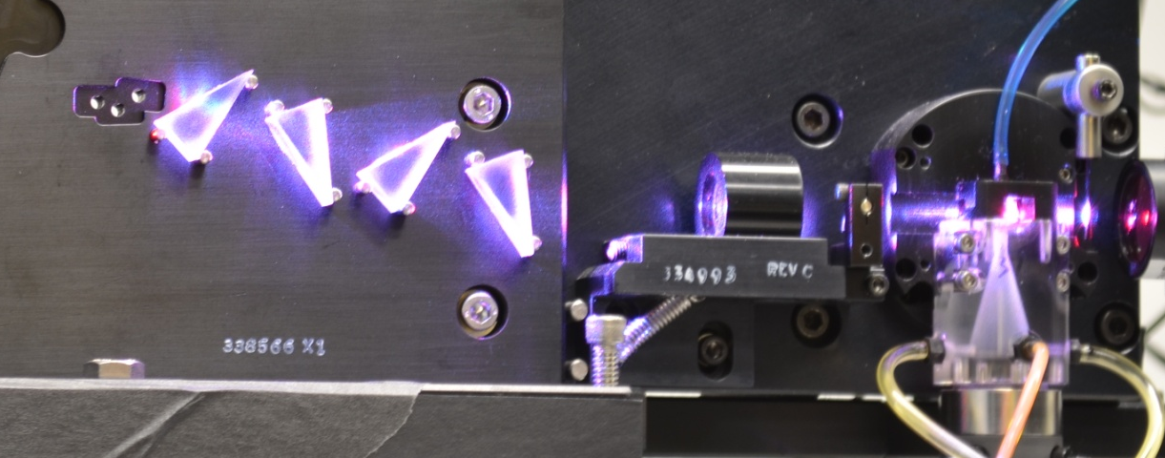
Scintillon Spectral Flow Cytometer
Top View
PMT/Filter Assembly
SSC/ Fluorescence/
Raman
Collection
Spectrograph/ CCD
Changeable gratings
Adjustable slits
On-chip pixel binning
FALS Detector
Laser beams
405 nm
488 nm
660 nm
Flow Cell
Front View
FALS Collection
Performance - spectral
Spectral axis: 1600 pixels
Spectral resolution: 0.3 nm (max)
Speed: ~200 events/sec (max)
Next gen:~2000 events/sec (max)
Performance - conventional
Sensitivity: 27 MESF PE
Separation limit: 81 MESF PE

Slide 12
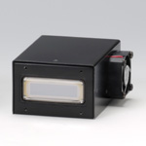
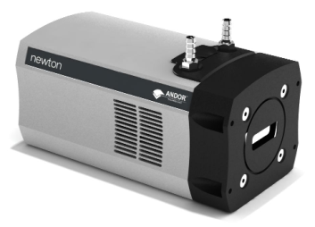
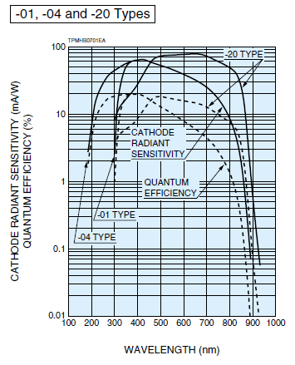
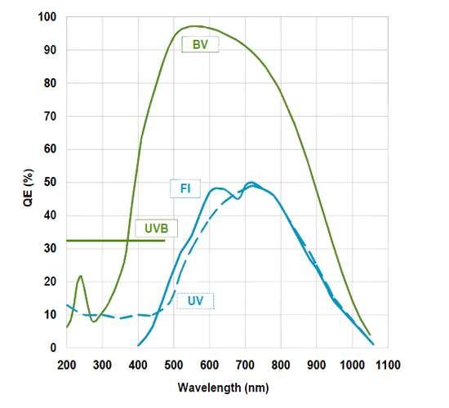
Photodetectors
Multianode PMT
Charge coupled device (CCD)
Fast
32 channels
Low QE
High QE
1600 channels
Slow

Slide 13
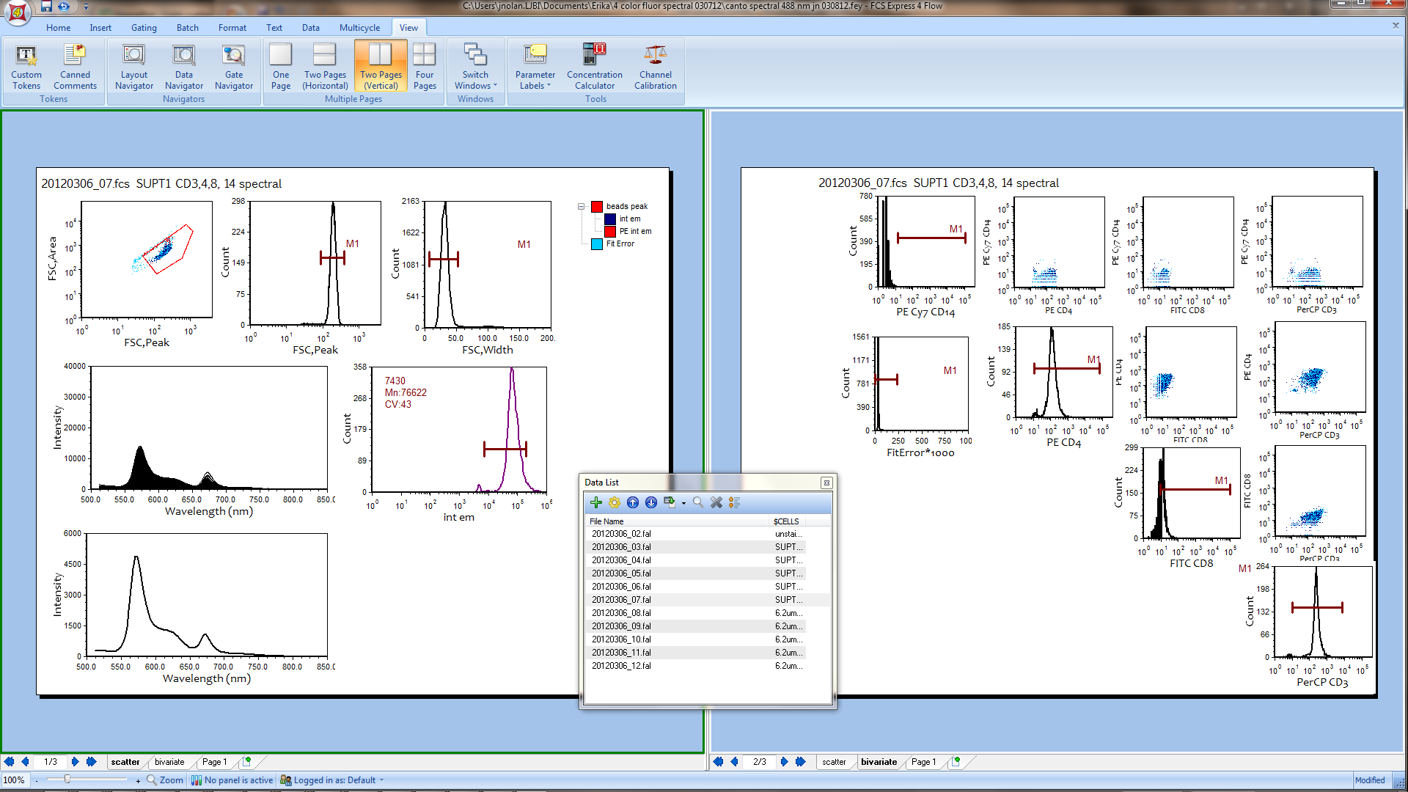

Spectral FC Data Analysis

Slide 14
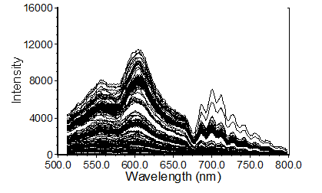
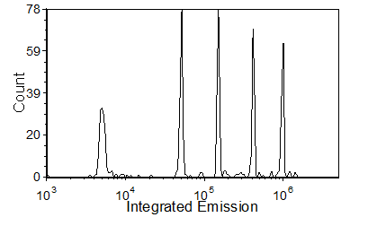
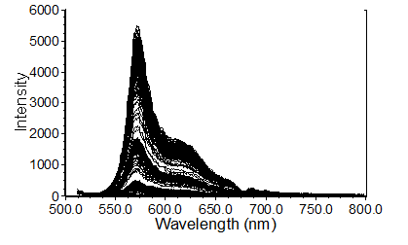
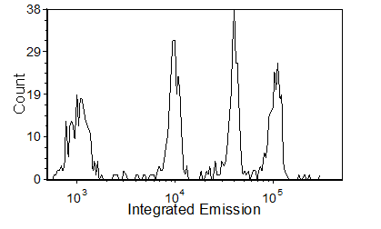
Instrument Performance
Multifluorophore, multi-intensity reference particles – Spherotech UltraRainbow
Single fluorophore, multi-intensity calibration particles – BD Quantibrite PE
~60 mW 488 nm, 25 usec pulse width
Nolan et al (2013) Cytometry

Slide 15
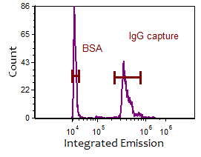
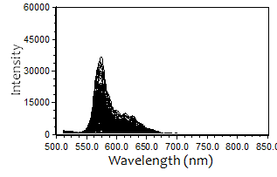
PBMC Immunophenotyping
Antibody Capture Beads
Single Color Reference Spectra
Nolan et al (2013) Cytometry

Slide 16
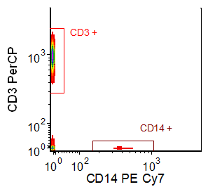
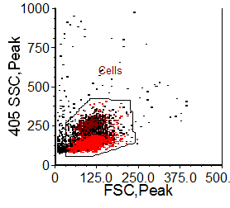
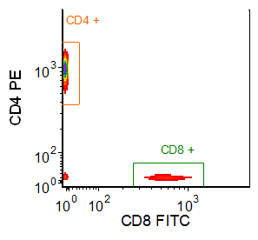
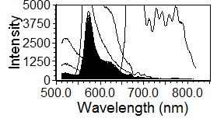
PBMC Immunophenotyping
Cells
CD3+
Raw Spectra
Reference Spectra
(capture beads)
Unmixed Signals
Spectral
Unmixing
Nolan et al (2013) Cytometry

Slide 17
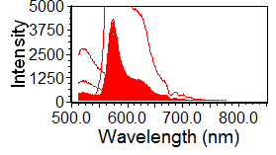
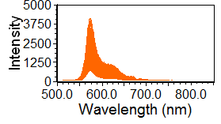
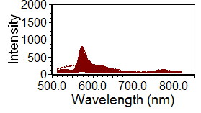
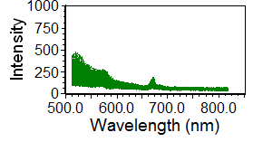
PBMC Immunophenotyping
Cells
CD3+
Cells
CD3+
CD3+, CD4+
CD14+
CD3+, CD8+
Nolan et al (2013) Cytometry

Slide 18
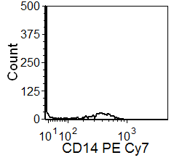
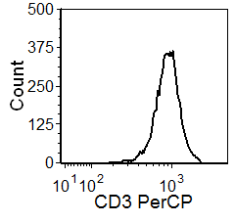
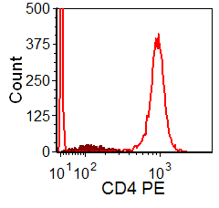
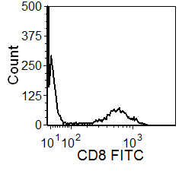
PBMC Immunophenotyping
Cells
CD3+
Cells
Cells
CD3+
CD3+
CD14+
Nolan et al (2013) Cytometry

Slide 19
Unmixing autofluorescence
Sony Biotechnology

Slide 20
Unmixing autofluorescence
Sony Biotechnology

Slide 21
Summary
Spectral flow cytometry measures all of the emission from cells
Spectral unmixing replaces compensation
Performance is equivalent or better than conventional flow cytometry
Autofluorescence becomes an additional parameter rather than a source of background

