Slide 1
Advanced Flow Cytometry
J. Paul Robinson & John Nolan
2-Light Sources, Detectors, & Data Acquisition
John Nolan

Slide 2
Learning Objectives
Basics of the FC measurement
  Illumination
  Signal generation
  Light collection
  Detection
  Data acquisition
Light scatter and fluorescence

Slide 3
Flow Cytometer Schematic
Sample Inlet
Sheath Inlet
Data Acquisition System
Sample
Stream
Detectors
Collection
Optics
Filters
Sheath
Stream
Dichroic mirrors
Beam Shaping Optics

Slide 4
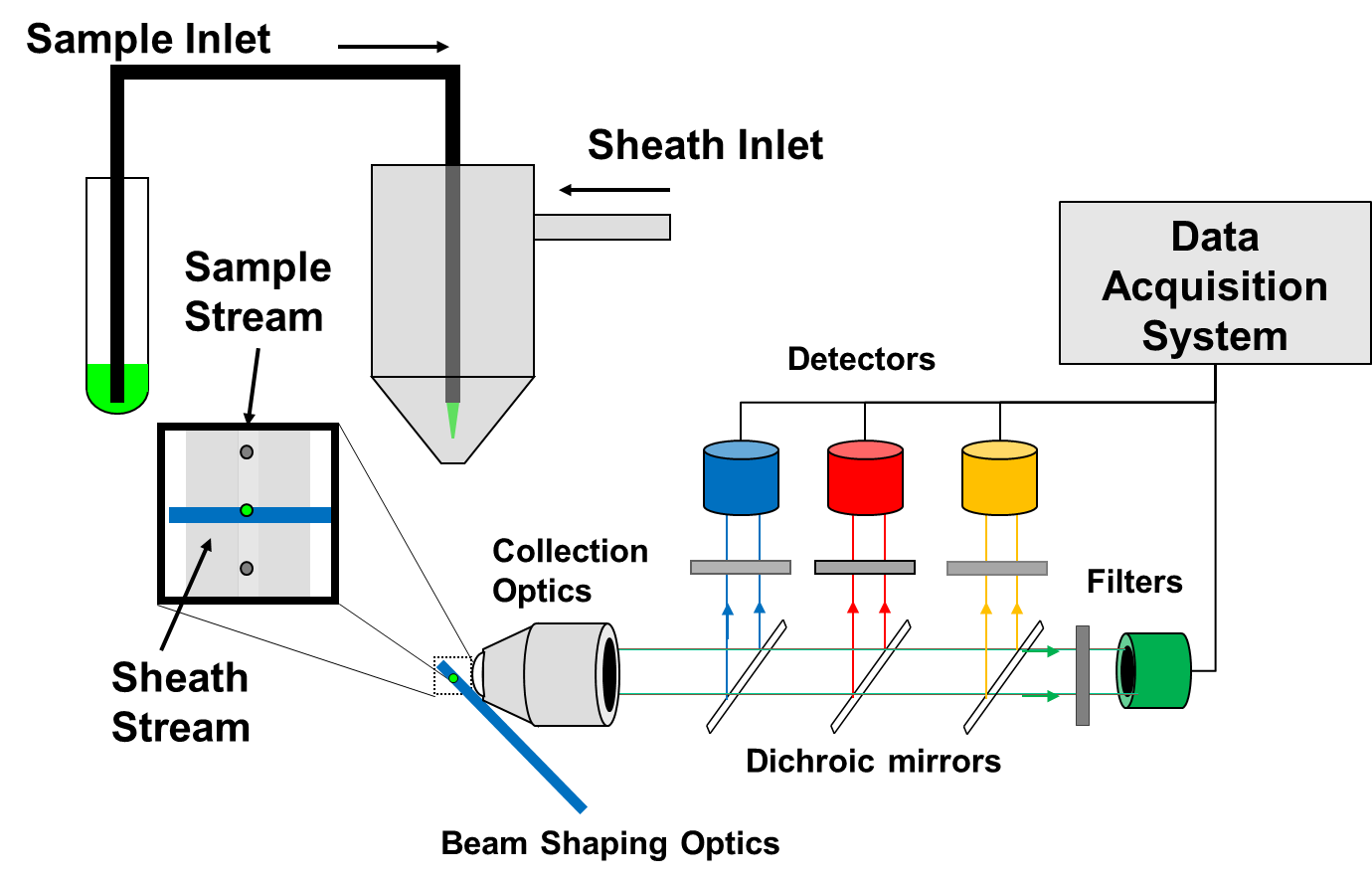
Light sources
Source | Pros | Cons
Arc Lamps | Continuous spectra | Cumbersome, hot
Gas Lasers | High intensity, range of discrete λ | High cost, power & cooling requirements
Solid state lasers | Lower cost, high intensity | Still an expensive component
LEDs | Small, cheap, range of λ | Limited intensity

Slide 5
Probe volume and light collection
The measurement probe volume is defined by the dimensions of the laser beam and sample stream:
10 um x 10 um x 10 um = ~1 pL
Light produced in probe volume is collected and delivered to detectors.
The numerical aperture of the collection optics determines how much light is collected: ~5-20%
Collection
Optics

Slide 6
Signal generation
Signal | Features | Uses
Forward light scatter | Large signals from large particles, high background | Cell detection
Side scatter | Smaller signals, lower background | Discrimination of different cell types
Fluorescence | Sensitive detection, many colors | Measure antibodies, nucleic acids, ions, etc.

Slide 7
Facts of Light Scatter
Light scatter does not measure size (or granularity)
Light scatter can, under certain circumstances, be proportional to size (or granularity)
Light scatter intensity is a complex function of wavelength, particle size and shape, angle of collection, and refractive index
Light scatter is well described mathematically
www.philiplaven.com/mieplot.htm

Slide 8
Light scatter: Collection angle
Above λ, light scatter is highly angle dependent
LS is much stronger at small (forward angles)
background is also higher (obscuration)
Below λ, particles behave as points, and little angular dependence is observed
- Lower background makes 90⁰ better for measurement of small particles
www.philiplaven.com/mieplot.htm

Slide 9
Light scatter: Particle diameter
Calculated at 488 nm excitation and 80-100⁰ collection
Above λ, monotonic increase in scatter with increasing radius (but be careful with FALS)
Below λ, scatter decreases with an r⁶ dependence (small particles get very dim, very fast)
www.philiplaven.com/mieplot.htm

Slide 10
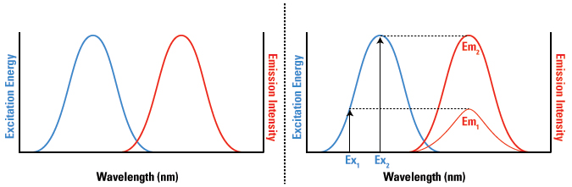
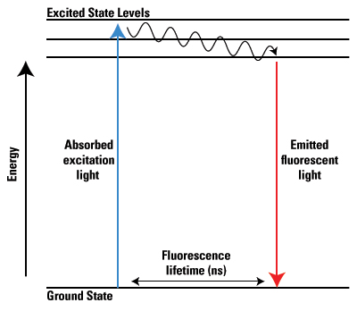
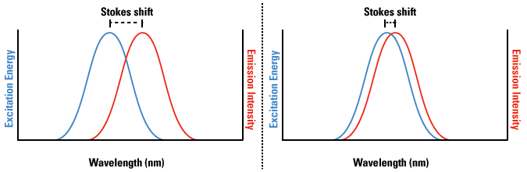
Fluorescence
Absorbance: extinction coefficient (ε)
Fluorescence: quantum yield (Φ)
Brightness = ε x Φ
Thermo-Fisher Scientific

Slide 11
Event detection
Detection is triggered when the signal crosses a threshold
Trigger channel is often light scatter for cell analysis
Sometimes fluorescence is a better choice

Slide 12
Signal pulse
Naivar and Galbraith (2015) Current Protocols in Cytometry

Slide 13
Analogue signal processing
Amplifiers (linear and log)
Peak sense and hold
Integrators (pulse area)
Digitization of pulse height and area

Slide 14
Digital signal processing
ADC digitizes signal pulse
Algorithms calculate height, area, width
Digitization of pulse height and area

Slide 15
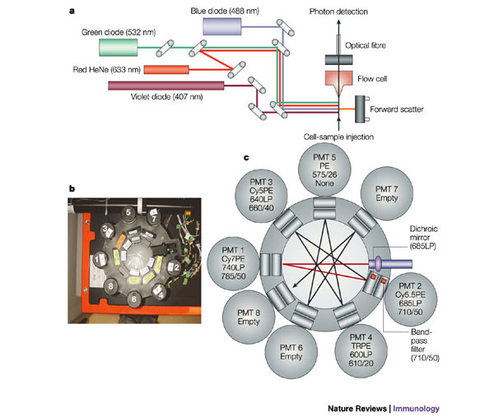
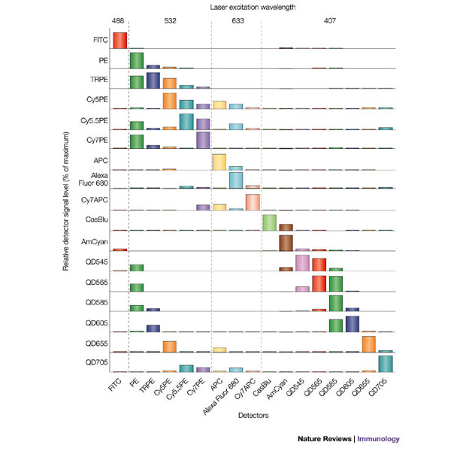
Multiparameter detection
Perfetto, 2004

Slide 16
Fluorescence intensity calibration beads
Dye solution has 1 x 10¹² fluorophore molecules per unit volume
Fluorescence intensity of 10⁶ beads stained with reference fluorophore in a unit volume equals that of the same volume of fluorophore solution
Equivalent Bead fluorescence = (1 x 10¹² fluorophores)/10⁶ beads
= 1,000,000 fluorophores per bead
Wang and Gaigalas (2011) Development of Multicolor Flow Cytometry Calibration Standards: Assignment of Equivalent Reference Fluorophores (ERF) Unit. J. Res. Natl. Inst. Stand. Technol. 116, 671-683.

Slide 17
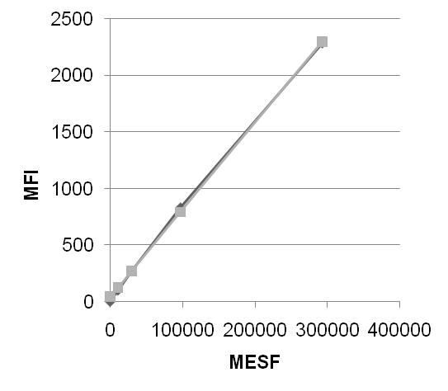
Calibration in MESF units
Bangs Quantum FITC MESF calibration beads

Slide 18
How bright are my cells/particles?
Uncalibrated fluorescence channel number
Channel number is an arbitrary scale, and allows relative comparisons:
The bright events are ~20-fold brighter than the dim events

Slide 19
This bright:
Calibrated MESF scale
MESF is an absolute scale, and allows absolute comparisons:
The bright events are ~800-5000 MESFs in intensity, while the dim events are ~ 100-400 MESFs in intensity

Slide 20
Summary
Overview of key components of a flow cytometry
Features of optical signals
Principles of fluorescence calibration

Slide 21
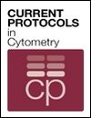


Protocols and More Info
Chapter 1 Flow Cytometry Instrumentation
Chapter 2 Image Cytometry Instrumentation
Chapter 3 Safety Procedures and Quality Control
Chapter 4 Molecular and Cellular Probes
Chapter 5 Specimen Handling, Storage, and Preparation
Chapter 6 Phenotypic Analysis
Chapter 7 Nucleic Acid Analysis
Chapter 8 Molecular Cytogenetics
Chapter 9 Studies of Cell Function
Chapter 10 Data Processing and Analysis
Chapter 11 Microbiological Applications
Chapter 12 Cellular and Molecular Imaging
Chapter 13 Multiplexed and Microparticle‐Based Analyses

