Slide 1
Advanced Flow Cytometry
J. Paul Robinson & John Nolan

Slide 2
Advanced Flow Cytometry
1-Cell Receptors | 30 min | JN
2-Advanced data processing | 30 min | JPR
3-Spectral Flow Cytometry | 30 min | JN
4-Mass cytometry | 15 min | JPR
Break and discussion | 15 min
5-Nanoparticle flow cytometry | 30 min | JN
6-High throughput flow cytometry | 30 min | JPR
7-Environmental and microbial flow cytometry | 30 min | JPR
8-The future of flow cytometry | 30 min | JN

Slide 3
1-Measurement of Cell Surface Receptors
Advanced Short Course
John P. Nolan
Scintillon Institute
San Diego, CA
jnolan@scintillon.org

Slide 4
Learning Objectives
At the conclusion of this lecture you will know
The basic features of ligand-receptor interactions
How to measure specific and non-specific binding
How to quantify the number of receptors
Approaches to assess receptor function

Slide 5
Outline
Receptor-ligand interactions
Immunophenotyping
Antibodies
Receptor occupancy
Receptor signaling
Receptor internalization

Slide 6
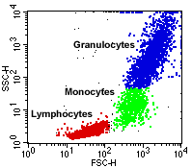
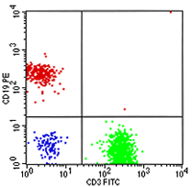
Multiparameter Flow Cytometry

Slide 7
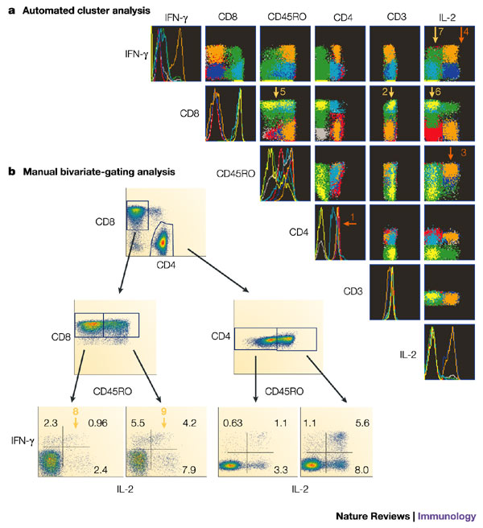
Multiparameter Cell Analysis
Hierarchical gating is used to identify subsets
There is much interest in automating this analysis as the number of parameters grows
Notes:
CD4 are helper T cells
CD8 are cytotoxic T cells
CD45RO -/+ are naïve and memory T cells
IFN and IL2 are cytokines produced as part of a functional response

Slide 8
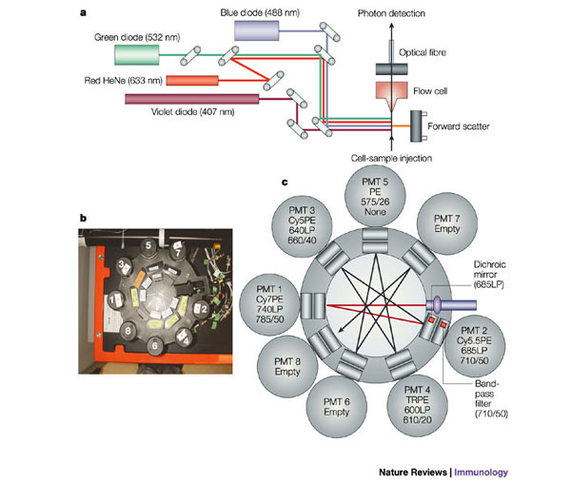
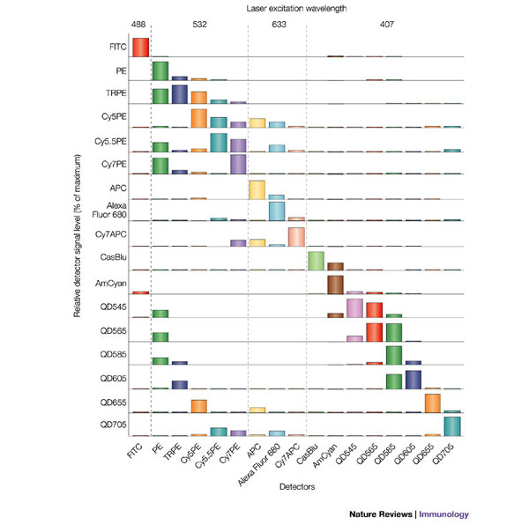
Polychromatic Flow Cytometry
Perfetto, 2004
Notes:
Instrumentation for multiparameter measurements
Violet, blue, green, and red lasers
Efficient light collection and spectral separation
Cross talk occurs, dealt with through compensation
System is maxed out from and instrument standpoint, but what about reagents?

Slide 9
Immunophenotyping Resources
Most mAb vendors have online panel design tools and tutorials
OMIPS: Optimized multiparameter immunophenotyping panels (Cytometry A)
ISAC’s CYTO U: webinars and tutorals

Slide 10
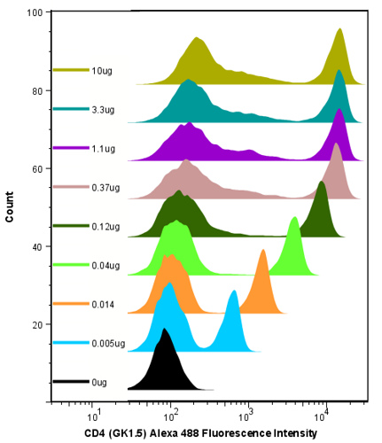
Antibody Titration

Slide 11
Measuring Non-specific Binding
Block/compete with unlabeled ligand
Inactive ligand/receptor mutant
Receptor knockout cell line
Isotype control

Slide 12
How bright are my cells?
Reporting data in absolute units of intensity
  Photons (not so useful in practice)
  MESF: molecules of equivalent soluble fluorochromes
  ERF: equivalent reference fluorochromes

Slide 13
Example of MESF determination
Dye solution has 1 x 10¹² fluorophore molecules per unit volume
Fluorescence intensity of 10⁶ beads stained with reference fluorophore in a unit volume equals that of the same volume of fluorophore solution
Equivalent Bead fluorescence = (1 x 10¹² fluorophores)/10⁶ beads
= 1,000,000 fluorophores per bead
Wang and Gaigalas (2011) Development of Multicolor Flow Cytometry Calibration Standards: Assignment of Equivalent Reference Fluorophores (ERF) Unit. J. Res. Natl. Inst. Stand. Technol. 116, 671-683.

Slide 14
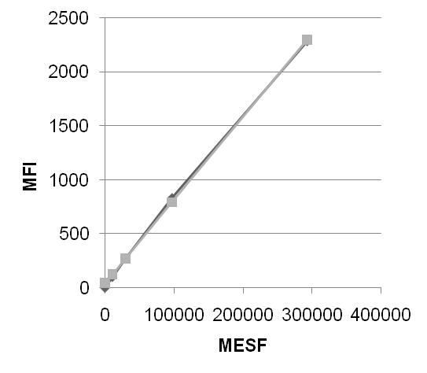
Calibration of fluorescence intensity
Bangs Quantum FITC MESF calibration beads
Quantum FITC MESF (Bangs Labs)

Slide 15
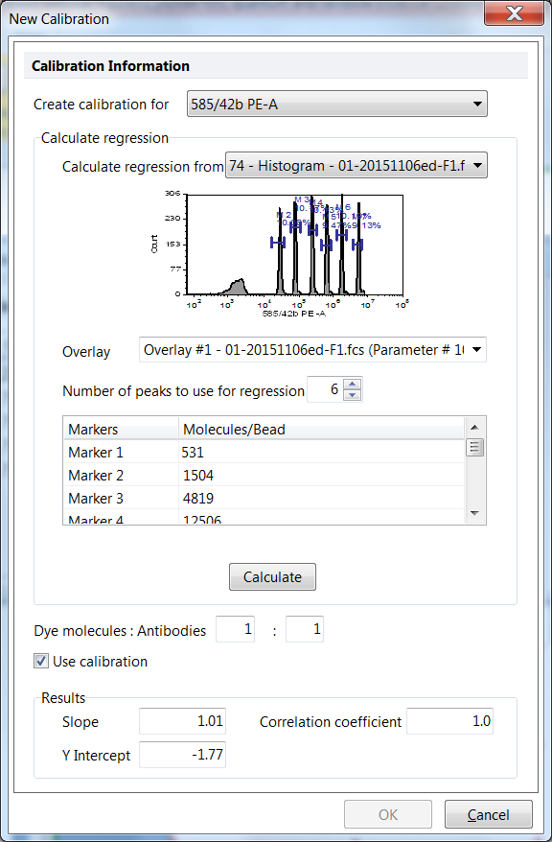
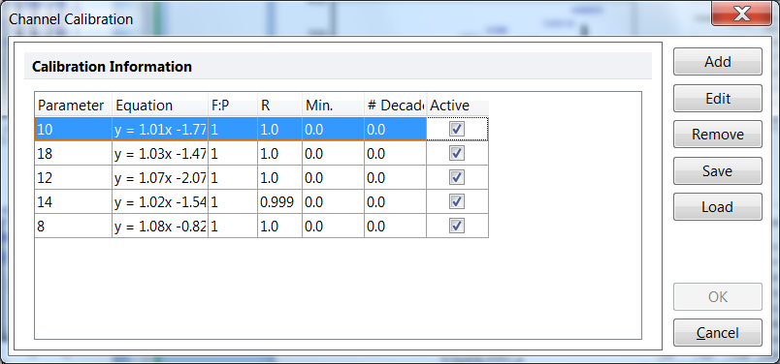
Calibration of fluorescence intensity
Bangs Quantum FITC MESF calibration beads
Quantum FITC MESF (Bangs Labs)

Slide 16
How many molecules are on my cells?
Two approaches:
From MESF, # = MESF/(F/P*Qr), where
  - F/P is the fluorophore/protein ratio
  - Qr is the quantum yield of the conjugated fluor relative to free fluor
  Pros: Accurate, works for any fluorescent ligand
  Cons: MESF standards not available for all fluors
Using calibrated capture beads
  Stain with fluorescent antibody used in assay
  Construct calibration curve
  Pros: Simple, works for any fluorophore
  Cons: Not all antibodies are captured equally

Slide 17
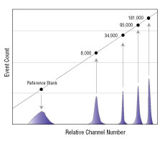
Antibody Capture Beads
Bangs Simply Cellular Calibration Beads
- Captures labeled 1° Ab by Fc region

Slide 18
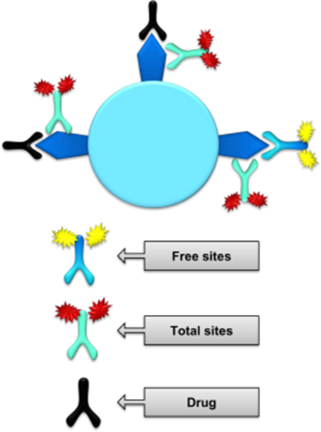
Receptor Occupancy
mAbs used as therapeutics
Fl-mabs used to measure:
  Total receptor
  Free drug binding sites
Stewart et al (2016) Cytometry B

Slide 19
Receptor Occupancy
Green et al (2016) Cytometry B

Slide 20
Receptor-Ligand Interactions
R
+
L
R
L
Receptor-ligand pairs
Protein-antibody: CD4- anti-CD4
Protein-protein: EGFR-EGF
Protein-peptide: FPR-fMLP
Protein-carbohydrate: VCAM-1 -
Protein-nucleic acid: TLR-RNA

Slide 21
Equilibrium Binding

Slide 22
Binding Kinetics
k_{on}
L
+
R
L
R
K_{D} = k_{off}/k_{on}
k_{off}

Slide 23
Receptor Signalling: Calcium Flux
2
5
0
100 nM
2
0
0
10 nM
1
5
0
1 nM
1
0
0
0 nM fMLP
5
0
0
Nolan et al (1995) Cytometry
Graves et al (2002) Cytometry

Slide 24
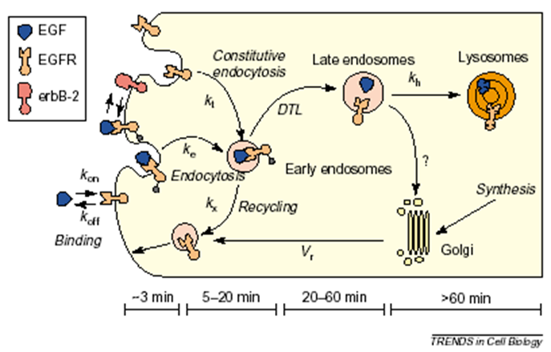
Receptor Function
Wiley et al (2003)

Slide 25
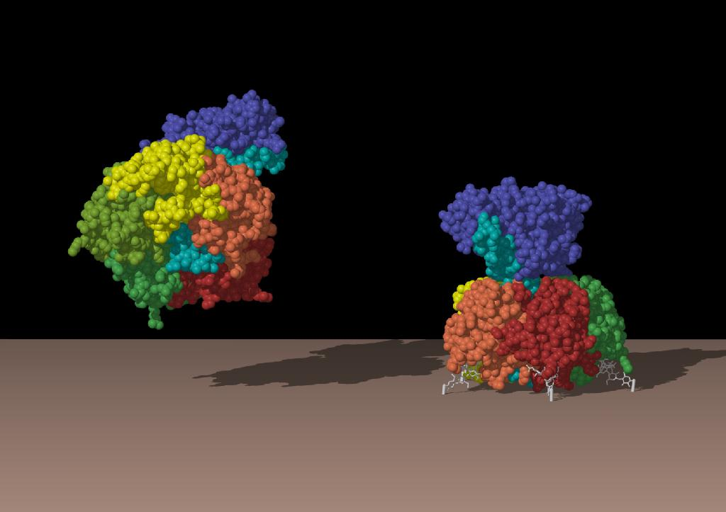
Cholera Toxin
AB₅
  A: 27 kDa catalytic domain (ADP ribosylase)
  B: 11.5 kDa binding (pentameric)
Binding
  Ganglioside GM1
Internalization
  Target: adenylate cyclase
Interest for
  Diagnostics
  Therapeutics
Other Uses
  Lipid raft probe
  Adjuvant
  Vaccine targeting

Slide 26
Interaction of CTxB with Cells
Binding not well described by single site model
At least two classes of cell surface binding sites

Slide 27


Sub-Cellular Localization
T= 0 minutes
T= ~30 minutes
Cells and Alexa488-CTxB incubated at 4°C for 60 minutes, washed and warmed to 37°C, and fluorescence visualized by confocal microscopy.

Slide 28
Processing of CTxB
Fraction of fluorescence rapidly lost from cell, density dependant

Slide 29
pH Quench of Extracellular CTxB
Labeled,
washed
at 4°C
Transport
and
Processing
Secretion
Internalization
pH 7.4
pH 4

Slide 30
Internalization and Processing
Internalization is rapid
Excretion is rapid
A significant fraction remains on the cell surface

Slide 31
Summary
FC enables quantitative measurement of:
Receptor number and function
Equilibrium binding and kinetics
Signaling
Processing and internalization

