Slide 1
Miftek Cyto booth
What is out goal:
Miftek is a technology development company. We are designing a new technology that will be of interest to the folks at this conference on May 19—24
However, we are not ready to announce our instrument, so our goal is to get folks to come to our booth to look at photos I have taken over 35 years of members of this organization. So I am offering a donation of $5 to the ISAC education fund for every person whose photo is NOT on this screen. As there will be about 2500 folks at the meeting, it could cost me a few thousand dollars, but its worth it.
About 30 years ago, one of the big companies came out with a message to people : Just Wait! that is the message I want to get across. So I considered something like “Don’t Buy Now – Gen-2 is coming soon..” or similar…
I am also going to print business cards with the same material on it – they will be very small, but it might bring people to our booth….
best
paul Robinson (cso@Miftek.com)

Slide 2
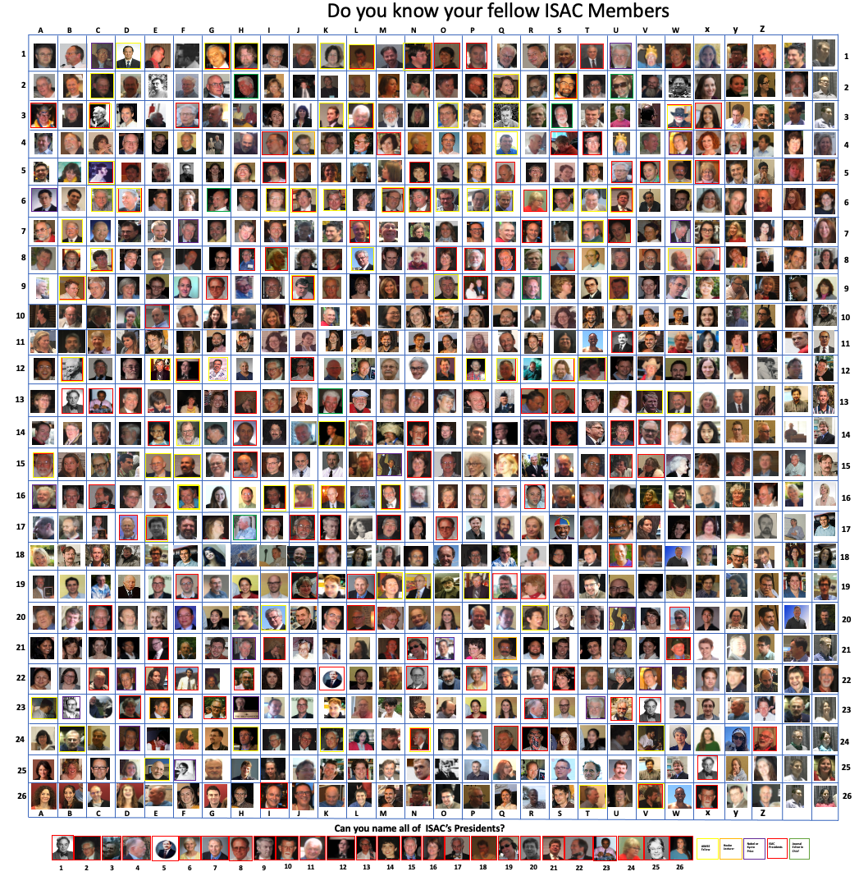
Graphics artist Brynn Brothers brynnbrothers@gmail.com
central image is 235 (7.7ft) x 162 (5.3ft)
DON’T BUY NOW
GEN-2 IS COMING….
DON’T BUY NOW
GEN-2 IS COMING….
JUST
WAIT
JUST
WAIT
multiply the length value by 30.48
1.04987 x 7.28346 ft sides
9.67848 ft x 7.28346 ft
Hi Paul, Thanks for reaching out! Can you send me a link to the booth you’re looking to purchase from Happy Bear? I can use that to send you a quote. Please also let me know your in-hands date. Thanks, Brynn Brynn Brothers - Graphic Designer Brynnbrothers.com

